Slide 1




Monarchs, Milkweed and
The Milky Way
Vayujeet Gokhale
Professor of Physics and Astronomy,
Truman State University
DarkSky Missouri

Slide 2






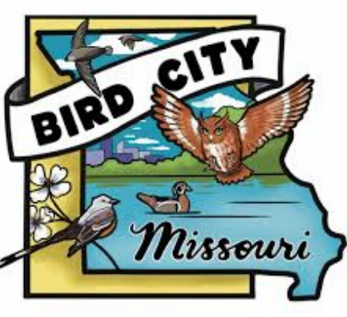


Acknowledgements

Slide 3
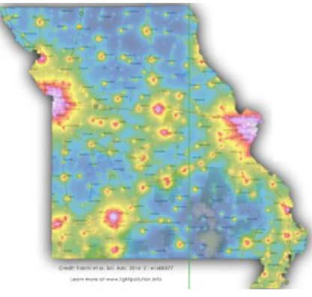
Outline of Presentation
Perspective
Defining the Problem
Solutions
DarkSky Missouri
Columbia SHINEs as a Bird-Safe City

Slide 4
Handouts
Five Principles Card
DarkSky Missouri + Products (WHITE)
Campus SHINE (SALMON)
Missouri State Parks/MMN + Products (Green)
Stickers!!

Slide 5
Actions
Do a Home Assessment
Talk to Neighbors and your HOA/community to improve outdoor lighting
DarkSky status for nearby parks & historic sites: Arrow Rock, RBMP, and Finger Lakes
Columbia should aim to be a “DarkSky Community”: Outdoor Lighting Laws & Ordinances

Slide 6

Actions: Home Assessment
https://darkskymissouri.org/get-involved/certify-home

Slide 7

Actions: My Neighbors Lighting
https://darksky.org/resources/what-is-light-pollution/light-pollution-solutions/lighting/my-neighbors-lighting/

Slide 8

Actions: DarkSky Places Program
https://darksky.org/what-we-do/international-dark-sky-places/apply/

Slide 9

Actions: DarkSky Model Ordinances
https://darksky.org/what-we-do/advancing-responsible-outdoor-lighting/darksky-recognized-codes-and-statutes/

Slide 10
Perspective
“…shadows from the starlight,
softer than a lullaby…”

Slide 11
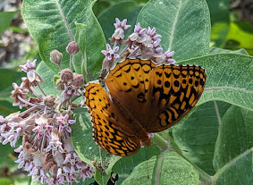
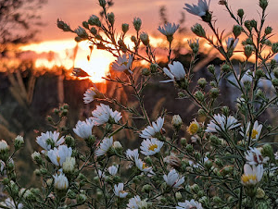
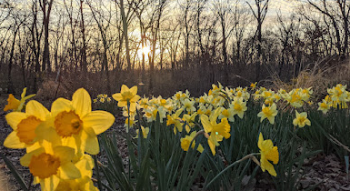
Spring time in America

Slide 12
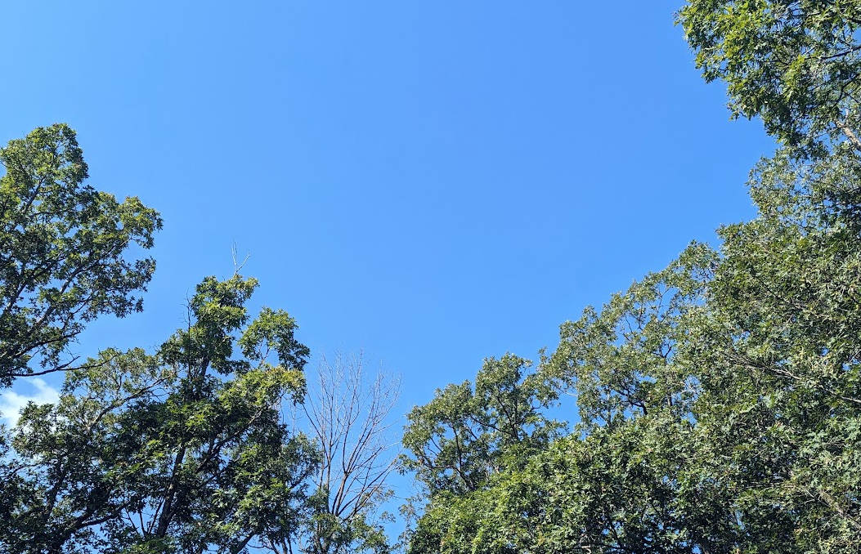
Blue Skies, Twilight, and
Darkness at Night

Slide 13
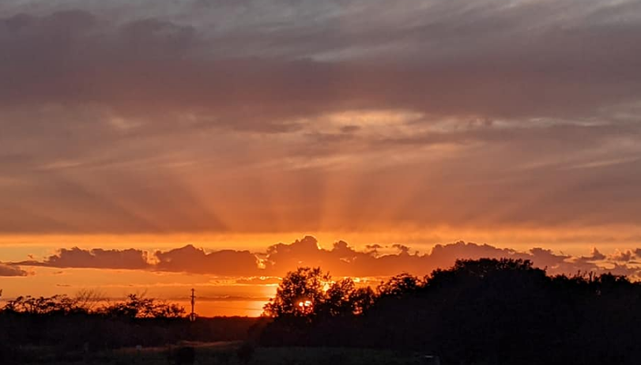
Blue Skies, Twilight, and
Darkness at Night

Slide 14
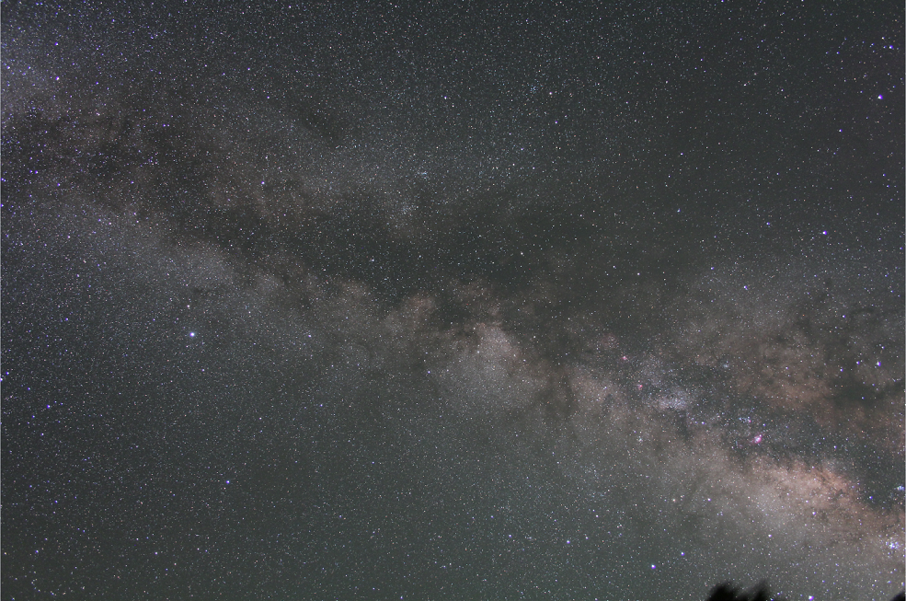
“Darkness” at night
Flagstaff, Az
5 minute exposure, tracking ‘on’

Slide 15
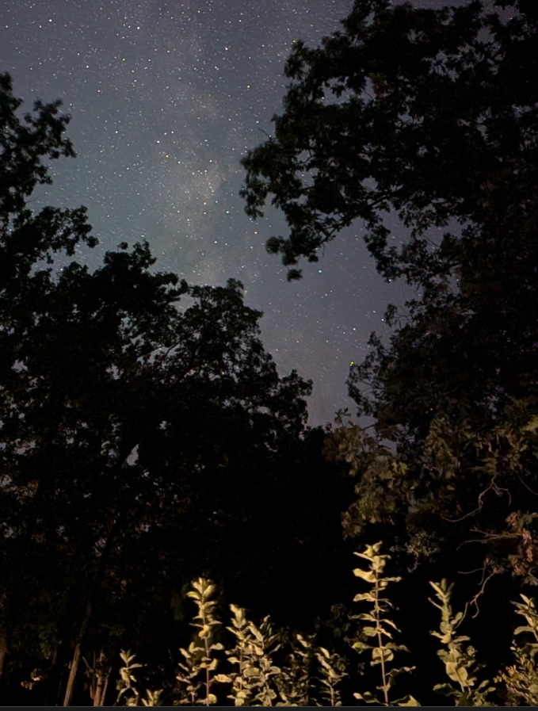
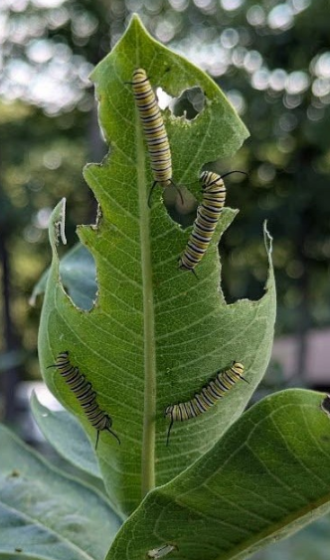
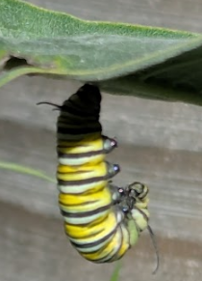
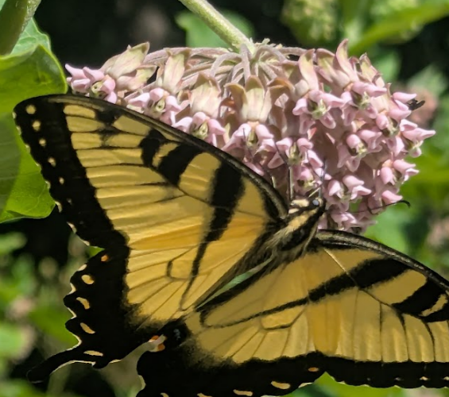
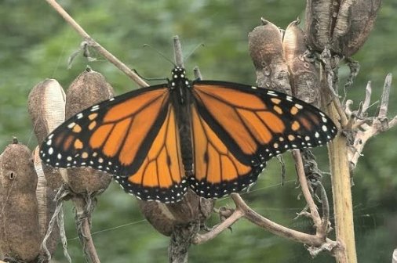
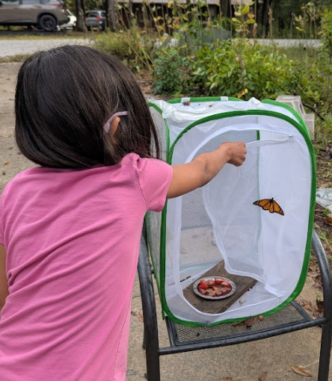
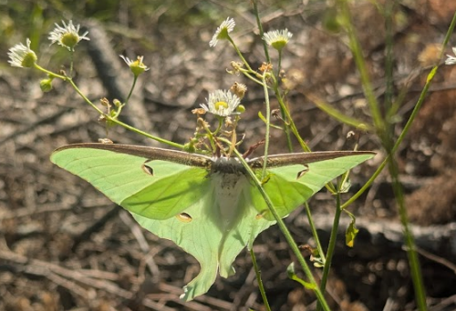
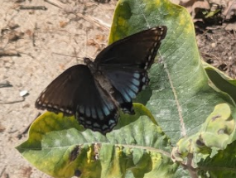
Monarchs, Milkweed,
Milky Way, and friends

Slide 16
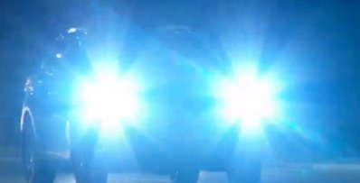
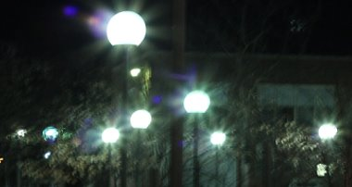
Defining the Problem
" Look at the stars,
look how they shine for you..."

Slide 17
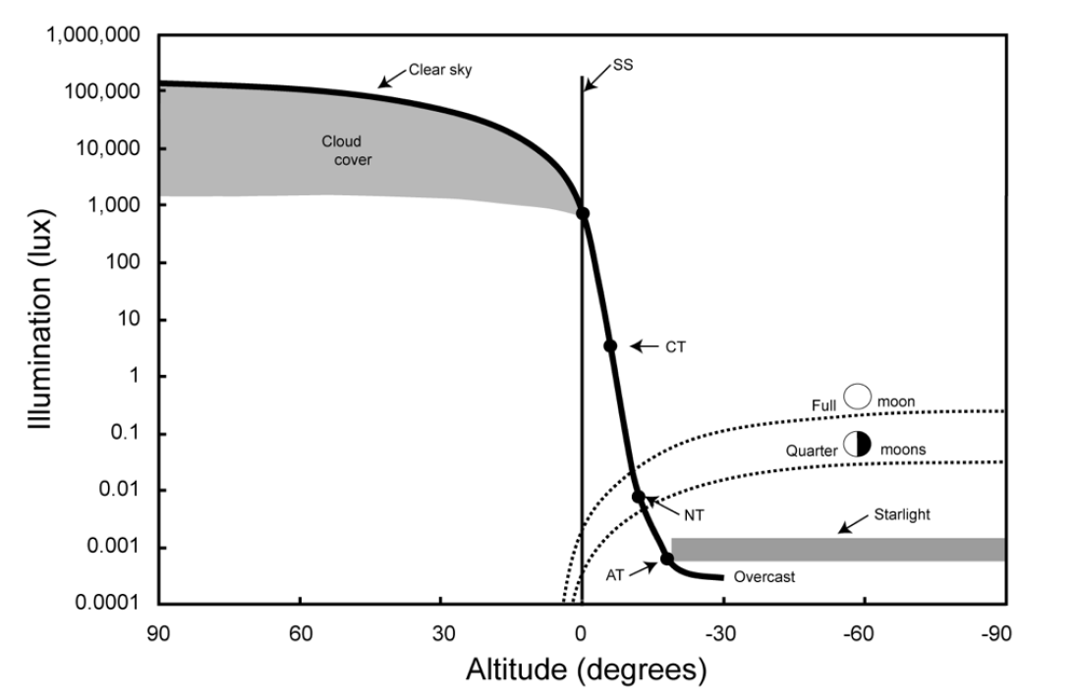
Natural Illumination
Night and Day
Urban Lighting
Credit: T. Longcore
Parking Lots
Sunset
Billboards
Urban Parks
Midnight
High Noon
Sky Glow
Dark Sky International: State of the Science 2023, John Barentine

Slide 18
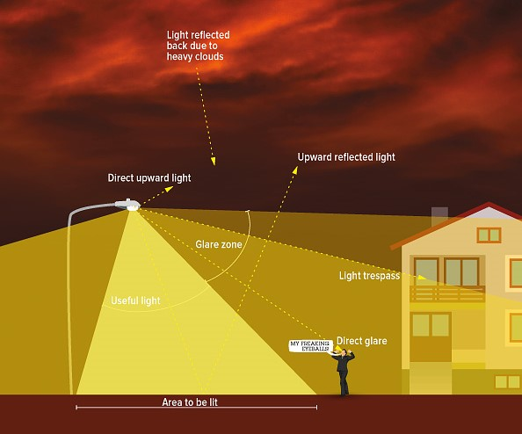
What is Light Pollution?
[ALAN = Artificial Light At Night]
Photo Credit: IDA

Slide 19
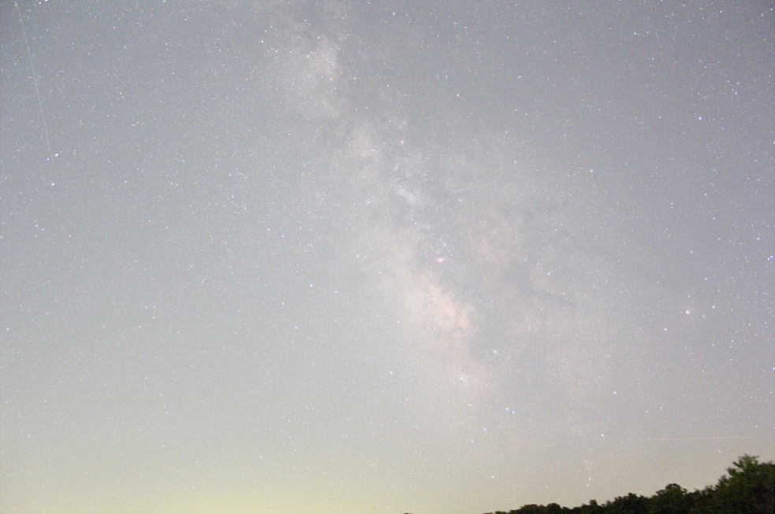
“Darkness” at night: Sky Glow
Kirksville, Mo
1 minute exposure, tracking ‘on’

Slide 20
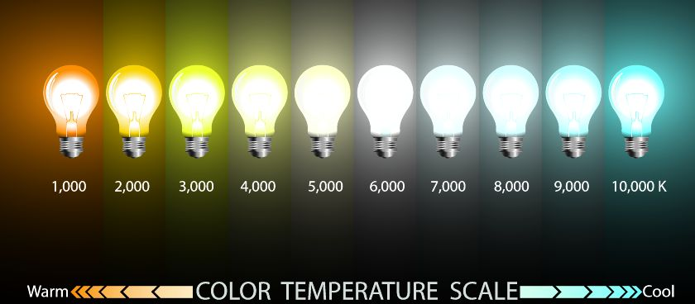
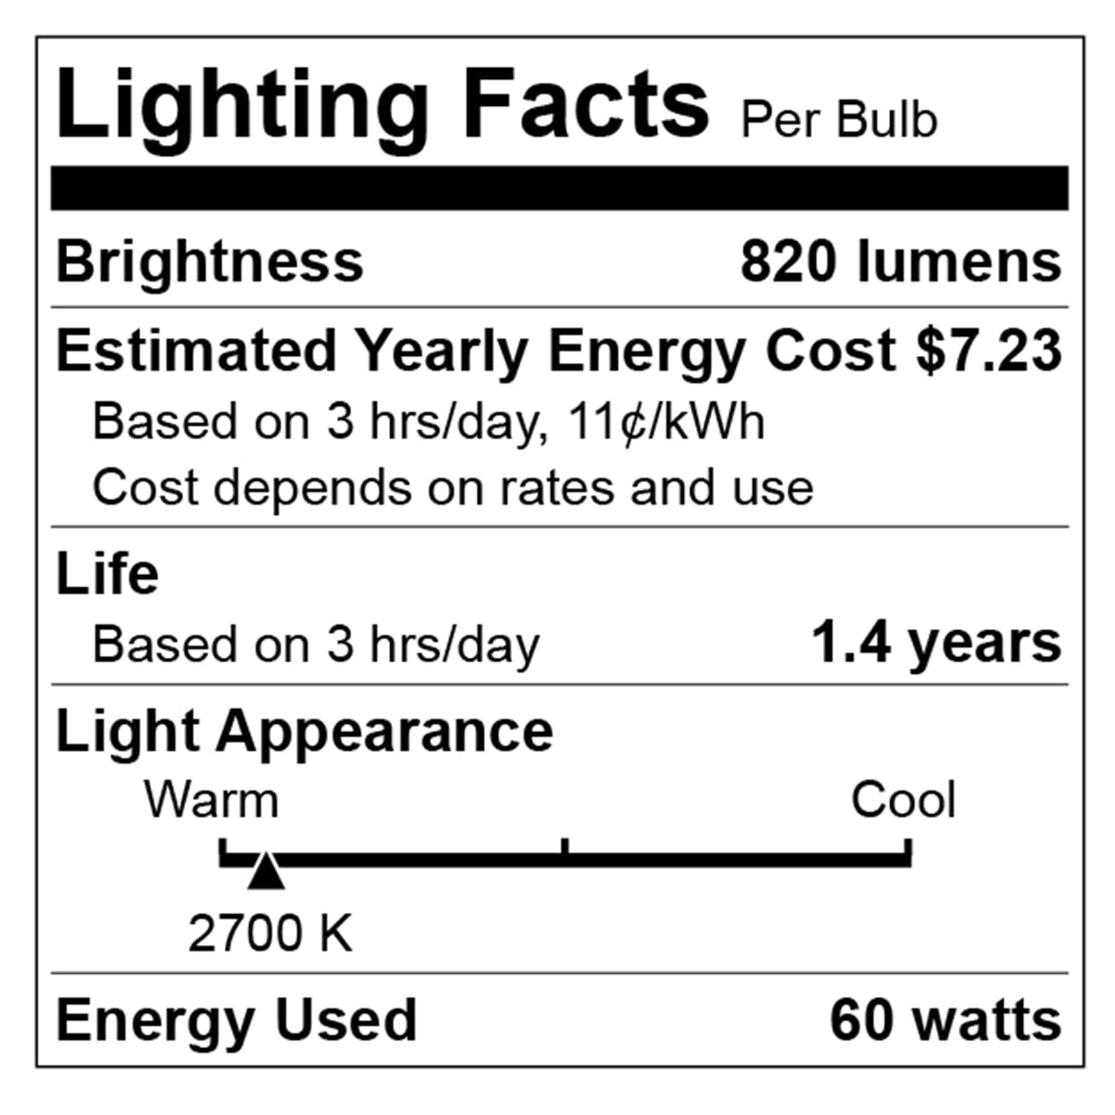
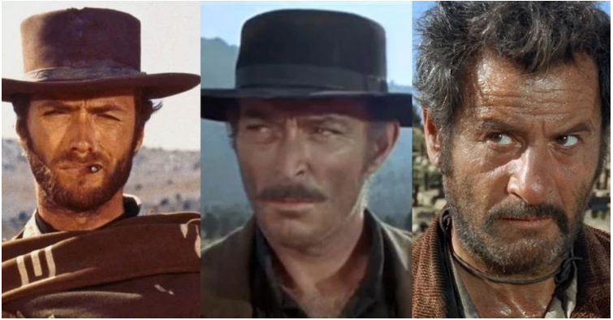
Light Intensity and Color are both important
For outdoor lighting, aim for
3000 K and below, preferably
about 2000 K.
Orange/Red good, yellow bad, blue light ugly

Slide 21
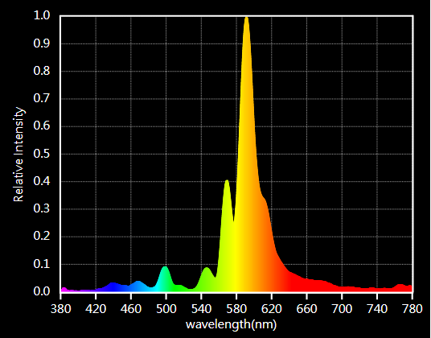
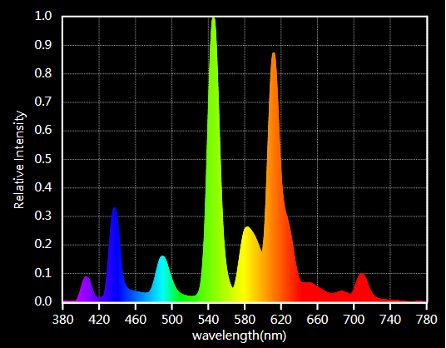
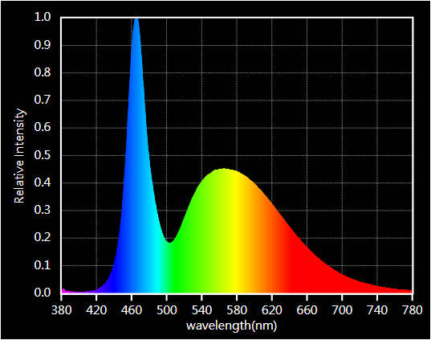
Color is important but check spectrum!

Slide 22
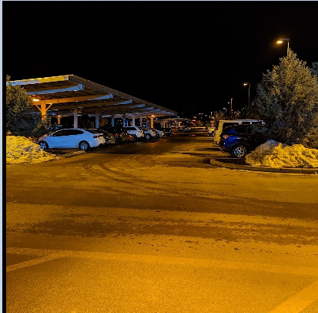
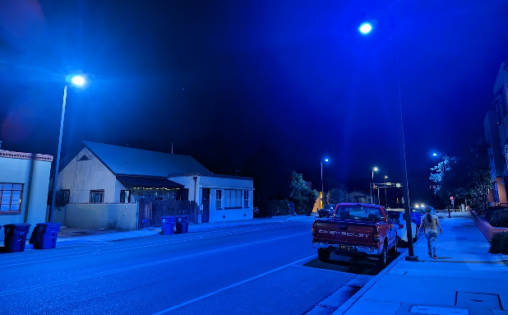
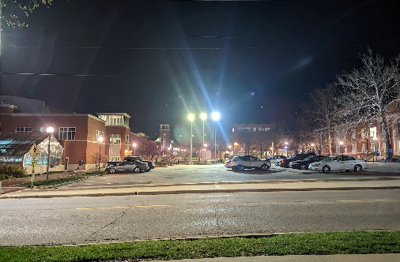

Amber, Blue, and White Light
Residential Neighborhood
Albuquerque, NM
Walmart @Flagstaff, Az
Parking lot
@ Truman State

Slide 23
Light pollution is the human-made alteration of outdoor light levels from those occurring naturally.

Slide 24
Responsible Lighting at Night
" Let there me night..."

Slide 25
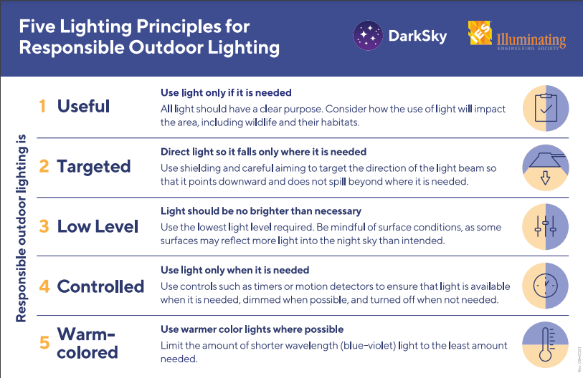
Maintaining Natural Darkness at Night

Slide 26
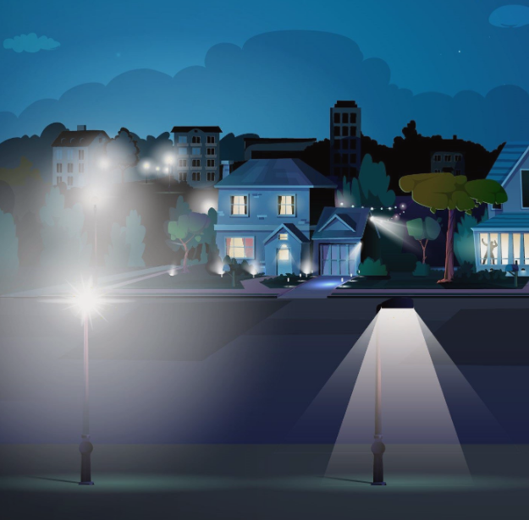
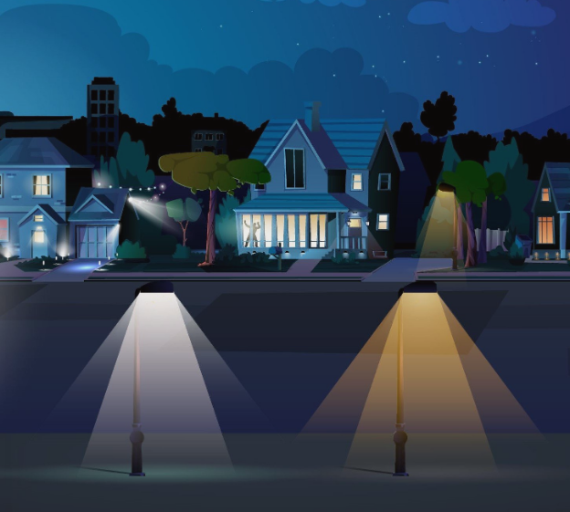
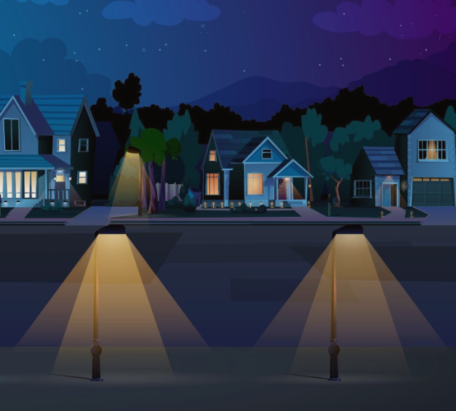
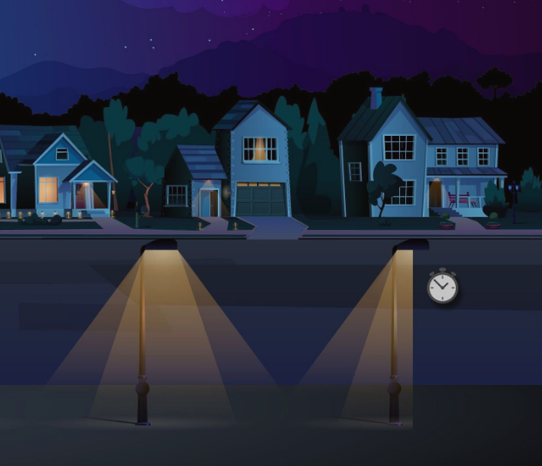
Principles For Responsible Lighting
Shielding
Color
https://www.bigbenddarkskyreserve.org/lighting
Intensity
Purpose & Timing

Slide 27
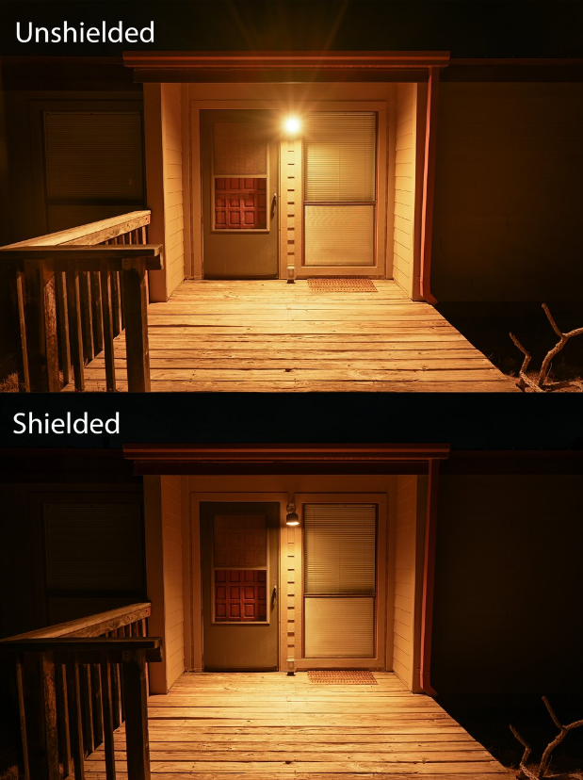
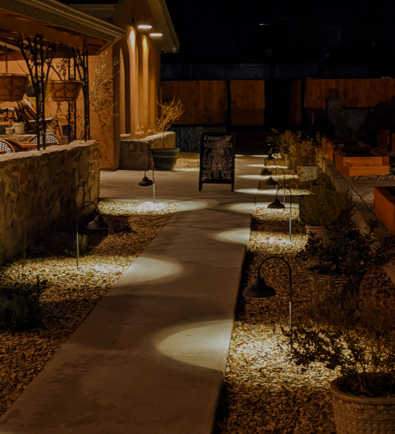
Examples: Residential
Las Cruces, NM
Near Big Bend NP, Texas

Slide 28
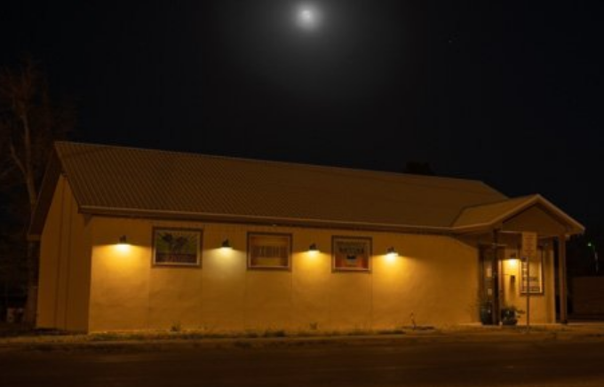
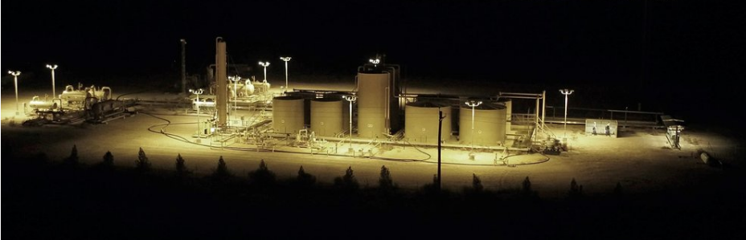
Responsible Lighting: Examples
Printco@Alpine, Tx
Walmart @Flagstaff, Az
Oil Tanks@
Balmorhea, Tx

Slide 29
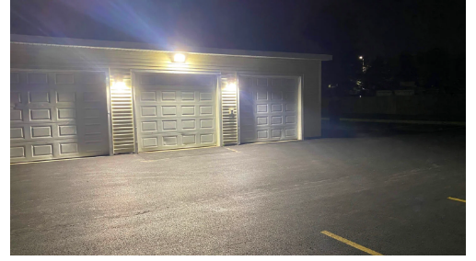
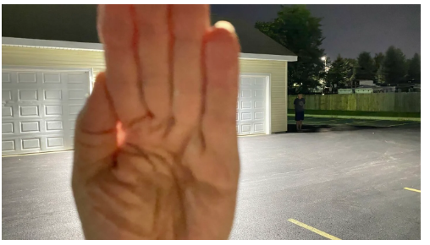
Direct Glare and Safety

Slide 30
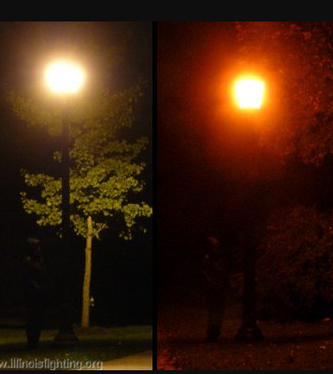
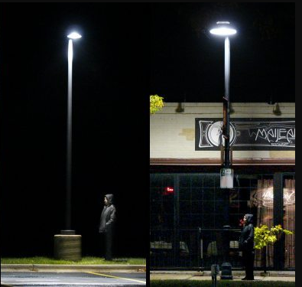
Direct Glare and Safety

Slide 31
Maintaining Natural Darkness at Night
Best practice lighting design incorporates the following design principles:
Start with natural darkness and only add light for specific purposes.
Use adaptive light controls to manage light timing, intensity and color.
Light only the object or area intended – keep lights close to the ground, directed and shielded to avoid light spill.
Use the lowest intensity lighting appropriate for the task.
Use non-reflective, dark-colored surfaces.
Use lights with reduced or filtered blue, violet and ultra-violet wavelengths.

Slide 32
Natural Darkness at Night
The technical solutions to light pollution are rather straight-forward: minimize use of outdoor light, direct it where it is needed, and use amber/red light instead of blue-white light.
The bigger challenge is to overcome individual and institutional inertia and make people change their habits.

Slide 33
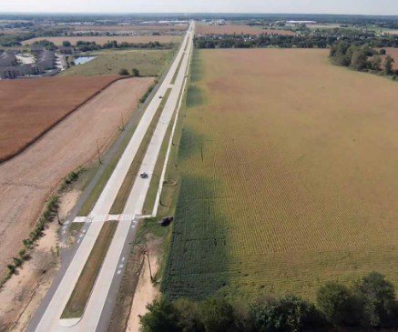
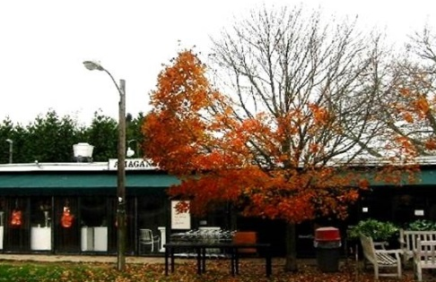
Why Protect Dark Skies

Slide 34
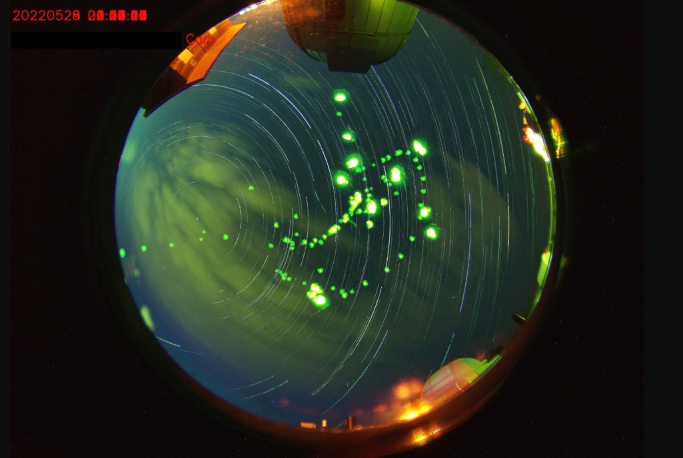

Why Combat Light Pollution?
Human Health and Safety
  Circadian rhythm
  Vision impaired by Glare
Animal Health
  Bird Migration, Sea Turtles
  Bees, Fireflies, and other insects
  Ecological impact
The Environment
  Increased greenhouse emissions
  Unnecessary waste of precious natural resources
Astronomy
  Stargazing, astronomy research
  Aesthetics
Fireflies photobomb the
all -sky-camera at the
Truman State Observatory

Slide 35
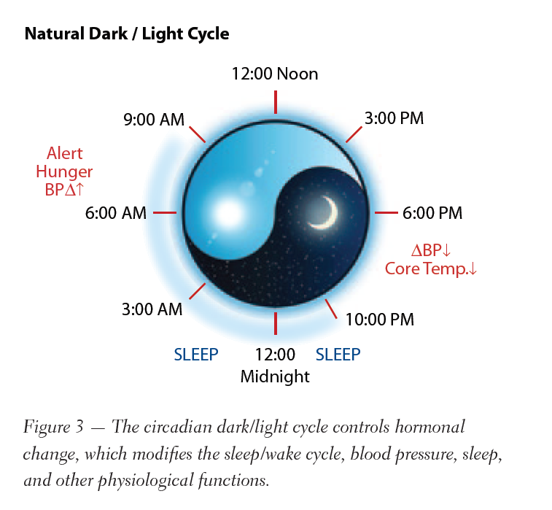
Human Health
https://www.youtube.com/watch?v=BKQH6T1DZvI

Slide 36
ALAN and Humans
Glare affects most of us, most commonly in the context of vehicle head-lights and/or bright LEDs mounted sideways on walls and/or Electronic Billboards
LED lights, due to greater directionality, cause greater glare.
Harder to quantify the effects of glare in terms of color, and its effects on “recovery time” of eyes.
Severity of glare is related largely to the dosage (how bright?).

Slide 37
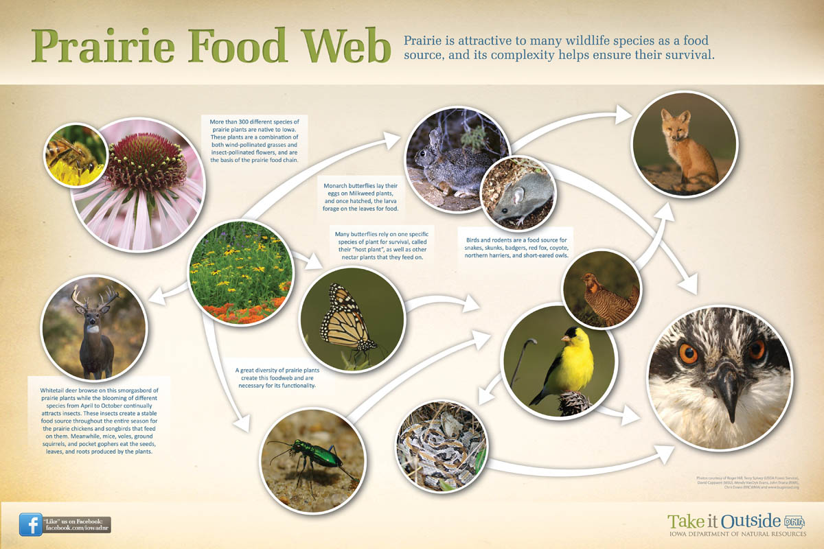
Prairie Food Web

Slide 38
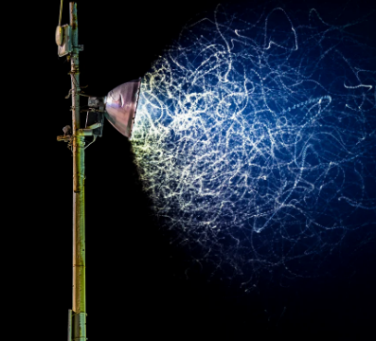
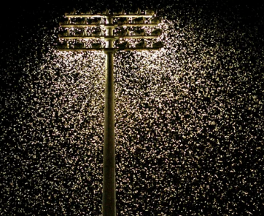
Pollinators and ALAN
Moths, including sphinx or hawk moths, are especially common and diverse nocturnal pollinators.
Nocturnal pollinators use natural light from the stars and moon in the night sky to navigate.
This light-seeking behavior draws them to artificial light where they become confused and trapped.
Artificial light leaves pollinators exposed, making them easier to spot and reducing their ability to see these predators.
Turn off unneeded lights whenever possible and shade windows during the twilight hours.
https://www.pollinator.org/

Slide 39



Slide 40

Birds and ALAN: Bird Migration

Slide 41


ALAN And Bird Migration
Twice each year, billions of birds fly between wintering and breeding grounds, facing innumerable threats along the way.
“Live” bird migration maps!
https://birdcast.info/migration-tools/live-migration-maps/
https://www.allaboutbirds.org/news/mesmerizing-migration-watch-118-bird-species-migrate-across-a-map-of-the-western-hemisphere/

Slide 42

ALAN And Birds

Slide 43

ALAN And Bird Migration (Horton et al., 2019)
Seasonal (a) magnitude and (b) relative rankings of the 125 largest urban areas in the continental US. Point color shaded by the mean light radiance and sizes (in [b]) are scaled by the square root of urban area.
Inset in (b) depicts the top 15 (spring or fall) rankings

Slide 44


ALAN And Bird Migration
Example: 9/11 Tribute in Light site.

Slide 45

ALAN And Birds
Birds trapped in light domes near Big Bend National Park (left) and Kirksville, Missouri (right)

Slide 46

ALAN And Birds
Birds belly’s are lit up by upward pointing light (and also due to reflection off the snow). These birds should be “invisible” at night, but are not.
Picture Credit: http://www.missouriskies.org/

Slide 47

One Example, Chicago: October 2023
https://birdcast.info/news/major-collision-event-in-chicago-4-5-october-2023

Slide 48
Similarities between Chemical and Light Pollution
Organism Impact Chemical* Light** LP Examples
Human Exposure yes yes urban/industrial settings
Wildlife Exposure yes yes urban/industrial settings
Abnormal behavior yes yes migrations, attraction/avoidance
Growth yes yes plants, cancer cells
Reproduction yes yes mammals, amphibians
Survival yes yes sea turtles, birds
Death yes yes sea turtles, birds
* Sufficient data generated by studies on numerous chemicals.
** Insufficient data; repeated observations of incidences and correlation to
presence of artificial lighting.

Slide 49
Environmental Restoration Comparison
“Cleaning the Problem Up”
Hypothetical scenario – compare 10 acres of land in watershed environment contaminated by either hazardous chemicals or light pollution
Chemical Pollution ($$$$$$$$$$$$$$$)
Source – residual presence may persist after source is eliminated
Environmental noncompliance fines
Civil/criminal litigation costs
Remediation/clean-up/disposal costs
High Manpower/equipment costs
Chemical Monitoring/recovery costs
Long term recovery usually required
Certain conditions may impede full recovery
Public and wildlife health could potentially continue to be impacted after restoration.
Light Pollution ($)
Source – on/off; no residual presence after source is eliminated
Planning and design costs
Equipment retrofit costs
Disposal/recycle of old equipment
Less manpower/equipment demand
Low/no monitoring requirement
Short term recovery anticipated
Minimum impediment to full recovery
Public and wildlife health could potentially be significantly improved after restoration.

Slide 50
Let there be night…

Slide 51


A Call to Action
https://lightpollutionmap.info/

Slide 52


Slide 53
Milkweed, Monarchs, and the Milky Way
“We can no longer afford to consider air and water common property, free to be abused by anyone without regard to the consequences. Instead, we should begin now to treat them as scare resources, which we are no more free to contaminate than we are free to throw garbage into our neighbors yard.”

Slide 54






Milkweed, Monarchs, and the Milky Way

Slide 55
Extra Slides

Slide 56



DarkSky Missouri
The mission of DarkSky Missouri is to raise awareness about light pollution issues in Missouri, promote quality outdoor lighting, protect our natural environment and our beautiful night sky, and educate the public how reducing light pollution can lower energy costs.
Operating Zones

Slide 57
DarkSky Missouri: Goals
Increase engagement with city, county, and state officials:
  Best practices
  Laws and ordinances
  Public and Private other wilderness areas
  (DarkSky certification, DarkSky Activities)
Educational and Training Programs targeting:
  School and College campuses,
  State Parks and Conservation areas,
  Aligned organizations (Master Naturalists, “Bird-people”, CFM affiliates etc.)
  Other concerned citizens

Slide 58
Programs
Campus SHINE = Safe and Healthy Illumination in the Nighttime Environment
Sky Brightness Measurement Programs:
  Missouri Master Naturalists
  Missouri State Parks
  MDC offices and properties
“Highway 63 Project”: DarkSky Communities
  Kirksville, Columbia, Jefferson City
  Downtown Lighting Inventories
  Identifying hazardous windows & structures
  Pilot, proof-of-principle window treatments

Slide 59


Bird City Network
A recognition program first launched in 2009, with its inaugural designation in Wisconsin.
More than 200 communities across four countries are actively participating
Program serves as a guide where communities collaborate to identify threats birds face and implement practical solutions
No population size requirement
Requires a total of 10 action items tailored specifically for Missouri (6 required, 4 custom)
  Once actions are complete, community can then apply for the designation

Slide 60
Bird City Network
Focused on Four Categories:
  Improving habitats
  Addressing Threats
  Engaging People
  Promoting sustainability
Form a local Bird City team:
  Review the list of tailored, bird-friendly actions
  (Columbia is already doing a lot of these actions!!)
  Works together to coordinate actions in your
  community
  Complete application together

Slide 61
Bird City Network
Fill out Dream Team Worksheet (guide), Intent to Apply form, and submit to birdfriendlycommunities@mrbo.org
We will then invite you to login and manage your online application!
We want to celebrate and recognize your community’s hard work!
Let’s get Columbia on the map and be the first Bird City Missouri designation!

Slide 62

What we need from you
“Formally” include Five Principles for Responsible Outdoor Lighting in your conservation and restoration efforts.
Become a member!
Bring your expertise and join a DarkSky Missouri committee:
  Outreach: Advocate for responsible lighting
  Engagement: Help run newsletter, social media etc.
  University and School engagement: Engage students
  Laws and Ordinances: Engage lawmakers and policymakers
  Membership: Help boost membership
Participate in our DarkSky Training program

Slide 63



!! BECOME A MEMBER OF DARK SKY Missouri!!

Slide 64

!! BECOME DARK SKY ADVOCATES !!
Printco@Alpine, Tx
Walmart @Flagstaff, Az
FACEBOOK: DARKSKYMISSOURI

Slide 65


ALAN and Natural Cycles of Darkness

Slide 66
ALAN And Bird Migration
So, ALAN is completely disrupting the cycles associated with moon-phase, since cloudy nights in cities mimics clear nights with Moonlight vis-à-vis sky brightness, which could severely confuse migratory birds.
Also note that birds tend to follow waterways and rivers on their migration routes, and these are locations were humans tend to settle as well.
For example: STL, KC, Chicago, Minniapolis, Memphis, Baton Rouge, New Orleans are only a few cities along just the Mississippi river!
Cities = High-rise buildings and lots of light pollution, and this is not good for migrating birds ☹

Slide 67

Mindful Use of Light
Lighting Fixtures help reduce:
  Light Trespass
  Glare
  Sky Glow
Efficient lighting and Overconsumption
  Too many light fixtures (clutter)
  Too much light (Lumen levels)
“Warm” Light
Colors is least
disruptive

