Slide 1
“Dark Sky as a Natural Resource”
31st July 2024
Vayujeet Gokhale
Professor of Physics and Astronomy, Truman State University
Chair,
DarkSky Missouri
https://darksky.truman.edu/campus-resources/

Slide 2
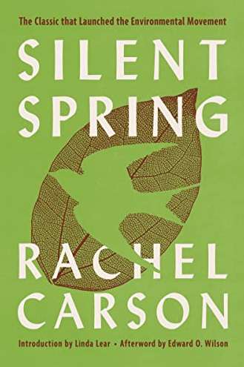
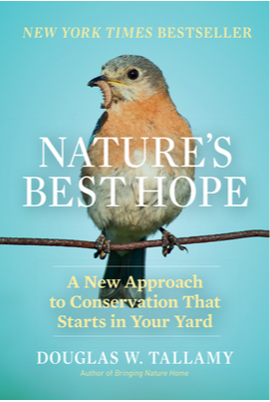
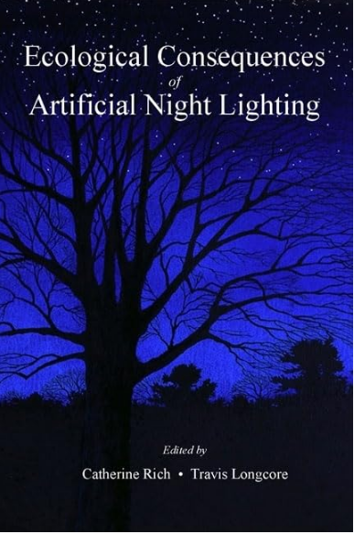
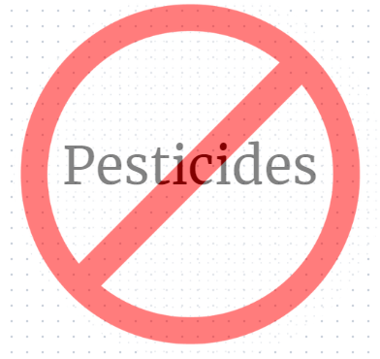
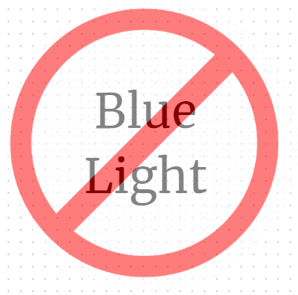
Milkweed and the Milky Way

Slide 3
Natural Illumination Night and Day Chapter 0: Darkness at night
“…shadows from the starlight,
softer than a lullaby…”

Slide 4
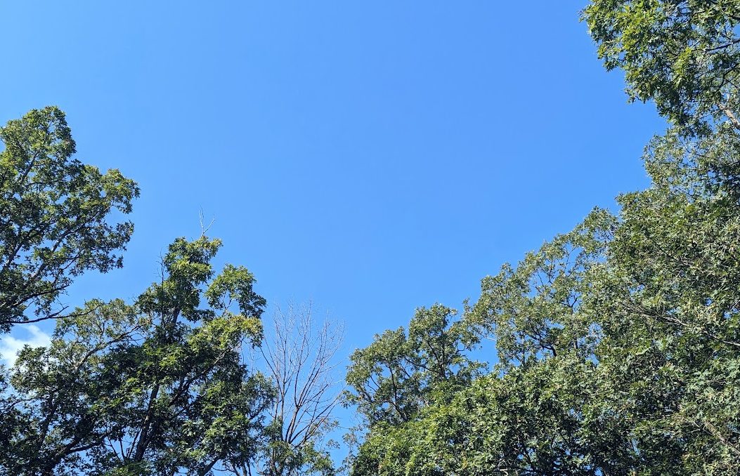
BLUE LIGHT = DAYTIME

Slide 5
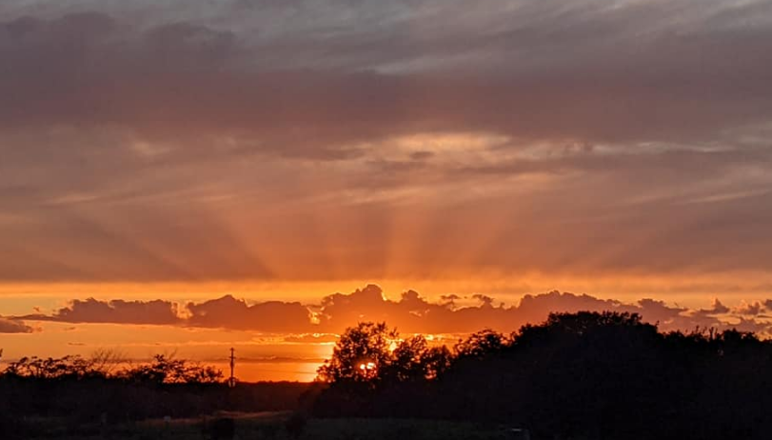
AMBER/YELLOW = TWILIGHT

Slide 6
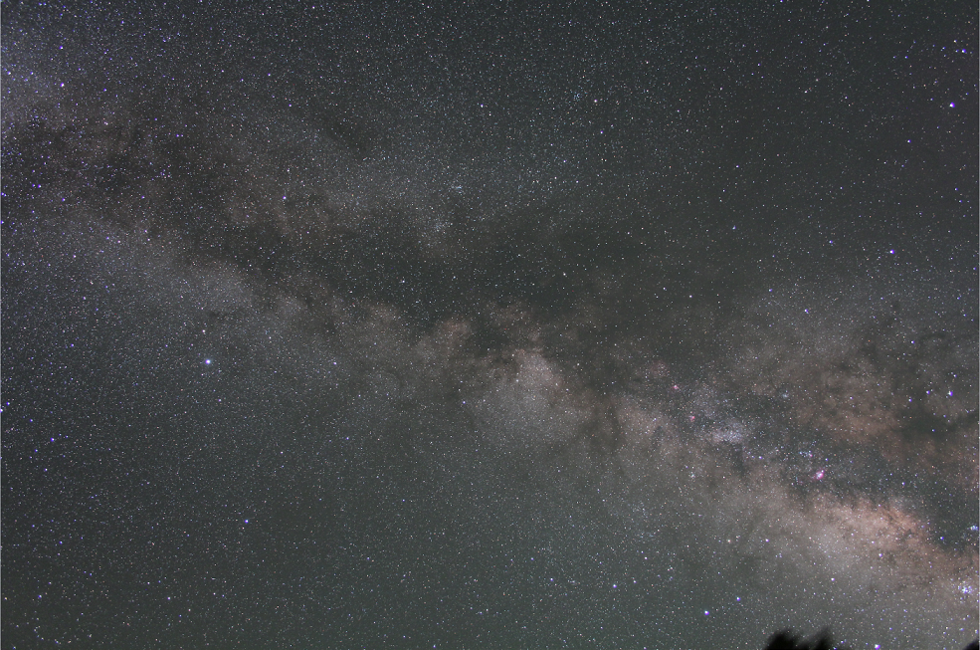
“Darkness” at night
Flagstaff, Az 5 minute exposure, tracking ‘on’

Slide 7
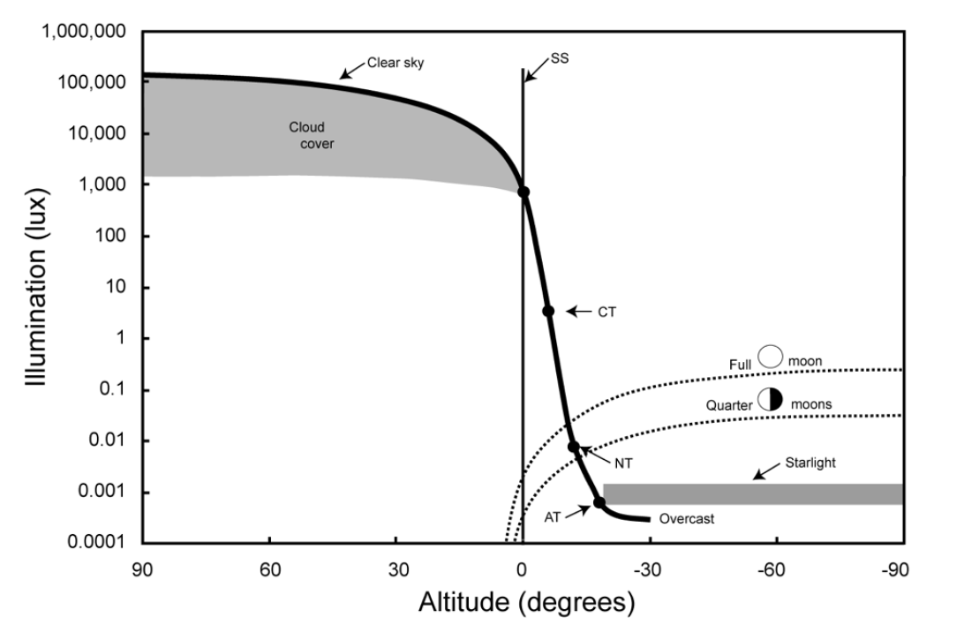
Natural Illumination Night and Day
Credit: T. Longcore
DarkSky International: State of the Science 2023, John Barentine

Slide 8
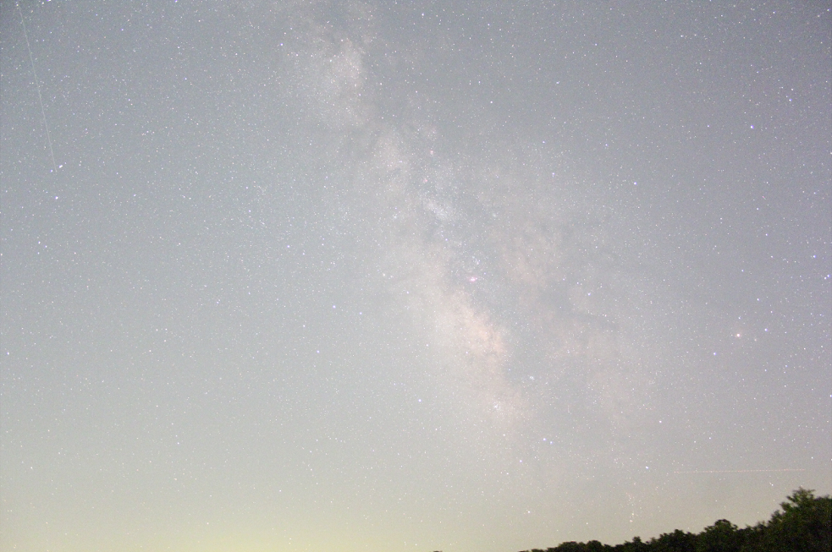
“Darkness” at night: Sky Glow
Kirksville, Mo 1 minute exposure, tracking ‘on’

Slide 9
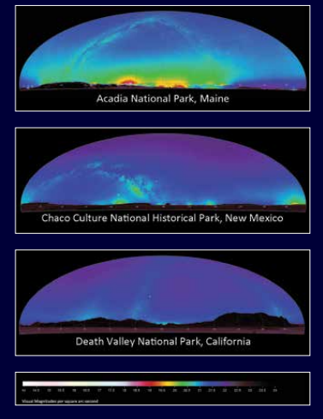
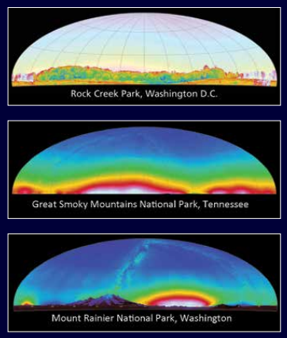
Sky Glow from 200 miles away

Slide 10
Natural Illumination Night and Day
Urban Lighting
Credit: T. Longcore
Parking Lots
Billboards
Urban Parks
Sky Glow
Dark Sky International: State of the Science 2023, John Barentine

Slide 11
Use of Artificial Light at Night, is a form of Pollution
Light Pollution

Slide 12
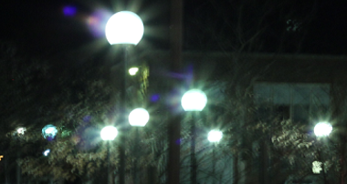
Chapter 1: Artificial Light at Night
“…let there be night”

Slide 13
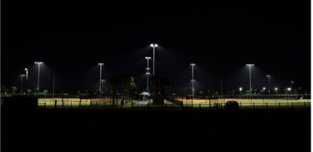
Purpose of Outdoor Lighting
0. To be able to see better,
Enhance safety for people,
Improve security for property,
Aesthetic value,
Economic development.
Common Applications
Roadway and street lights,
Parking lots,
Sports fields,
Housing complexes and Residential,
Downtown areas,
Malls and shops,
Gas stations & car dealerships,
Parks,
Electronic Billboards, etc.

Slide 14
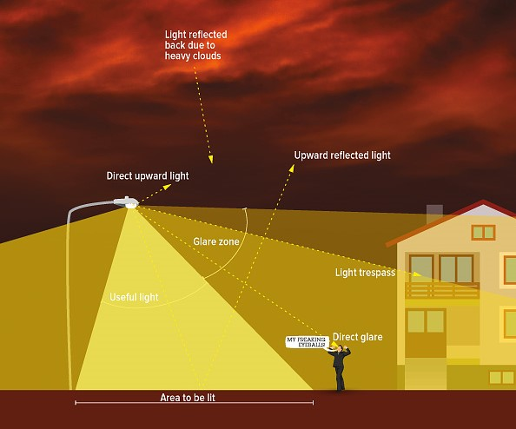
What is Light Pollution? [ALAN = Artificial Light At Night]
Photo Credit: IDA

Slide 15
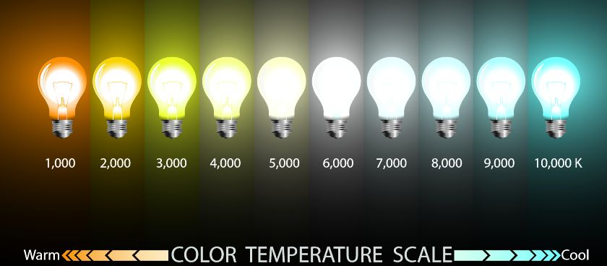
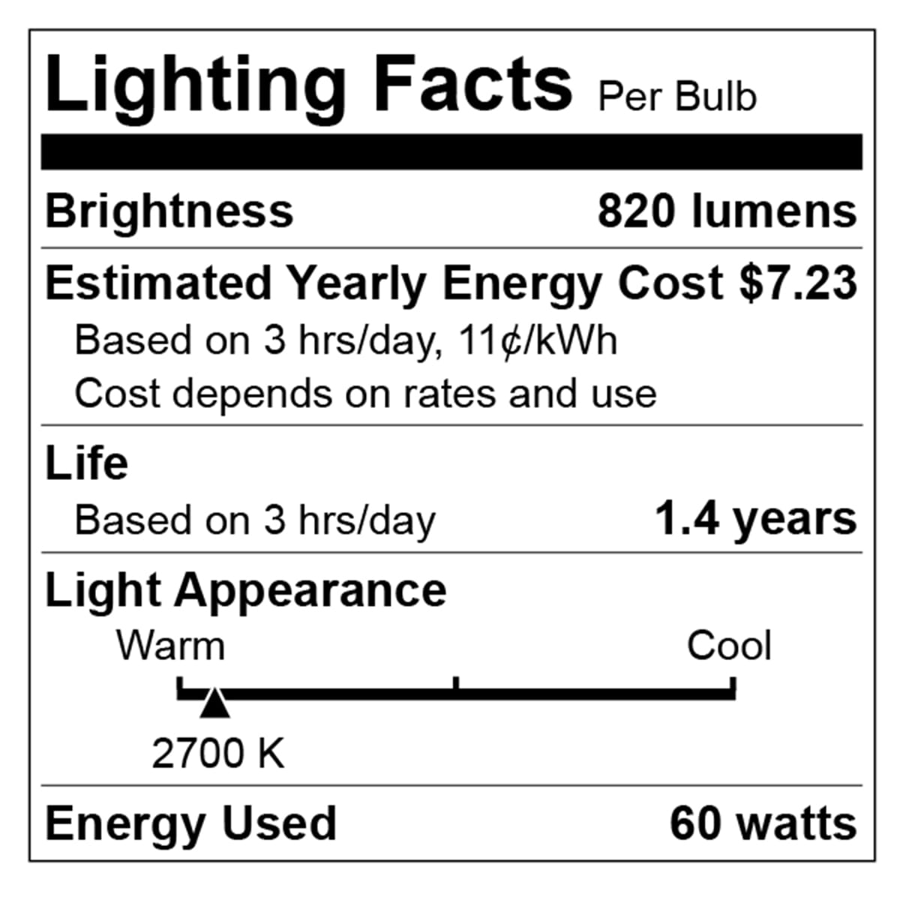
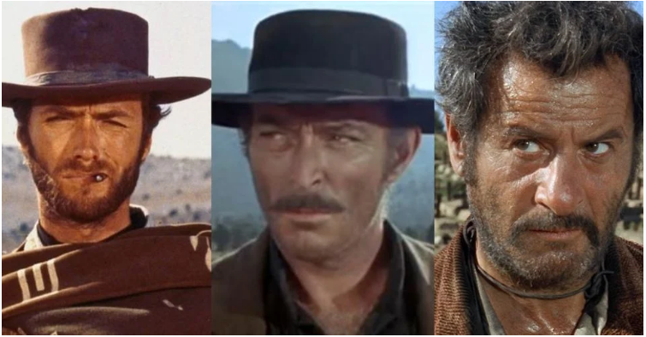
Light Intensity and Color are both important
For outdoor lighting, aim for 3000 K and below, preferably about 2000 K.
Orange/Red good, yellow bad, blue light ugly

Slide 16
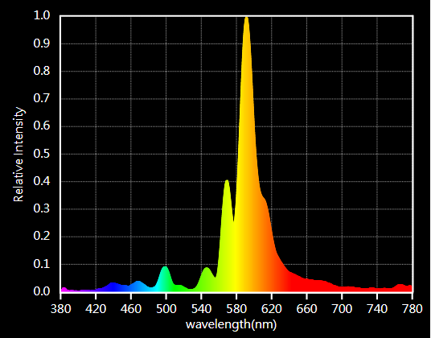
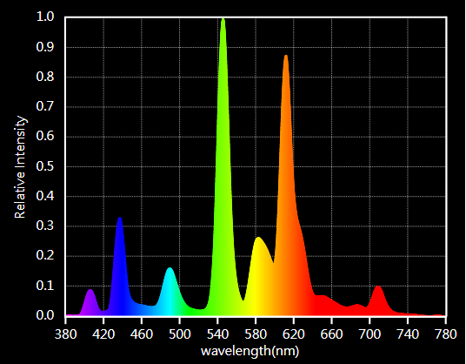
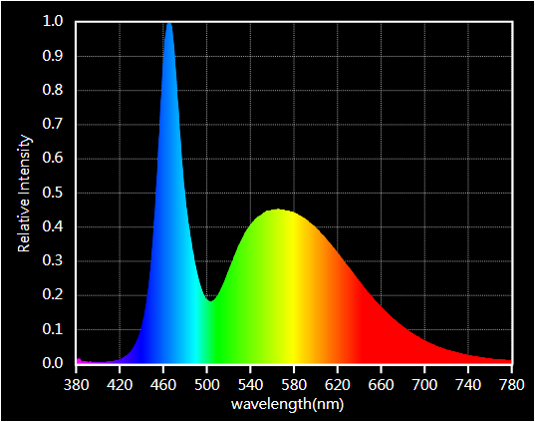
Color is important but check spectrum!

Slide 17
Chapter 2: How to reduce Light Pollution
Efficiency versus over-consumption
Between the swan and Hercules, Where even dark clouds glow…

Slide 18
How to combat Light Pollution?

Slide 19
How to combat Light Pollution?
Best practice lighting design incorporates the following design principles:
Start with natural darkness and only add light for specific purposes.
Use adaptive light controls to manage light timing, intensity and color.
Light only the object or area intended – keep lights close to the ground, directed and shielded to avoid light spill.
Use the lowest intensity lighting appropriate for the task.
Use non-reflective, dark-colored surfaces.
Use lights with reduced or filtered blue, violet and ultra-violet wavelengths.

Slide 20
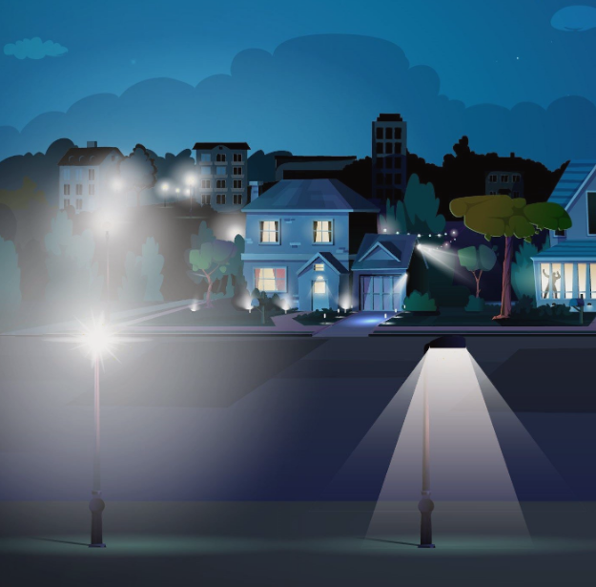
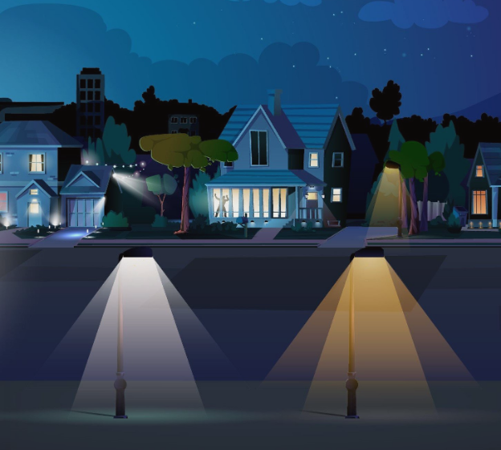
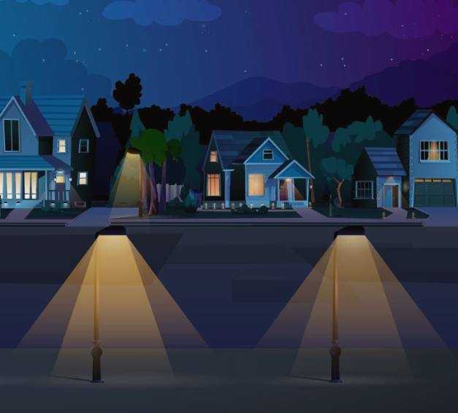
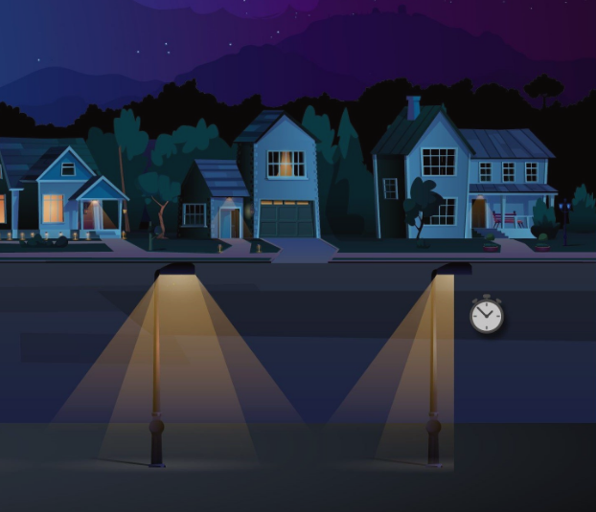
Reducing Light Pollution
Shielding
Color
https://www.bigbenddarkskyreserve.org/lighting
Intensity
Purpose & Timing

Slide 21
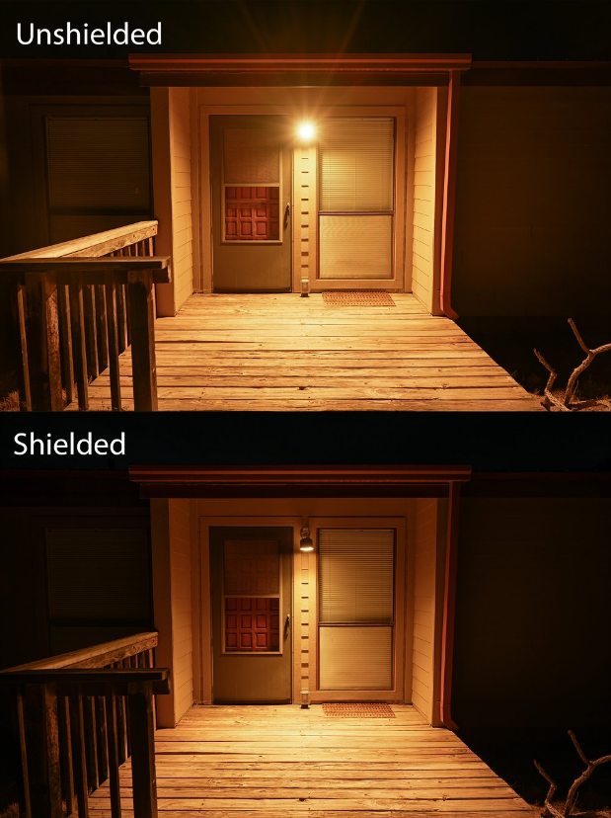
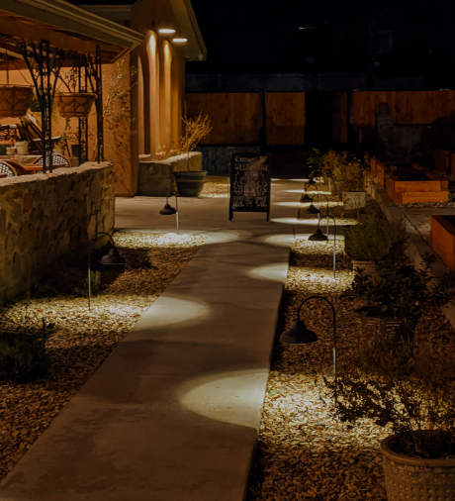
Examples: Residential
Las Cruces, NM
Near Big Bend NP, Texas

Slide 22
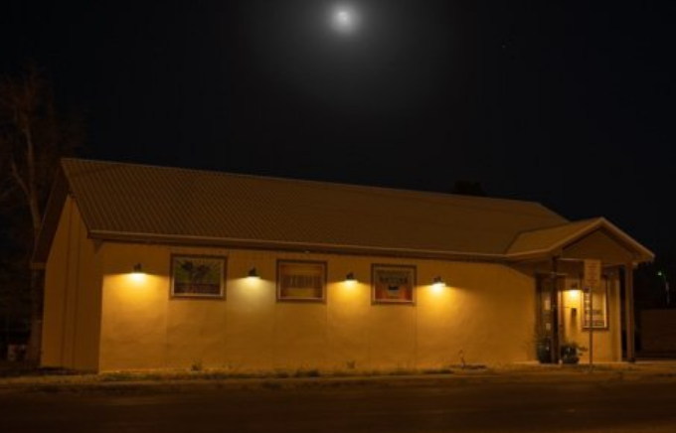
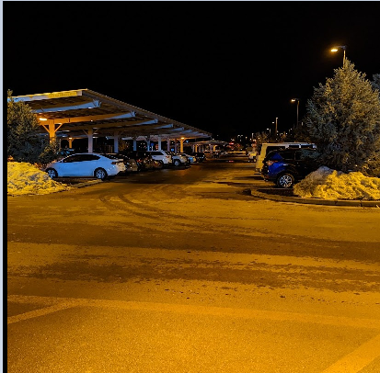
Reducing LP: Real Life Examples
Printco@Alpine, Tx
Walmart @Flagstaff, Az
Oil Tanks@ Balmorhea, Tx

Slide 23
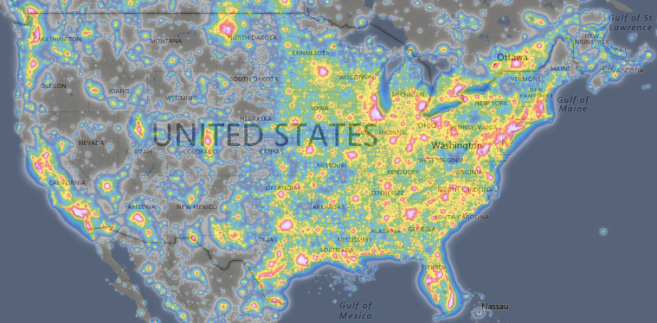
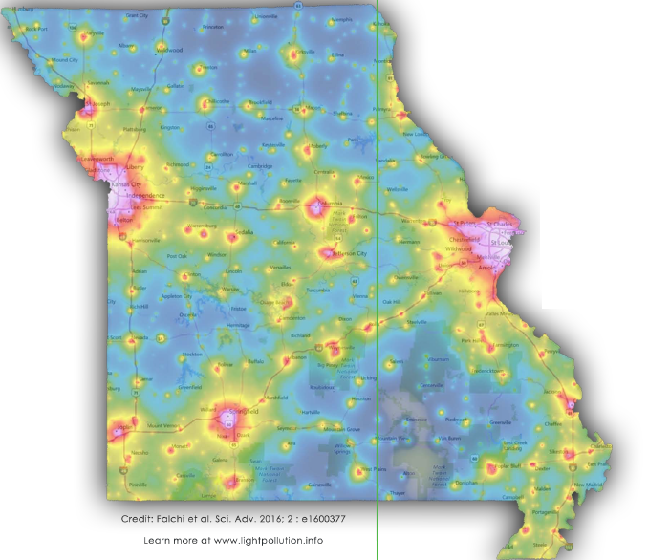
The Challenge
https://lightpollutionmap.info/
“The loss of the night sky is placed in the broader context of society’s difficulty in fully articulating non-consumptive values such as natural beauty.”
Terrell Gallaway (Missouri State University; IDA-Mo Board Member)
How to bridge this gap!?

Slide 24
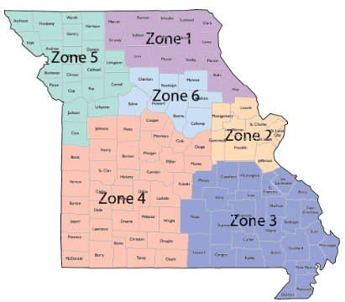
DarkSky Missouri
The mission of DarkSky Missouri is to raise awareness about light pollution issues in Missouri, promote quality outdoor lighting, protect our natural environment and our beautiful night sky, and educate the public how reducing light pollution can lower energy costs.
Operating Zones

Slide 25
What we need from you
“Formally” include Five Principles for Responsible Outdoor Lighting in your conservation and restoration efforts.
Become a member!
Bring your expertise and join a DarkSky Missouri committee:
Outreach: Advocate for responsible lighting
Engagement: Help run newsletter, social media etc.
University and School engagement: Engage students
Laws and Ordinances: Engage lawmakers and policymakers
Membership: Help boost membership
Participate in our DarkSky Training program

Slide 26
!! BECOME DARK SKY ADVOCATES !!
FACEBOOK: DARKSKYMISSOURI

Slide 27
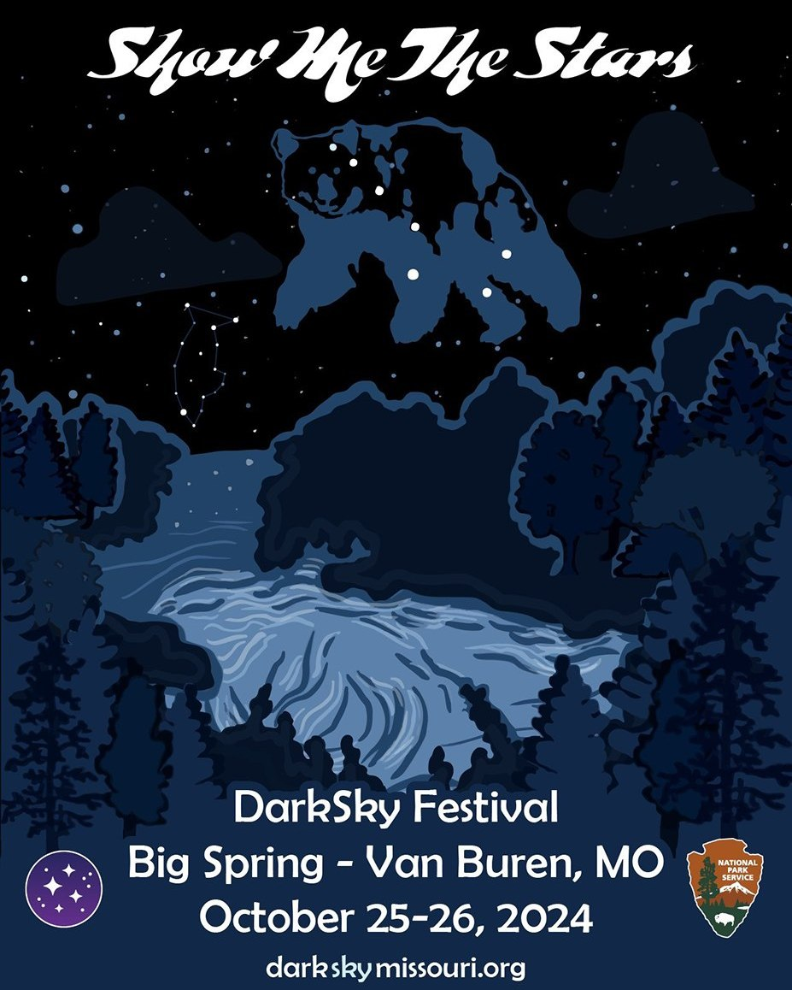
Free Registration!!

Slide 28
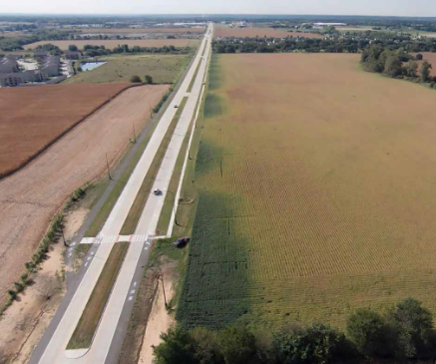
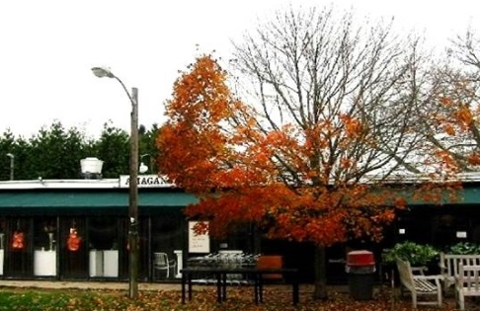
Chapter 3: Why Combat Light Pollution?

Slide 29
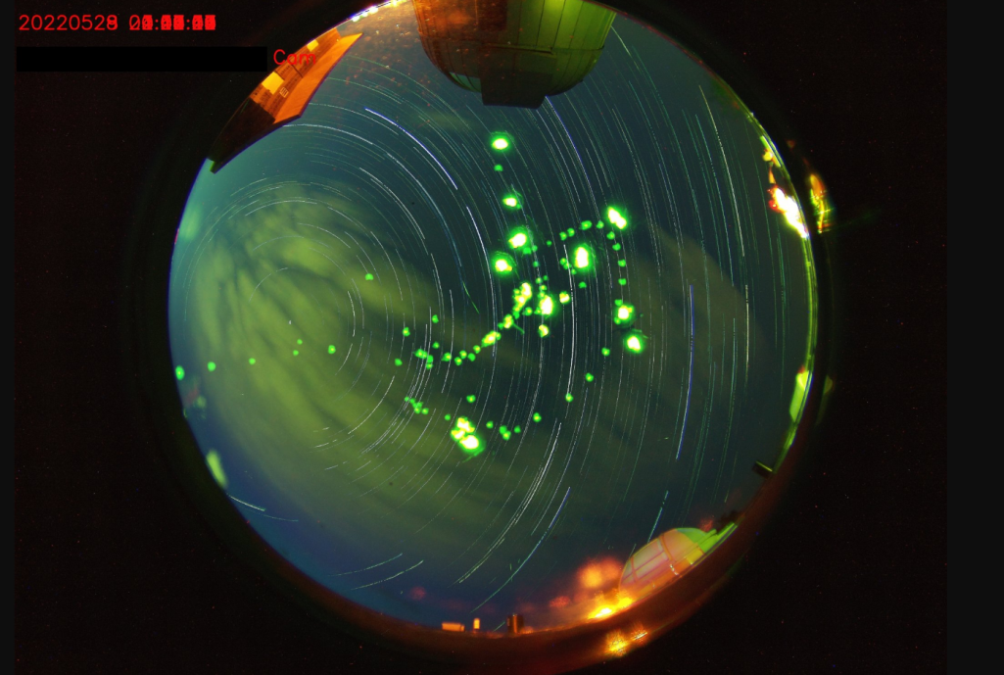
Why Combat Light Pollution?
Human Health and Safety
Circadian rhythm
Vision impaired by Glare
Animal & Plant (?) Health
Bird Migration, Sea Turtles
Bees, Fireflies, and other insects
Ecological impact
The Environment
Increased greenhouse emissions
Unnecessary waste of precious natural resources
Astronomy
Stargazing, astronomy research
Aesthetics
Fireflies photobomb the all -sky-camera at the Truman State Observatory

Slide 30
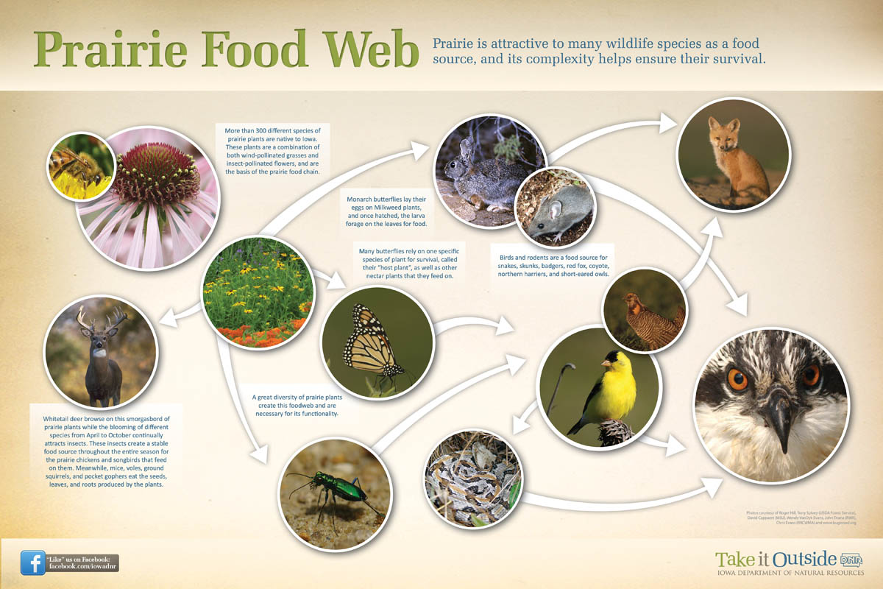
Prairie Food Web

Slide 31
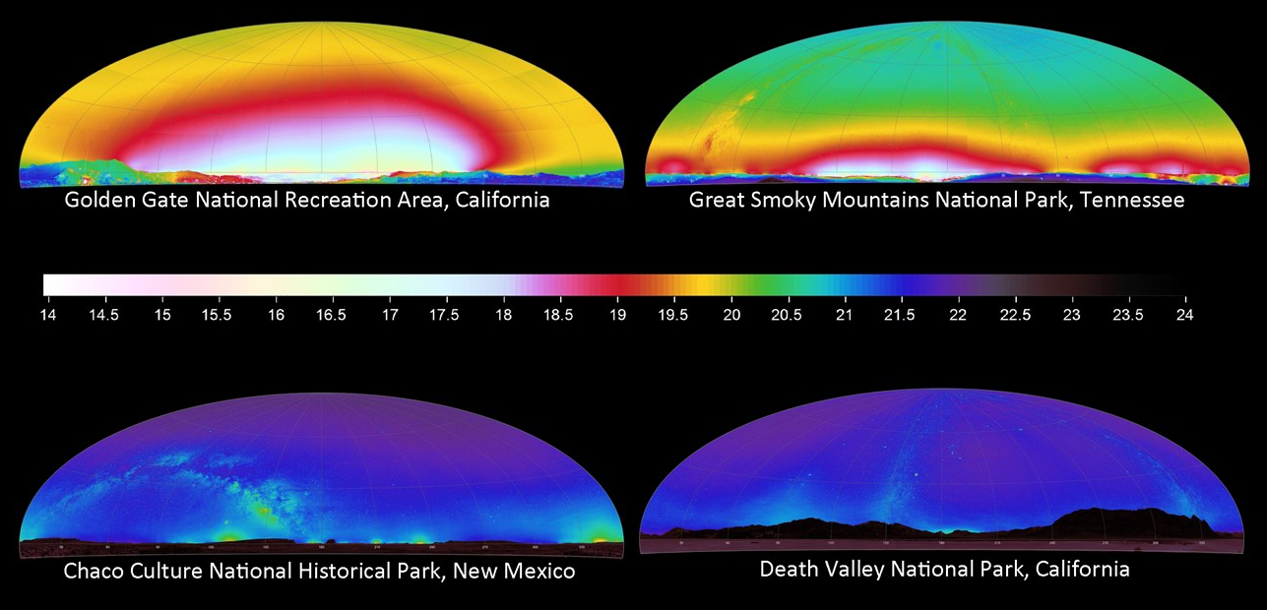
Prairie Food Web
https://www.nps.gov/articles/measuring-light-pollution-across-a-landscape.htm

Slide 32
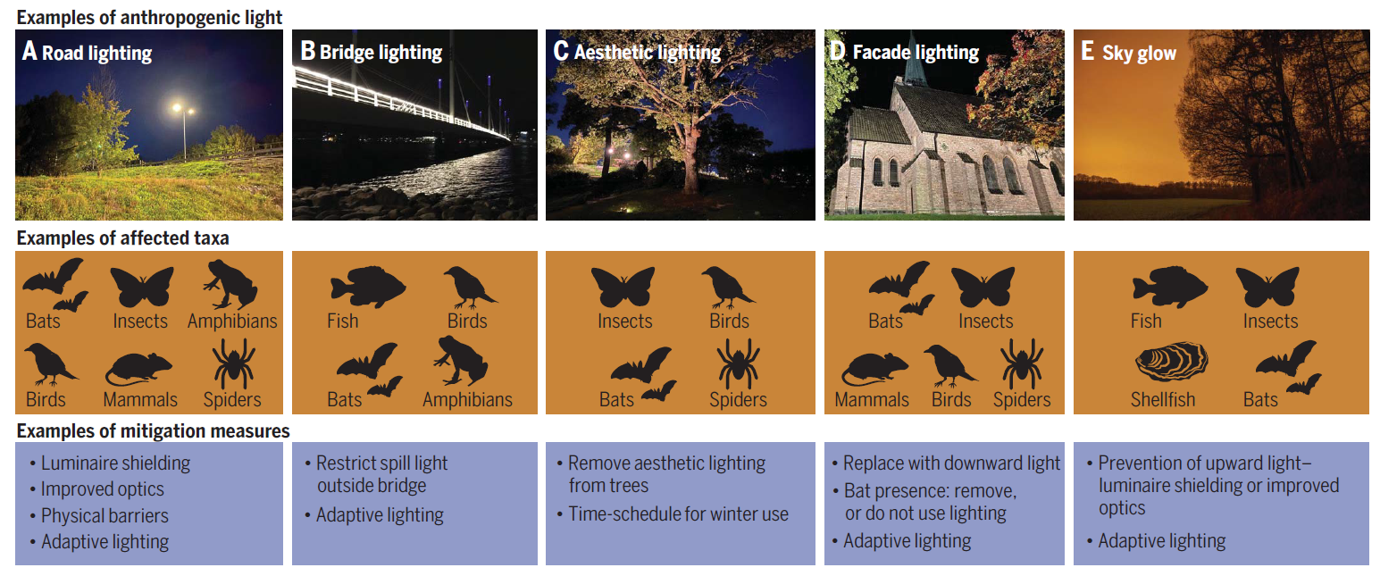
ALAN = Artificial Light At Night
“Effects of anthropogenic light on species and ecosystems” -- Annika K. Jägerbrand and Kamiel Spoelstra, Science: Light Pollution Special Issue 2023

Slide 33
ALAN: Plants, Crops, Trees
The study found three main effects of lighting on soybean plants:
development delays,
yield reduction, and
height increase.
This study was done with typical High-pressure Sodium lights!
LEDs are expected to make the problem worse.

Slide 34
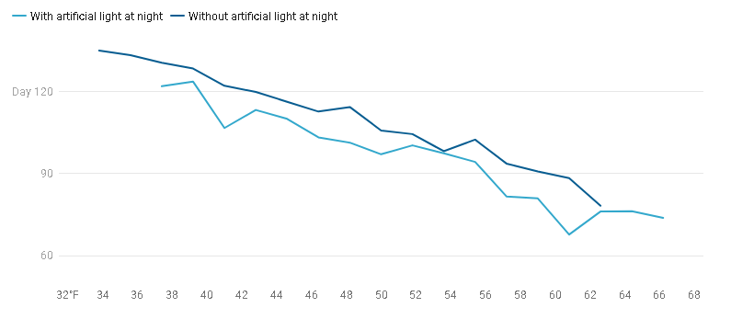
ALAN: Plants, Crops, Trees
Days
Meng et al., 2022
https://academic.oup.com/pnasnexus/article/1/2/pgac046/6569705
Temperature
ALAN profoundly disturbs the natural cycles of light and darkness that plants rely on to leaf out.
The date of breaking leaf buds advances and coloring of leaves is delayed.
In a warmer and brighter night future, breaking leaf buds will continue to shift earlier, but the coloring of leaves will show a more complex response.

Slide 35
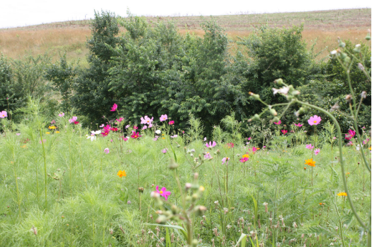
Role of Pollinators in Nature
Virtually all of the world’s seed plants need to be pollinated.
This is just as true for cone-bearing plants, such as pine trees on Alpine peaks, as for the more colorful and familiar flowering plants we see around us in Missouri.
Pollen, looking like insignificant yellow dust, bears a plant’s male sex cells and is a vital link in the reproductive cycle.
With adequate pollination, wildflowers:
Reproduce and produce enough seeds for dispersal and propagation
Maintain genetic diversity within a population
Develop adequate fruits to entice seed dispersers
https://www.youtube.com/watch?v=chvXwNbs3SA

Slide 36
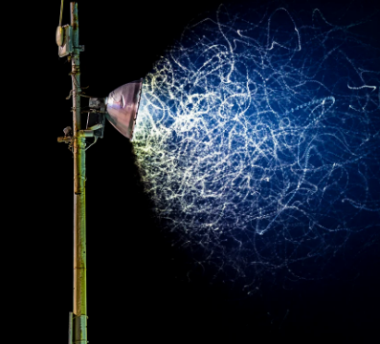
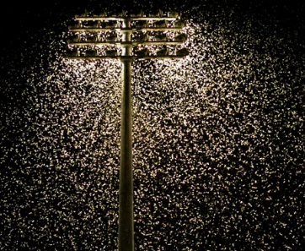
Pollinators and ALAN
Moths, including sphinx or hawk moths, are especially common and diverse nocturnal pollinators.
Nocturnal pollinators use natural light from the stars and moon in the night sky to navigate.
This light-seeking behavior draws them to artificial light where they become confused and trapped.
Artificial light leaves pollinators exposed, making them easier to spot and reducing their ability to see these predators.
Turn off unneeded lights whenever possible and shade windows during the twilight hours.
https://www.pollinator.org/

Slide 37
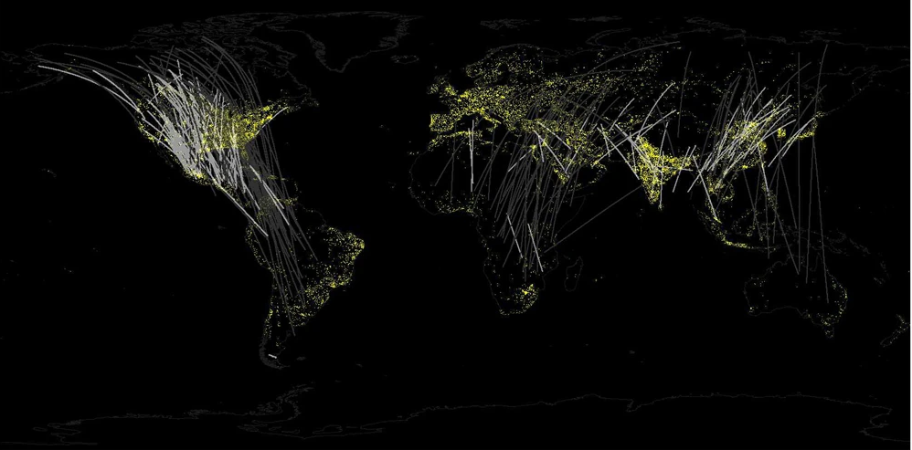
Birds and ALAN: Bird Migration

Slide 38
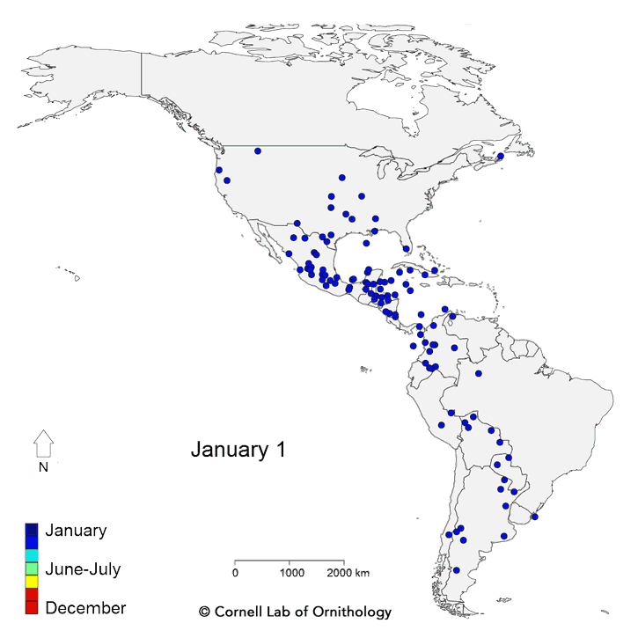
ALAN And Bird Migration
Twice each year, billions of birds fly between wintering and breeding grounds, facing innumerable threats along the way.
“Live” bird migration maps!
https://birdcast.info/migration-tools/live-migration-maps/
https://www.allaboutbirds.org/news/mesmerizing-migration-watch-118-bird-species-migrate-across-a-map-of-the-western-hemisphere/

Slide 39
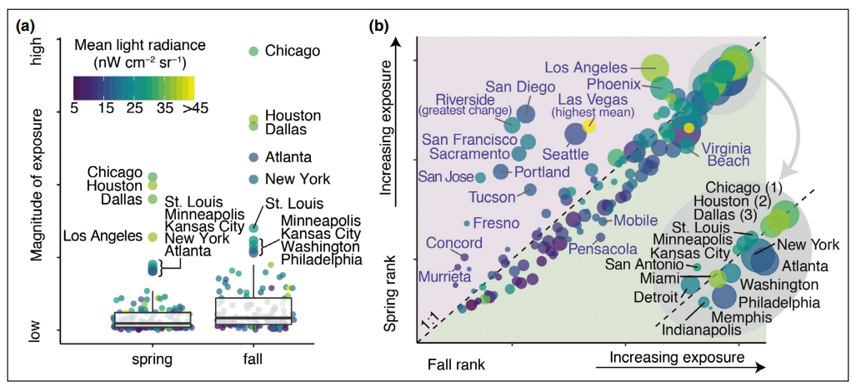
ALAN And Bird Migration (Horton et al., 2019)
Seasonal (a) magnitude and (b) relative rankings of the 125 largest urban areas in the continental US. Point color shaded by the mean light radiance and sizes (in [b]) are scaled by the square root of urban area. Inset in (b) depicts the top 15 (spring or fall) rankings

Slide 40
Birds at Night (Horton et al., 2019)
Of the nearly 630 terrestrial species of birds regularly occurring in North America, approximately 70% are considered migratory, and of these more than 80% migrate at night.
Trillions of flying organisms (eg birds, bats, insects) occupy the airspace within the troposphere during different periods of their annual cycles.
The recent recognition of airspace as vital habitat – one that is subject to increasing modification by humans – highlights the fundamental need to understand how organisms cope with such alterations.
Positive phototaxis is of particular concern for the conservation of migrating birds. Bright lighting in cities can become a beacon to some species, drawing them away from their migratory routes.

Slide 41
ALAN And Bird Migration
Why do land birds migrate at night?
Birds’ instinct to migrate is largely influenced by sudden shifts in temperature, available daylight (photo period), moon phases and light tail winds.
The evaluation of land bird migration has determined that flying conditions for long-distance travel are most favorable under the cover of darkness.
These favorable conditions include less potential for predation, cooler temperatures to help maintain body temperature and less inclement weather.

Slide 42
Birds at Night (Horton et al., 2019)
FLAP estimates that in Canada, approximately 25 million birds die due to bird collisions with buildings.
The Smithsonian reported that collisions likely kill between 365 million and 1 billion birds annually in the United States, with a median estimate of 599 million.
Homes and other buildings one to three stories tall accounted for 44 percent of all bird fatalities, about 253 million bird deaths annually
Larger, low-rise buildings four to 11 stories high caused 339 million deaths
And high-rise buildings, 11 floors and higher, kill 508,000 total birds annually.
https://flap.org/
https://abcbirds.org/

Slide 43
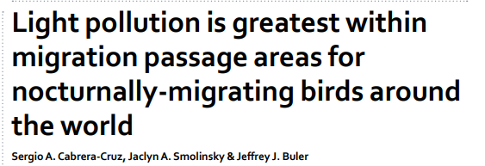
Birds at Night (Cabrera-Cruz et al., 2018)
“Our results suggest that migratory birds may be subject to the effects of light pollution particularly during migration, the most critical stage in their annual cycle. We hope these results will spur further research on how light pollution affects not only migrating birds, but also other highly mobile animals throughout their annual cycle.”

Slide 44
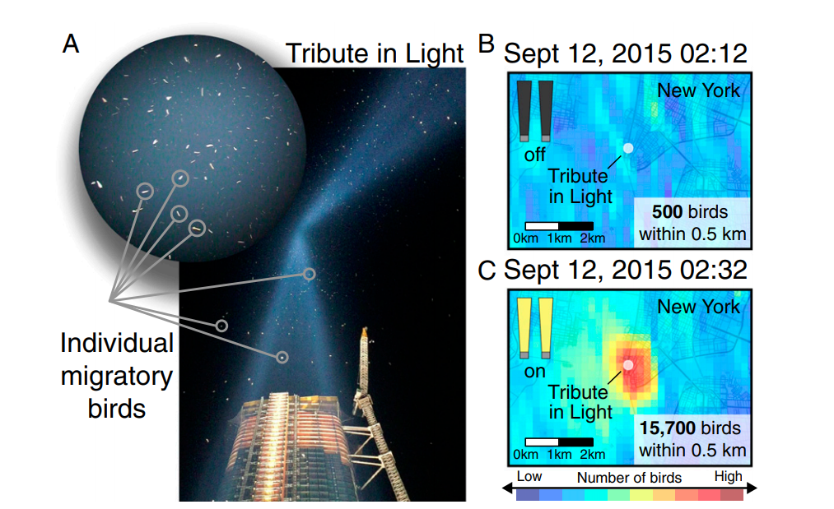
ALAN And Bird Migration Example: 9/11 Tribute in Light site.

Slide 45
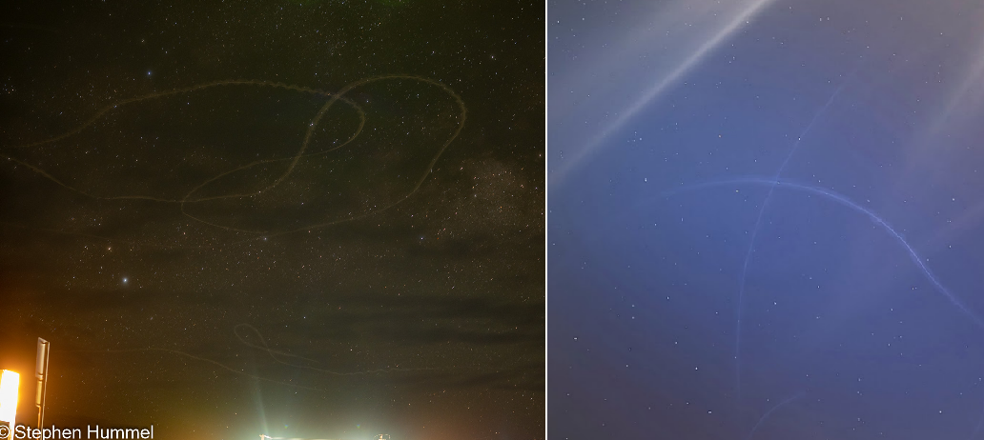
ALAN And Birds
Birds trapped in light domes near Big Bend National Park (left) and Kirksville, Missouri (right)

Slide 46
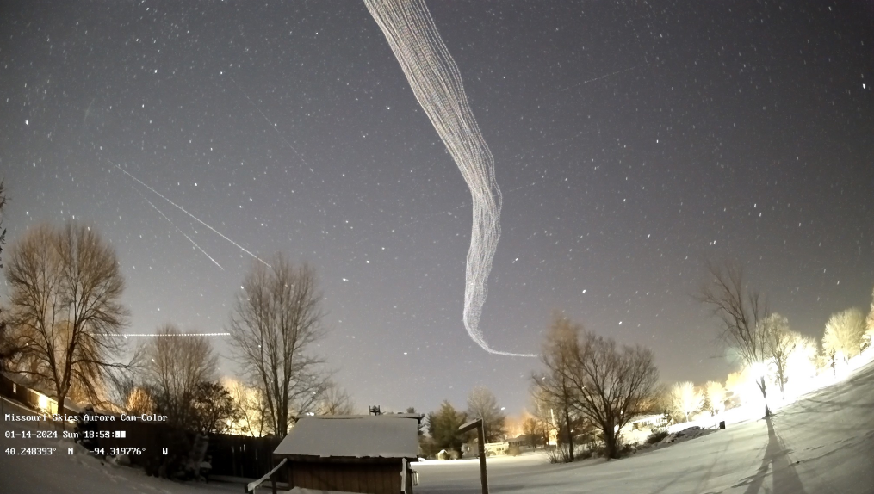
ALAN And Birds
Birds belly’s are lit up by upward pointing light (and also due to reflection off the snow). These birds should be “invisible” at night, but are not.
Picture Credit: http://www.missouriskies.org/

Slide 47
ALAN and Natural Cycles of Darkness

Slide 48
ALAN And Bird Migration
So, ALAN is completely disrupting the cycles associated with moon-phase, since cloudy nights in cities mimics clear nights with Moonlight vis-à-vis sky brightness, which could severely confuse migratory birds.
Also note that birds tend to follow waterways and rivers on their migration routes, and these are locations were humans tend to settle as well.
For example: STL, KC, Chicago, Minniapolis, Memphis, Baton Rouge, New Orleans are only a few cities along just the Mississippi river!
Cities = High-rise buildings and lots of light pollution, and this is not good for migrating birds ☹

Slide 49
One Example, Chicago: October 2023
https://birdcast.info/news/major-collision-event-in-chicago-4-5-october-2023

Slide 50
Summary
What is Light Pollution?
Quantity and Quality (Directionality, Intensity, color)
Why fight light pollution?
Human health and safety
Ecology and Environment
Outdoor Lighting Practices
Technical solutions
Color, Shielding, Timers
Public Outreach & Awareness
Laws and Ordinances
As Naturalists, you already have the skills and passion to address one or more of these aspects.
There are citizen science opportunities to quantify both the extent of light pollution, and its affects on living things.
There are opportunities to use demos, presentations, brochures, signage etc. to increase awareness about light pollution, and its harmful effects.

Slide 51
Reading Recommendations

Slide 52
Websites of Interest
https://www.bigbenddarkskyreserve.org/
https://flagstaffdarkskies.org/
https://extension.usu.edu/iort/cp-darkskies/
https://darksky.org/what-we-do/darksky-approved/products-companies/
https://darkskymissouri.org/
https://darkskymissouri.org/get-involved/take-dark-sky-training
https://www.softlighthouston.com/gallery
https://darksky.truman.edu/
https://darksky.org/resources/public-outreach-materials/
https://www.zotero.org/groups/2913367/alan_db
https://www.science.org/toc/science/380/6650
https://www.rasc.ca/sites/default/files/publications/JRASC-LPA-Special-Issue-lr.pdf

Slide 53
Lighting products
I have these in my kitchen, kids' bedrooms, and bathrooms as just ambient light. We have additional lights when we are cooking, for example:. Lumen level is low – so this is not meant to be a reading light or such. But it gives the room a nice warm-amber glow as i get the kids ready for bed, and i am telling them stories etc. https://www.amazon.com/Neporal-Equivalent-Blocking-Healthy-Nursery/dp/B08P5M8KHY
I have these in my labs at school, use them for demos, and in my study area at home: https://www.amazon.com/Cree-Lighting-Connected-Compatible-CMA19-60W-AL-9ACK-B3/dp/B09XYXVZH9 You need to install an app on your phone, and need wireless network to connect for the first time. Programmable to change color and intensity, but i usually just do it based on what we are doing. I have it on amber light when i am on my computer, and if the kids are playing or we are reading etc., i set it on "white light".
These are yellow lights – similar to the "bug lights" that have been around. Slightly more blue content than option 1 above, but still pretty good. I don't use these simply because i already have the above two. I do have a bunch of these that i give away or use for demos in my lab: https://www.amazon.com/LOHAS-LED-Equivalent-Lighting-Decorative/dp/B0CPDS4VLV

Slide 54
Reducing Light Pollution
The technical solutions to light pollution are rather straight-forward: minimize use of outdoor light, direct it where it is needed, and use amber/red light instead of blue-white light.
The bigger challenge is to overcome individual and institutional inertia and make people change their habits.
This requires dark sky advocates to take the initiative and engage the public to create awareness about the issues involved, and to move people to act and demand change [bottom-up approach].
Additionally, dark sky advocates need to talk to administrators and lawmakers to help them pass laws and ordinances that prohibit the unnecessary and indiscriminate use of outdoor lights [top-down approach].

Slide 55
What can I do?
Audit of your property/neighborhood https://www.darksky.org/wp-content/uploads/bsk-pdf-manager/2020/01/Home-Lighting-Assessment-Print.pdf
Use dark sky friendly lighting at your home and business https://www.darksky.org/our-work/lighting/lighting-for-industry/fsa/fsa-products/
Advocate for a lighting ordinance in your town https://www.darksky.org/our-work/lighting/public-policy/lighting-ordinances/

Slide 56
What can I do?
Explore the darkskymissouri.org website and get involved https://www.darkskymissouri.org/
Watch ‘Saving the Dark’ Documentary by Sriram Murali (55 mins) https://www.youtube.com/watch?v=6fHxNn-FEnc
Participate in the Globe at Night (GaN) program https://www.globeatnight.org/

Slide 57
Extra Slides

Slide 58
Sky Brightness Measurement

Slide 59
Examples: Motels
Bluff Dwellings Resort & Spa Bluff, Utah

Slide 60
ALAN And Bird Migration: Mitigation Efforts
So, when it comes to bird migration light pollution is a problem – but high rise buildings are a particularly urgent problem that needs to be fixed.
The National Audubon Society is an American non-profit environmental organization dedicated to conservation of birds and their habitat.
The Audubon Society has teamed up with the Dark Sky International (DSI) on the “Lights-Out Program” aimed at creating awareness about bird-migration and to implement mitigation efforts to minimize the dangers posed by LP and high-rise buildings to birds.
https://www.audubon.org/ lights-out-program
https://www.lightsoutheartland.org/

Slide 61
Lights-Out Program: How to Contribute?
Turn off exterior decorative lighting
Extinguish pot and flood-lights
Substitute strobe lighting wherever possible
Reduce atrium lighting wherever possible
Turn off interior lighting especially on higher stories
https://www.audubon.org/lights-out-program

Slide 62
Lights-Out Program: How to Contribute?
Substitute task and area lighting for workers staying late or pull window coverings
Down-shield exterior lighting to eliminate horizontal glare and all light directed upward
Install automatic motion sensors and controls wherever possible
When converting to new lighting assess quality and quantity of light needed, avoiding over-lighting with newer, brighter technology.
https://www.audubon.org/lights-out-program

Slide 63
What can I do?
Audit of your property/neighborhood https://www.darksky.org/wp-content/uploads/bsk-pdf-manager/2020/01/Home-Lighting-Assessment-Print.pdf
Use dark sky friendly lighting at your home and business https://www.darksky.org/our-work/lighting/lighting-for-industry/fsa/fsa-products/
Advocate for a lighting ordinance in your town https://www.darksky.org/our-work/lighting/public-policy/lighting-ordinances/

Slide 64
What can I do?
Explore the darkskymissouri.org website and get involved https://www.darkskymissouri.org/
Watch ‘Saving the Dark’ Documentary by Sriram Murali (55 mins) https://www.youtube.com/watch?v=6fHxNn-FEnc
Participate in the Globe at Night (GaN) program https://www.globeatnight.org/

Slide 65
Summary
Most obvious and measurable symptom of LP is skyglow: Skyglow affects close to 80% of all people on the planet, and about 99% of US/European peoples.
You can help quantify light pollution via the GaN program and/or the Missouri SQM program.
Most of the quantifying methods we have seen measure skyglow: how much light is finding its way into the night sky?

Slide 66
Summary
Glare affects most of us, most commonly in the context of vehicle head-lights and/or bright LEDs mounted sideways on walls and/or Electronic Billboards
LED lights, due to greater directionality, cause greater glare.
Harder to quantify the effects of glare in terms of color, and its effects on “recovery time” of eyes.
Severity of glare is related largely to the dosage (how bright?).

Slide 67
Summary
Light Pollution is an increasing problem – urban sprawl and the increasing use of “inexpensive” LED lights is expected to make the problem worse.
“inexpensive” is doing a lot of heavy-lifting here
The inability to see stars is a symptom of the problem.
The real problem is the harm done to the ecological health, and the negative impact of LP on birds, pollinators, insects, and humans.

Slide 68
Why combat Light Pollution? The Circadian Rhythm
https://www.youtube.com/watch?v=BKQH6T1DZvI

Slide 69
The Circadian Rhythm

Slide 70
ALAN And Wildlife
Active at night, roost by day.
Some species are rare, threatened and endangered species.
Some species provide human and ecological health benefits.
Some species provide economic benefits
What are the effects of light pollution on their habitat and behavior?

Slide 71
ALAN & Habitat Disturbance Observations
Disruption of natural day-night illumination cycle in natural areas.
Replacement of nocturnal (night) cycle by elevated levels of continuous artificial lighting over broad natural areas.
Greatest exposure of terrestrial habitats is mostly under tree canopy and over ground level areas, which is the preferred zone of most terrestrial wildlife inhabitation.
Aquatic habitats subject to light trespass from upland and shoreline human habitation. Water surface reflections magnify light pollution.
Light pollution in wildlife habitats mimic extended daylight conditions causing wildlife behavior to be unnaturally modified.
Exposure of wildlife circadian rhythms to light pollution.
Wildlife biodiversity at risk in light polluted nocturnal habitats.
Diminished habitat function (e.g., shelter, protection, food).

Slide 72
COMMONLY OBSERVED EFFECTS OF HARMFUL POLLUTANTS
Behavior
Growth
Reproduction
Survival
Death
Habitat Modification
Pollutant Environmental Fate
Population Effects

Slide 73
Similarities between Chemical and Light Pollution
Organism Impact Chemical* Light** LP Examples
Human Exposure yes yes urban/industrial settings
Wildlife Exposure yes yes urban/industrial settings
Abnormal behavior yes yes migrations, attraction/avoidance
Growth yes yes plants, cancer cells
Reproduction yes yes mammals, amphibians
Survival yes yes sea turtles, birds
Death yes yes sea turtles, birds
* Sufficient data generated by studies on numerous chemicals.
** Insufficient data; repeated observations of incidences and correlation to
presence of artificial lighting.

Slide 74
Similarities between Chemical and Light Pollution
Chemical Light Examples
Habitat Modification yes yes coastal ecosystems*
Population Effects yes yes sea turtles, birds
Pollutant Environmental Fate persistent persistent ubiquitous in urban/
or short-lived industrial environments
Ecological Imbalance yes yes coastal ecosystems *
Environmental Restoration*** expensive$$$ cheap$ Florida coasts**
Cedar River, WA****
Restoration benefits long term immediate Florida coasts**
Cedar River, WA****
* = Chesapeake Bay
** = Sea turtle nesting habitats
*** = See next slide for explanations
**** = See ‘fish slide ‘– sockeye salmon habitat

Slide 75
Environmental Restoration Comparison “Cleaning the Problem Up”
Hypothetical scenario – compare 10 acres of land in watershed environment contaminated by either hazardous chemicals or light pollution
Chemical Pollution ($$$$$$$$$$$$$$$)
Source – residual presence may persist after source is eliminated
Environmental noncompliance fines
Civil/criminal litigation costs
Remediation/clean-up/disposal costs
High Manpower/equipment costs
Chemical Monitoring/recovery costs
Long term recovery usually required
Certain conditions may impede full recovery
Public and wildlife health could potentially continue to be impacted after restoration.
Light Pollution ($)
Source – on/off; no residual presence after source is eliminated
Planning and design costs
Equipment retrofit costs
Disposal/recycle of old equipment
Less manpower/equipment demand
Low/no monitoring requirement
Short term recovery anticipated
Minimum impediment to full recovery
Public and wildlife health could potentially be significantly improved after restoration.

Slide 76
LOOKING AT THE TOP OF THE FOOD CHAIN
HUMAN HEALTH IMPACTS
A MODEL FOR WILDLIFE EXPOSURE?
Circadian rhythms set to natural cycle of day and night
Light controls body’s internal clock or “circadian rhythm”
Immune System is circadian
Correlation between low melatonin levels and cancer in humans
Wildlife in or near urban areas may have more exposure to light pollution than humans
What are the physiological effects of light pollution on wildlife?
Could possible physiological changes resulting from light
pollution exposure result in the decline of wildlife species?

Slide 77
PUBLIC POLLUTION REGULATION
Chemical pollution tightly regulated by public law and multiple agencies
Light pollution is not regulated by environmental agencies.
Most agencies and many environmental interest groups are dead asleep on the issue
The States of Florida, for example, has set the precedent to regulate outdoor lighting strictly for wildlife conservation purposes.

Slide 78
PUBLIC POLLUTION REGULATION
Agencies put the burden on local governments to control light pollution.
WRONG APPROACH!!!!!
Light pollution needs the same attention as
chemical pollution
Environmental agencies need to address light pollution as a regional ecosystem and wildlife management approach.
Examples: Chesapeake Bay Program
Florida Everglades Program
Great Lakes Program

Slide 79
Specific Example of ALAN
Affecting Insects and Pollinators

Slide 80
Bird Migration and FLAP
https://flap.org/
Fatal Light Awareness Program (FLAP) Canada is a registered Canadian charity widely recognized as the pre-eminent authority on the bird-building collision issue.
Each year in Canada, around 25 million migratory birds die as a direct result of collisions with buildings.
We can only expect that number to grow unless we all work together to help mitigate local biodiversity loss through urban development that considers wildlife species.
For almost 30 years, FLAP Canada has engaged millions of people with dozens of campaigns and initiatives with one goal: keep birds safe from deadly collisions with buildings.

Slide 81
Preventing Birds Hitting Buildings
Apply markings in a dense pattern, leaving no gaps more than 5 cm by 5 cm (2 inches by 2 inches). If gaps are any larger, birds may try to fly through them and still hit the window.
Apply markings to the outside surface of the glass, NOT the inside. Reflections of trees or sky on the outside of the window may render any internal window markings invisible.
Markings must be of high contrast so that they stand out on the window. Markings with poor contrast, for example black dots on a very dark window, might not be noticed by birds.
Each marking should be no less than 6 mm (1/4 inch) in diameter.
Markings must cover the entire surface of the glass.
https://flap.org/stop-birds-from-hitting-windows/

Slide 82
Dark Skies: Resources
Dark Sky Heritage: Stargazing, myths, constellations, loss of night
https://figuresinthesky.visualcinnamon.com/
https://stellarium.org/
https://www.lightpollutionmap.info/
https://facstaff.bloomu.edu/mshepard/star_deck/star_deck_uses.htm
Darkness and Human wellbeing (see https://www.rasc.ca/lpa/resources and the publicly accessible google-drive linked there)
Circadian Rhythm
Direct glare
Darkness at night: Impact on living beings: Trees, Birds and bird migration; Insects and pollinators
https://academic.oup.com/pnasnexus/article/1/2/pgac046/6569705
https://flap.org/
https://birdcast.info/
https://www.lightsoutheartland.org/
Solutions & Resources:
Big Bend Dark Sky Reserve: https://www.bigbenddarkskyreserve.org/lighting-tips-and-tricks
Colorado Plateau Dark Skies: https://extension.usu.edu/iort/cp-darkskies/
Flagstaff Dark Sky Coalition: https://flagstaffdarkskies.org/
DarkSky Texas: https://darkskytexas.org/

Slide 83
ALAN And Bird Migration: References
https://www.audubon.org/lights-out-program
https://www.audubon.org/news/four-decades-building-strike-records-point-super-collider-birds
https://www.darksky.org/light-pollution-poses-threat-to-migrating-birds/
https://flap.org/
https://flap.org/wp-content/uploads/2019/11/US-Fish-and-Wildlife-Best-Practices.pdf
https://www.nature.com/articles/s41598-018-21577-6.pdf
https://birdcast.info/

