Slide 1
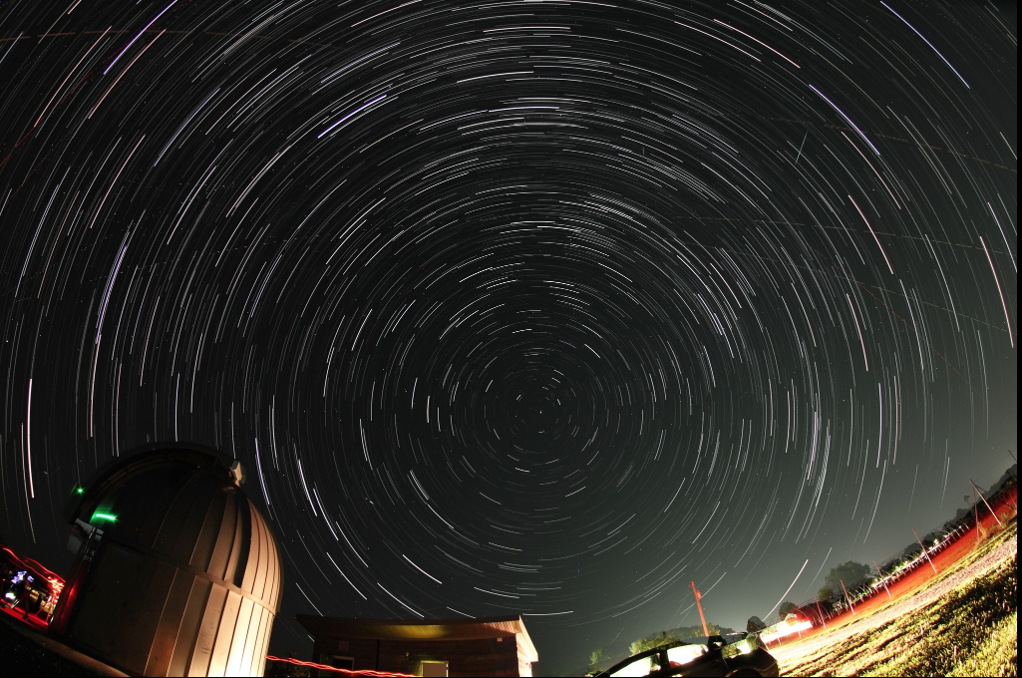
Let there be night
7th June 2024 Advanced Training
Vayujeet Gokhale @Vayujeet, @darkskyTSU
Truman State University

Slide 2
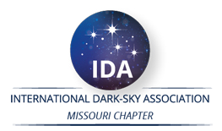
Summary
What is Light Pollution?
Quantity and Quality (Directionality, Intensity, color)
Why fight light pollution?
Human health and safety
Ecology and Environment
Outdoor Lighting Practices
Technical solutions
Color, Shielding, Timers
Public Outreach & Awareness
Laws and Ordinances
As Master Naturalists, you already have the skills and passion to address one or more of these aspects.
There are citizen science opportunities to quantify both the extent of light pollution, and its affects on living things.
There are opportunities to use demos, presentations, brochures, signage etc. to increase awareness about light pollution, and its harmful effects.

Slide 3
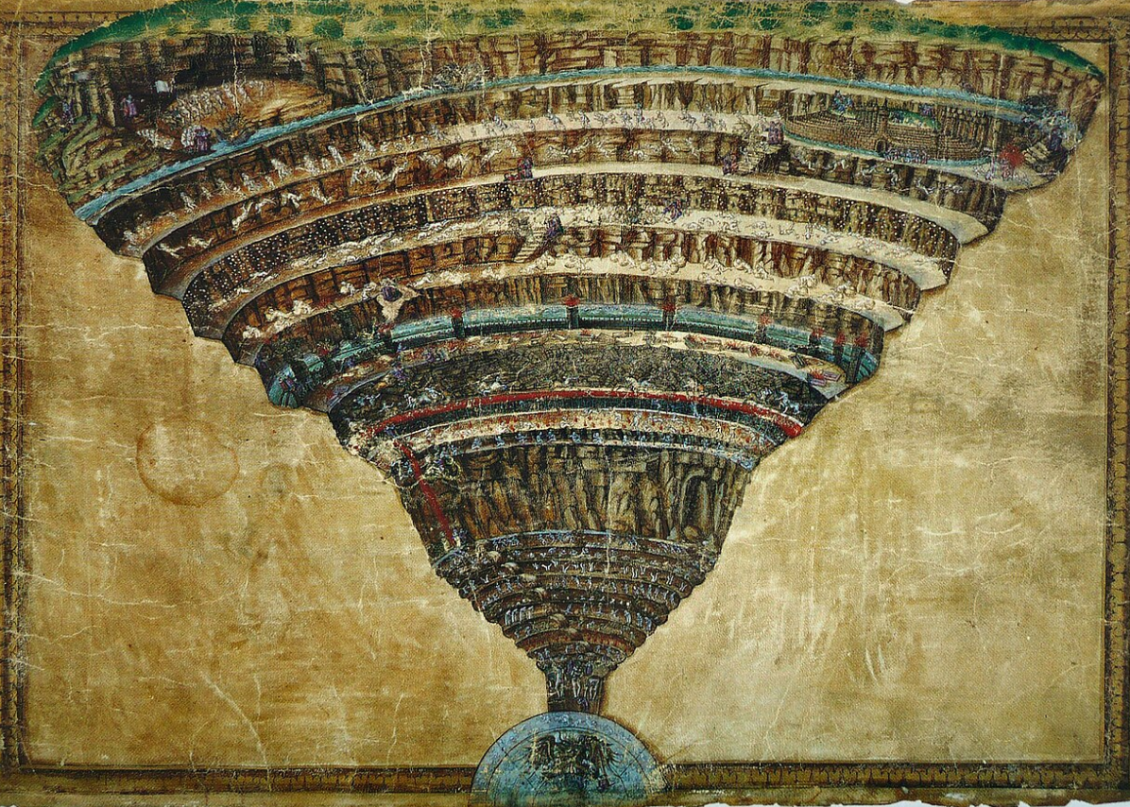
Dark Sky Advocacy
What is the value of darkness at night?
Why do we need Artificial Light at Night (ALAN)?
What is the problem?
Why should I care?
What are the technical solutions?
What can I do?
What is the problem (again!)?
Who else to recruit?
Let there be night…
Source: Wikipedia

Slide 4
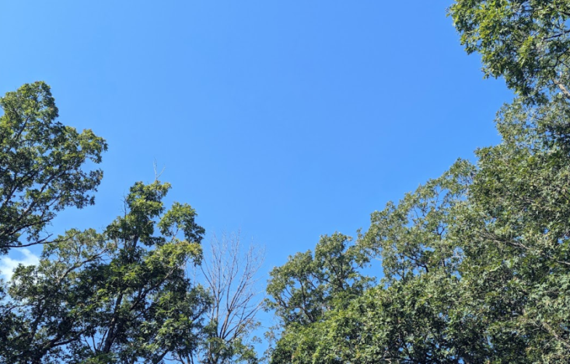
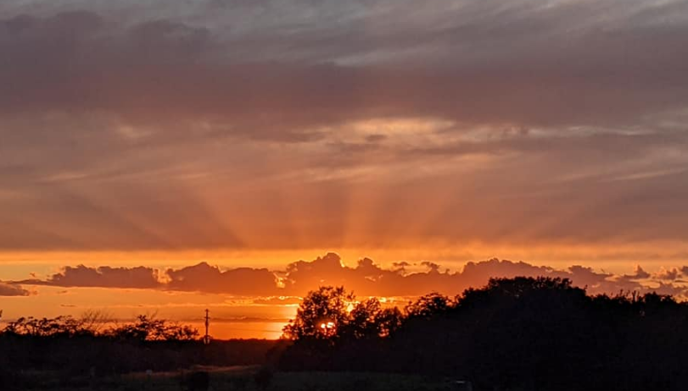
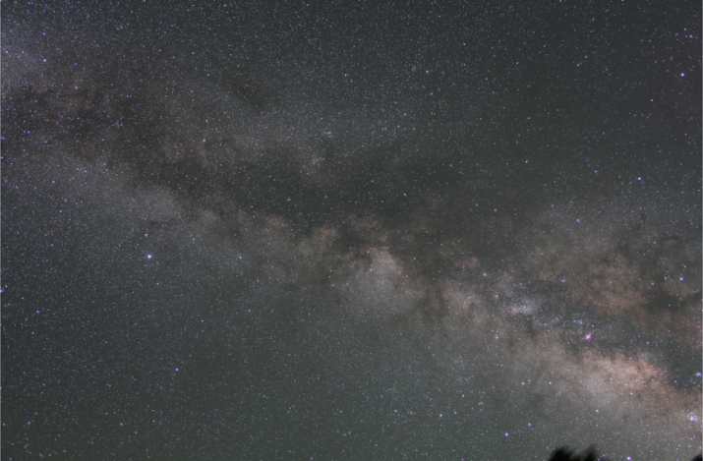
Discussion Topic 0: Discuss the value of darkness at night
“…shadows from the starlight,
softer than a lullaby…”

Slide 5
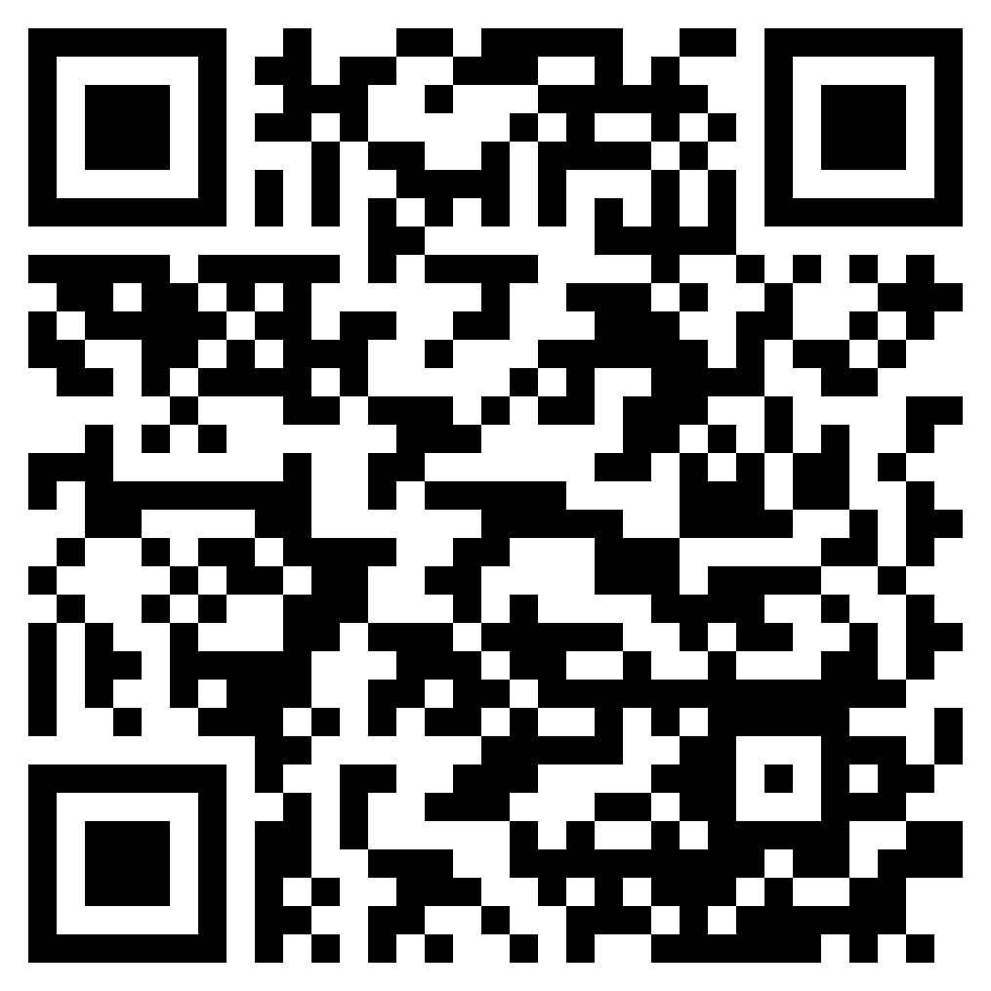
!! BECOME A MEMBER OF DARK SKY Missouri!!

Slide 6
!! BECOME DARK SKY ADVOCATES !!
FACEBOOK: DARKSKYMISSOURI

Slide 7
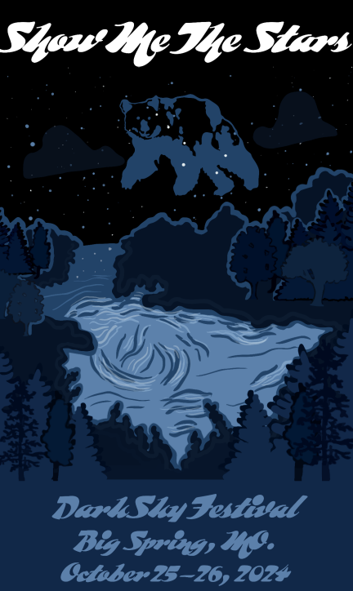
Nature Walks!
Float on the River!
Fishing!
Booths featuring DarkSky Missouri, Audubon Society, Master Naturalists!
Star Party!!
THIS IS A FREE EVENT!
Oh My….

Slide 8
Discussion Topic I Where and How would you include the impact of (“bad” and “good”) ALAN into your role as a Naturalist?

Slide 9
What can I do?
…the brightest lights cast the darkest shadows.

Slide 10
Advanced Training & Volunteer Opportunities
Nature and Extent of the Problem [Education and Interpretation]
Solutions to ALAN: Five Principles of Good lighting [Stewardship]
Outreach and Educational Ideas and Resources [Education and Interpretation, Citizen Science]
Experience the night sky

Slide 11
Advanced Training & Volunteer Opportunities
Dark Sky Heritage:
Stargazing,
Myths and constellations
Demonstrations and Handouts:
Skyglow during Stargazing events,
Direct glare (Intensity of light and directionality of fixture),
Light Color using color-changing LED lights,
Educational programs including night hikes, nocturnal wildlife inventories using night cams,
Post park notices about light pollution and its effects on wildlife in the area.
Quantifying Light Pollution (Citizen Science)
Globe at Night,
Surveys and inventories,
Satellite data (for bad weather days/nights).
!!ADOPT A PARK!!

Slide 12
Darkness at night is a natural resource LED technology can be a force for “good”, but mindless outdoor lighting practices means that we are losing darkness at night rapidly.
Light Pollution: Any adverse effect or impact attributable to use of ALAN

Slide 13
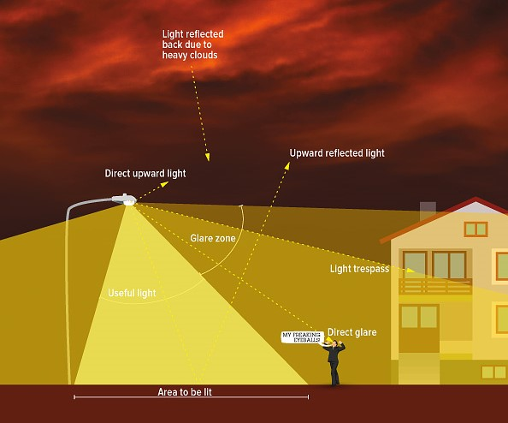
Types of Light Pollution [ALAN = Artificial Light At Night]
Color?
Photo Credit: DarkSky International
Directionality?
Utility?
Intensity

Slide 14
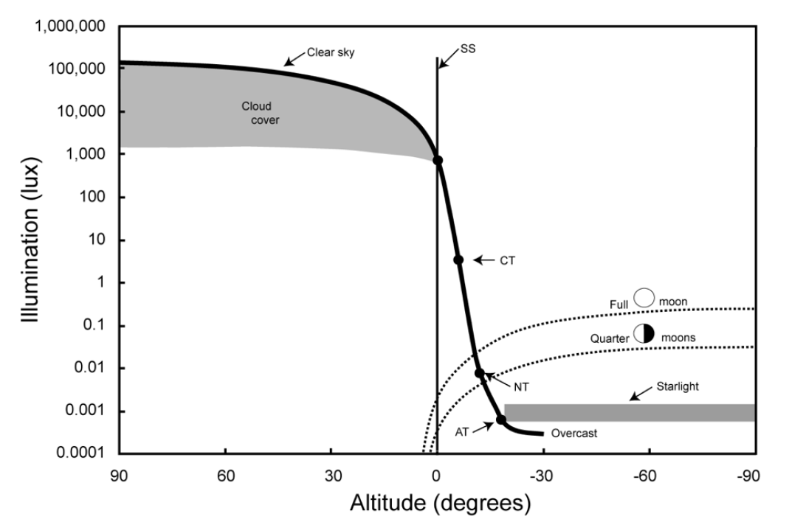
Natural Illumination Night and Day
Urban Lighting
Parking Lots
Credit: T. Longcore
Billboards
Urban Parks
Sky Glow
Dark Sky International: State of the Science 2023, John Barentine

Slide 15
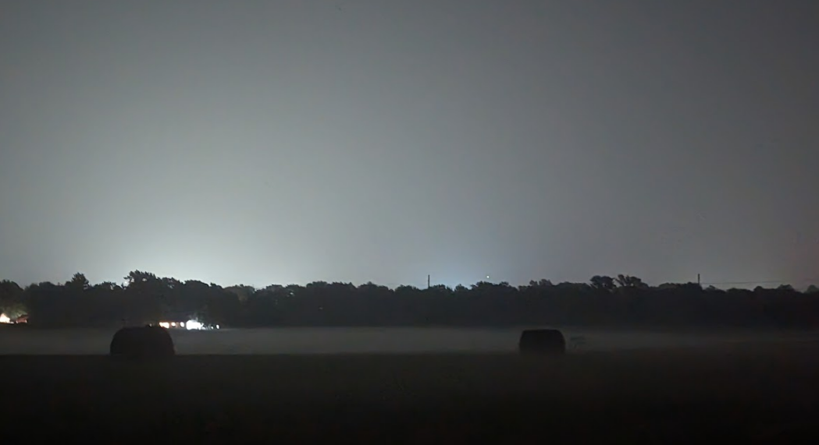
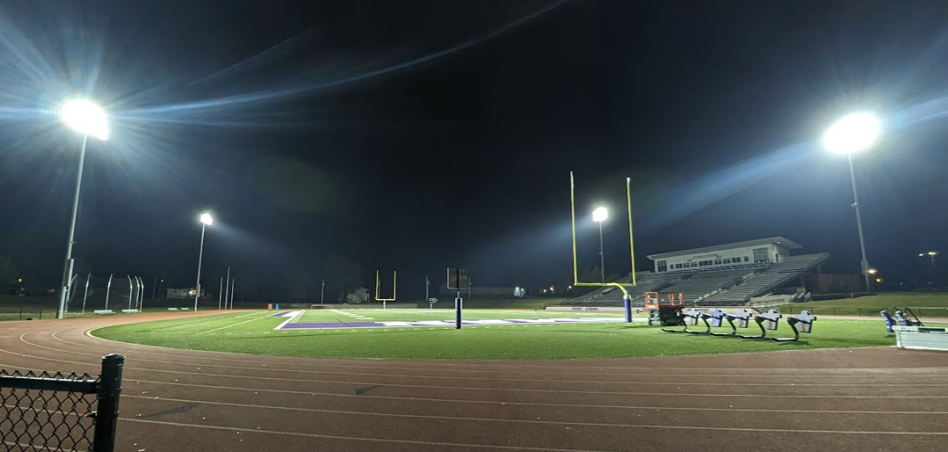
Quantifying Sky Brightness
Unshielded, bright blue-white lights lead to sky glow.
Sky Glow is measured in terms of “sky brightness”.
Between the swan and Hercules, Where even dark clouds glow…

Slide 16
Measuring Sky Brightness in terms of the Limiting Magnitude (i.e. faintest star you can see unaided)
The Globe and Night Network
https://www.globeatnight.org/

Slide 17
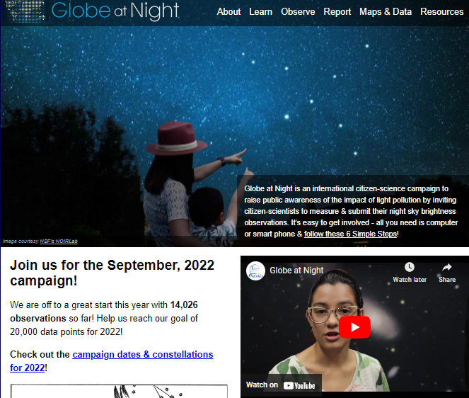
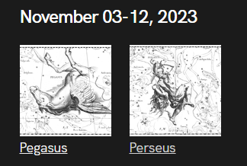
Globe at Night
Click here
https://www.globeatnight.org/

Slide 18
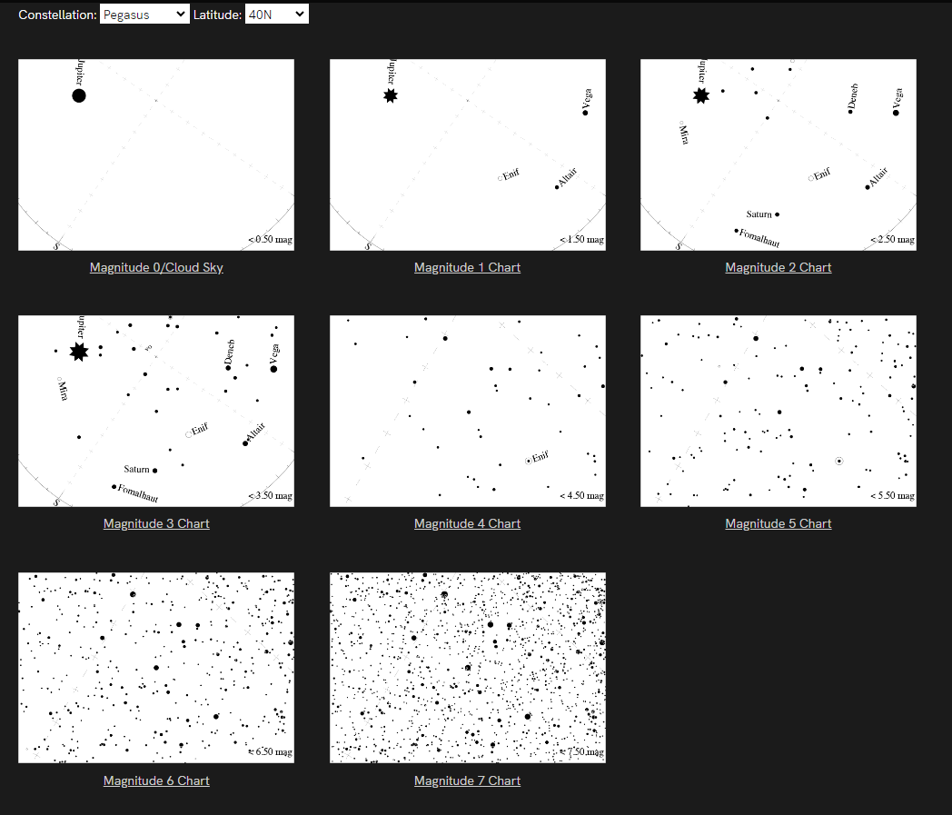
GaN: What does your sky look like?
Choose appropriate latitude (40-degrees is good for most of Mo)

Slide 19
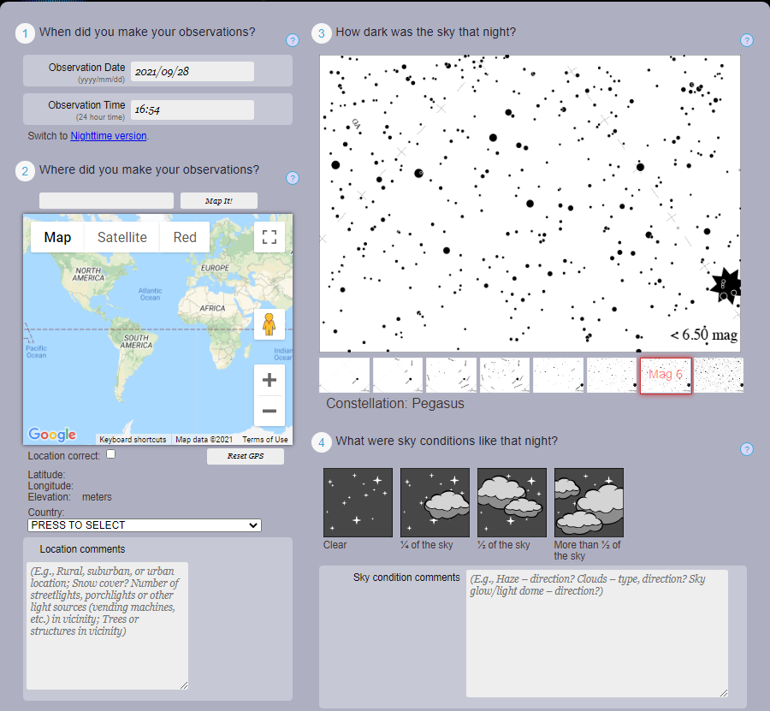
GaN: Report

Slide 20
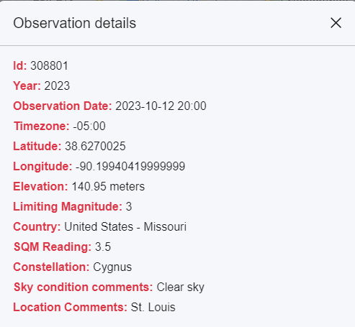
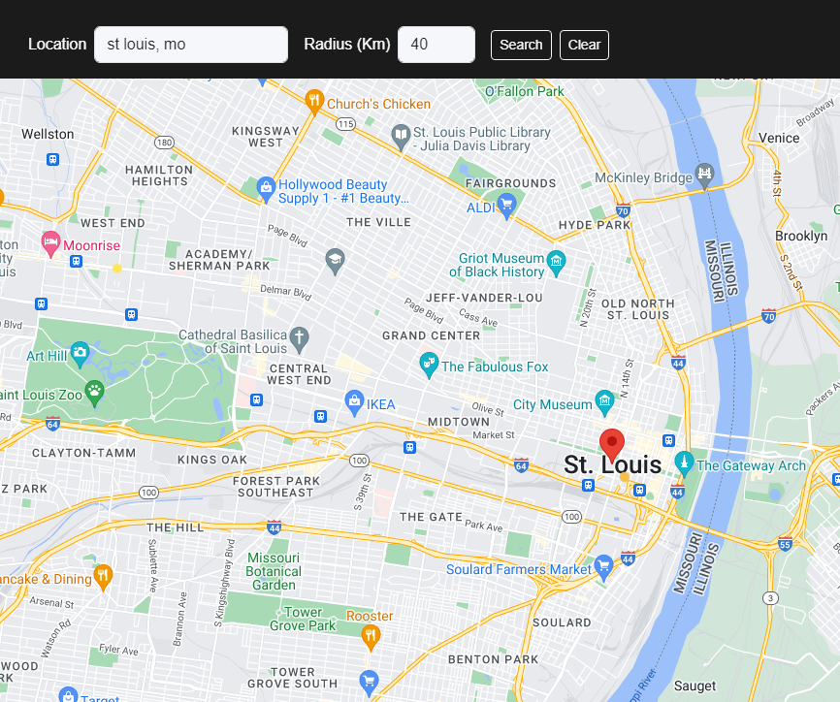
GaN: View your report!
https://app.globeatnight.org/map

Slide 21
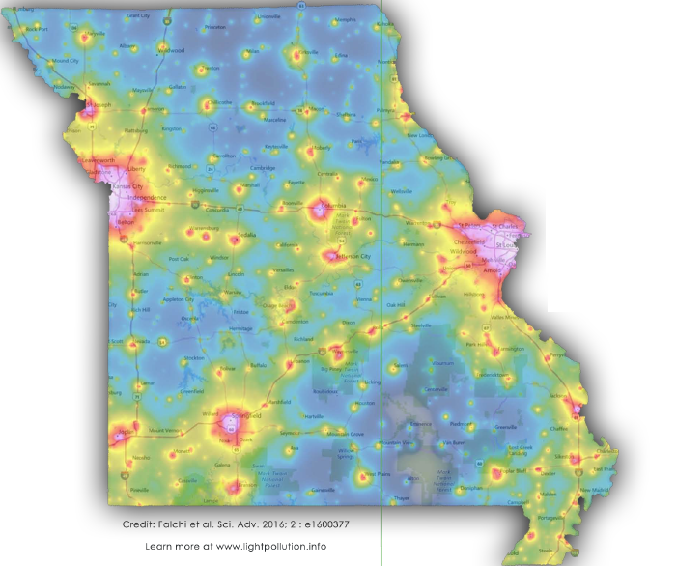
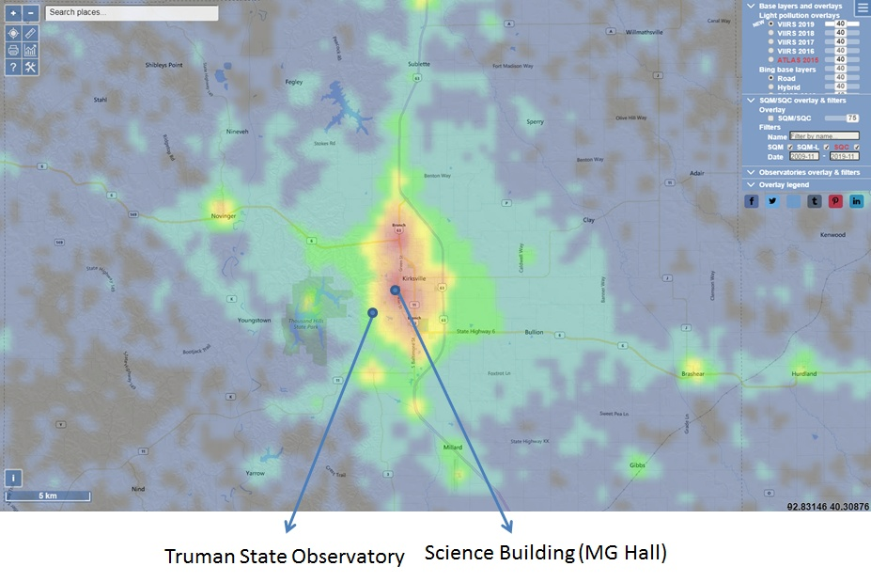
Satellite Maps
Light Pollution map of the World: https://www.lightpollutionmap.info/

Slide 22
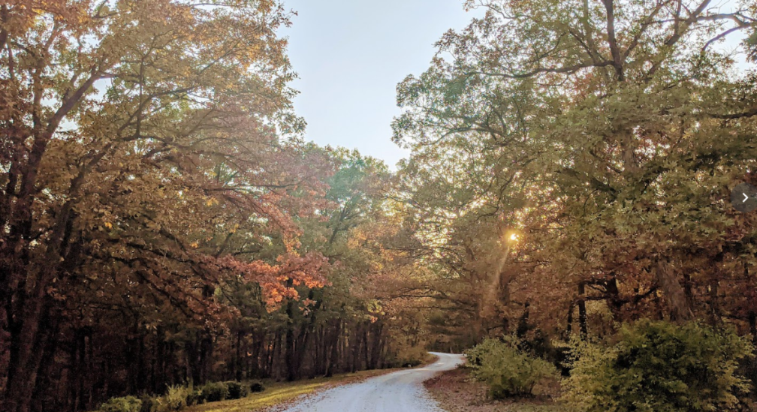
!! CHALLENGE !!
Identify a favorite location that you can access both day and night, preferably in a natural environment.
For the selected location, spend one hour in the day and one hour after nightfall. For each experience, document:
The date, time, and location of your visit
Your experience (both natural and manmade):
The type of light that you see.
What you see in the sky, on earth, and activity around you.
Sounds that you hear.
Smells.
How you feel.

Slide 23
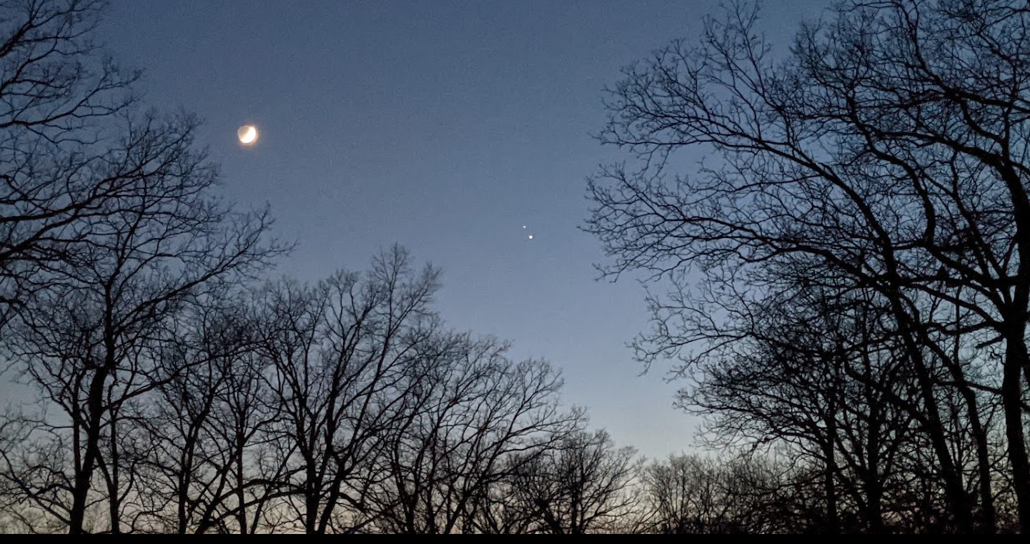
!! CHALLENGE !!
Write a short summary (less than one page) that compares your day and nighttime experience. Send the summary to Don Ficken at dficken@darkskymissouri.org
https://darkskymissouri.org/images/webinar/MMNChallenge.pdf

Slide 24
Why do we need Artificial Light At Night (ALAN)?
The problem and the solution

Slide 25
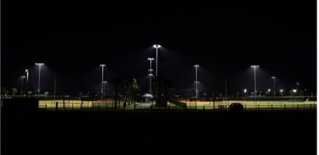
Purpose of Outdoor Lighting
Enhance safety for people,
Improve security for property,
Aesthetic value,
Economic development.
Common Applications
Roadway and street lights,
Parking lots,
Sports fields,
Housing complexes,
Residential,
Downtown areas,
Malls and shops,
Gas stations & car dealerships,
Parks,
Electronic Billboards, etc.

Slide 26
We do need artificial light at night: it serves many useful purposes.
The problem and the solution
So what is the problem…?

Slide 27
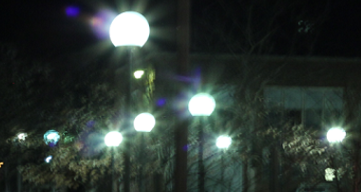
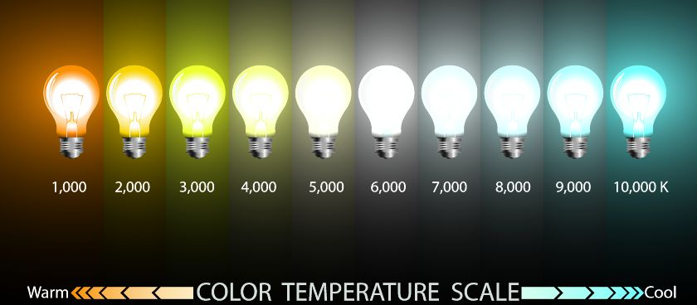
Mindfulless Use of Light
Bad Lighting Fixtures
Light Trespass
Glare
Sky Glow
Efficient lighting and Overconsumption
Too many light fixtures (clutter)
Too much light (Lumen levels)
Light Color

Slide 28
Natural Illumination Night and Day
Urban Lighting
Parking Lots
Credit: T. Longcore
Billboards
Urban Parks
Sky Glow
Dark Sky International: State of the Science 2023, John Barentine

Slide 29
Light Color and Spectrum
The problem and the solution
Starry Starry night,
Paint your palette amber and red…

Slide 30
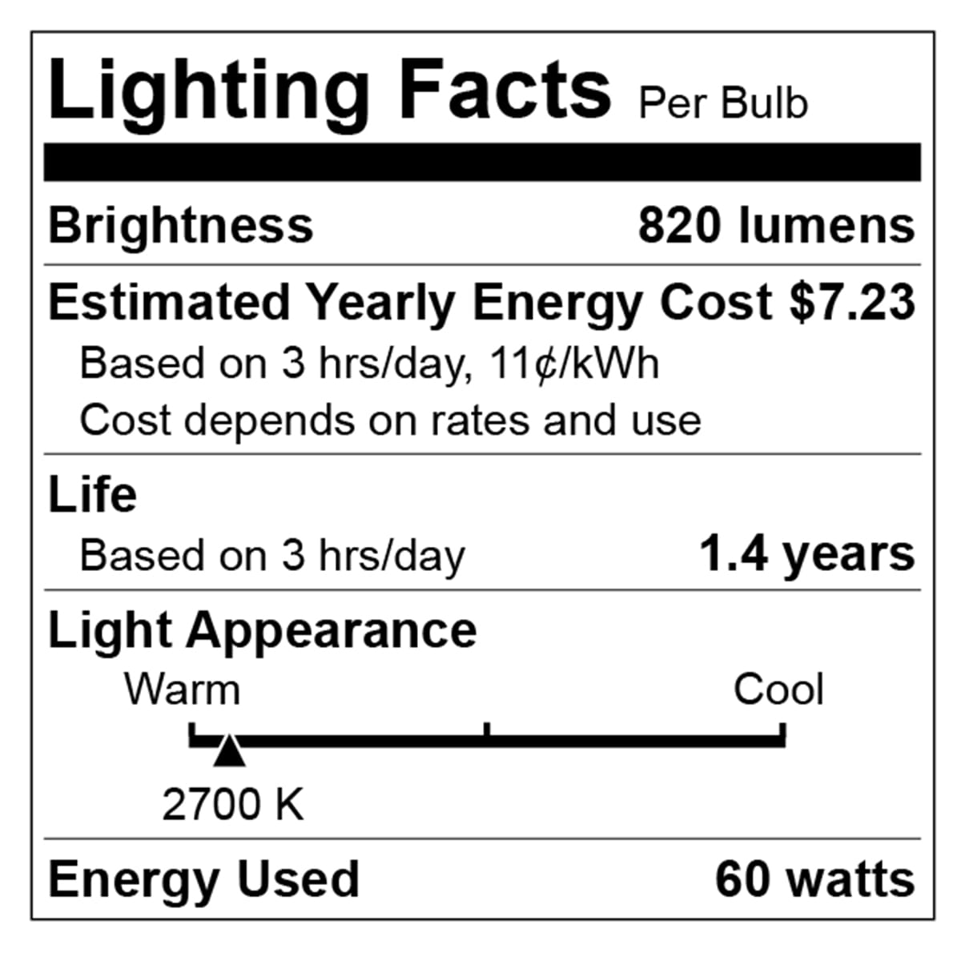
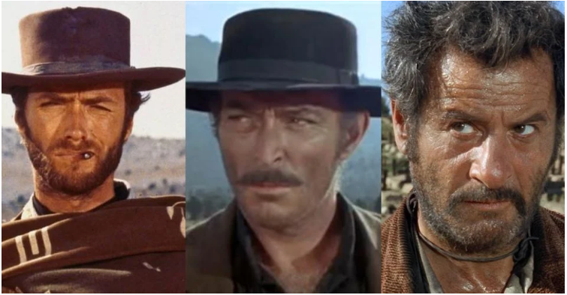
Light Intensity and Color are both important
For outdoor lighting, aim for 3000 K and below, preferably about 2000 K.
Orange/Red good, yellow bad, blue light ugly

Slide 31
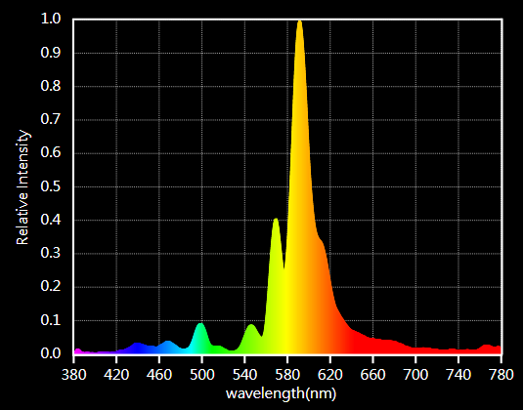
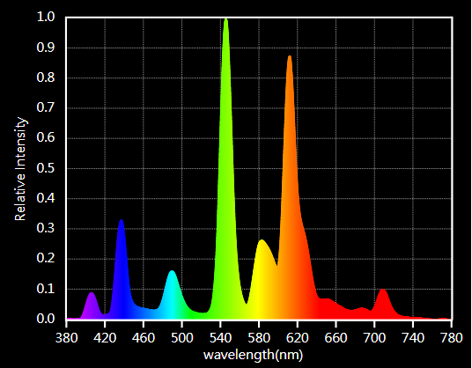
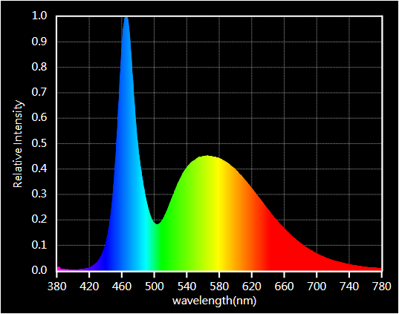
Color is important but check spectrum!

Slide 32
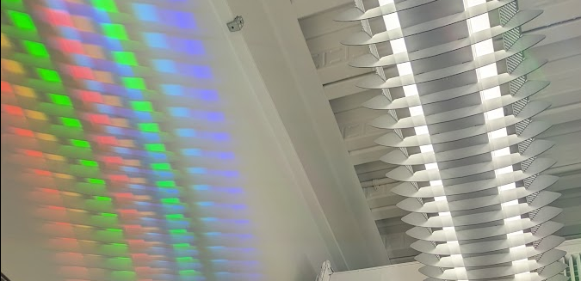
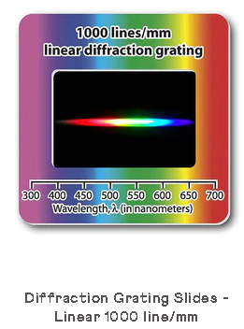
Simple Light Color Demo
https://www.rainbowsymphony.com/collections/diffraction-grating

Slide 33
Fine, so stargazers cannot see the stars due to light pollution. Big deal!
Why should I care…?

Slide 34
Life @ Night

Slide 35
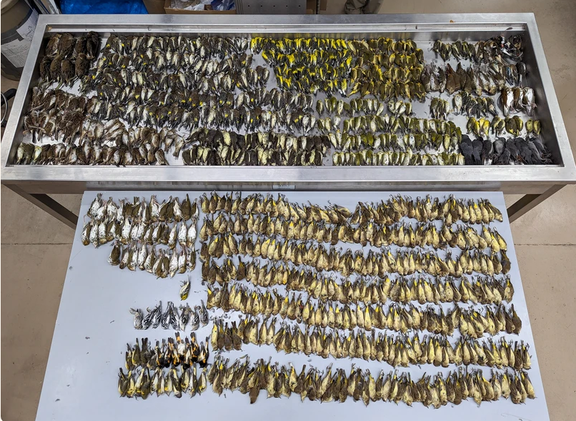
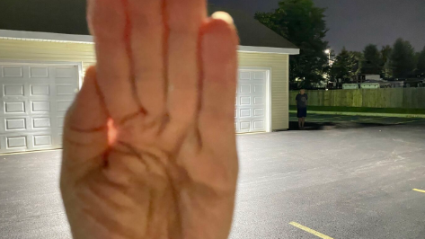
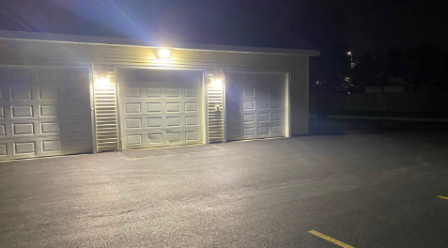
Consequences of Bad Lighting
Human Health and Safety
Circadian rhythm
Vision impaired by Glare
Animal Health
Bird Migration, Sea Turtles
Bees, Fireflies, and other insects
Ecological impact
The Environment
Increased greenhouse emissions
Waste of precious natural resources
Astronomy
Stargazing, astronomy research
Heritage & Aesthetics
Photo: Daryl Coldren/Field Museum

Slide 36
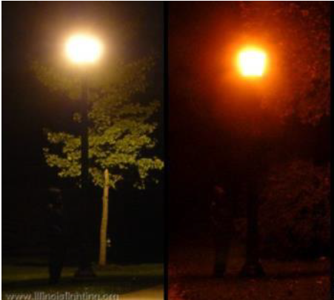
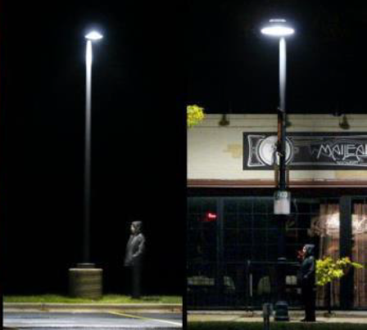
Human Safety
Utah Master Astronomer Handbook
Photographs of four streetlights at night, two unshielded (left), and two fully shielded (right). There is a person standing beneath each light!

Slide 37
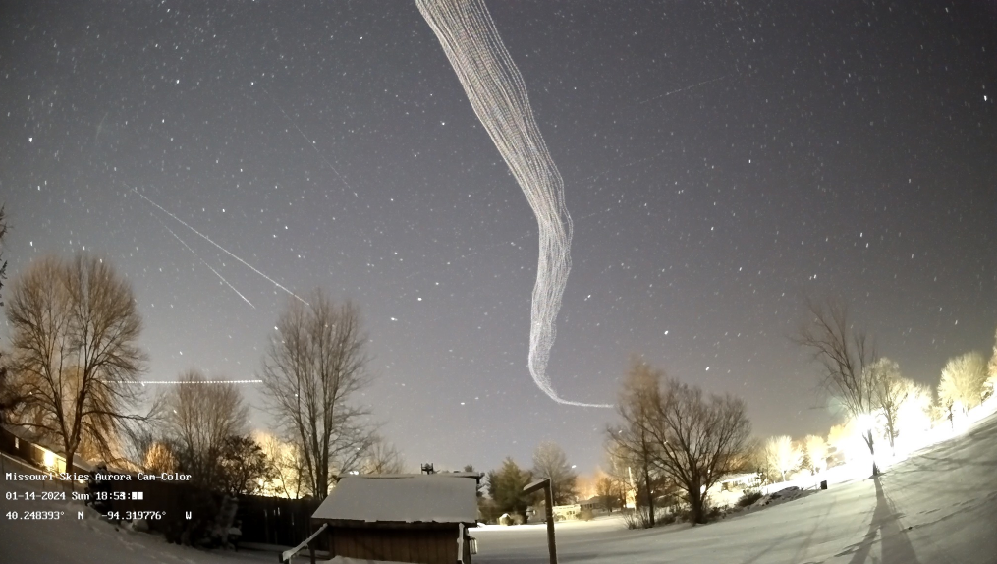
ALAN And Birds
Birds belly’s are lit up by upward pointing light (and also due to reflection off the snow). These birds should be “invisible” at night, but are not.
Picture Credit: http://www.missouriskies.org/

Slide 38
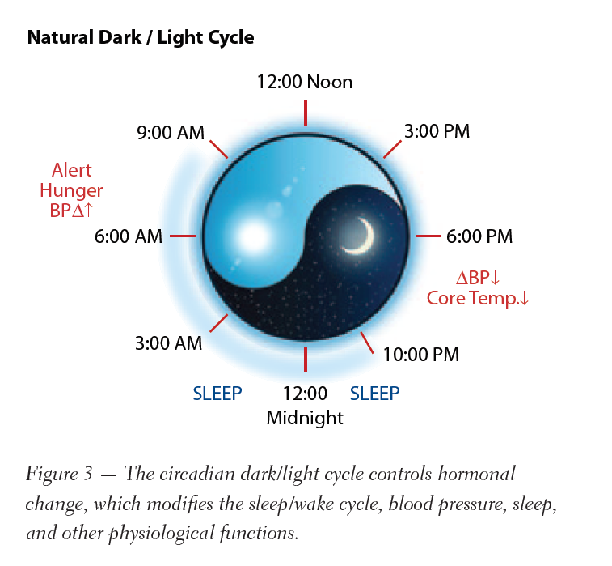
ALAN and Life
ALAN impacts nature in five primary ways:
Orientation/Navigation: Insects drawn to streetlights, migratory birds, turtles to light
Predation: Moths, drawn to streetlights
Competition: Some species adapt better
Reproduction: Flashing signs of fireflies
Circadian Rhythms: Internal processes in birds, fish, insects, plants, mammals etc.

Slide 39
Aah, so not being able to see the stars is only a *symptom* of the problem. The real problem is all this ecological and environmental damage!
What can be done…?

Slide 40
Let there be Night…
…the brightest lights cast the darkest shadows.

Slide 41
Responsible Outdoor Lighting

Slide 42
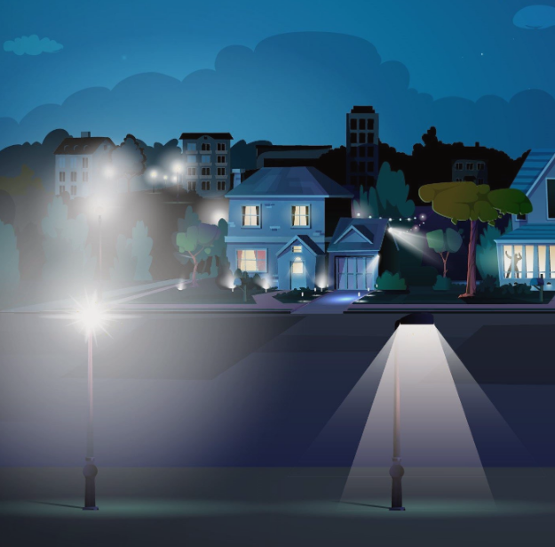
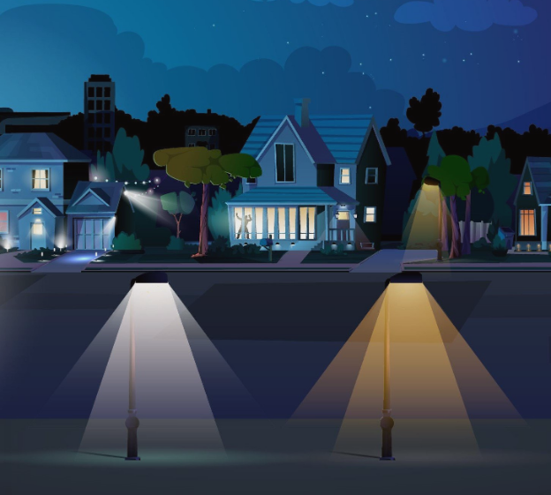
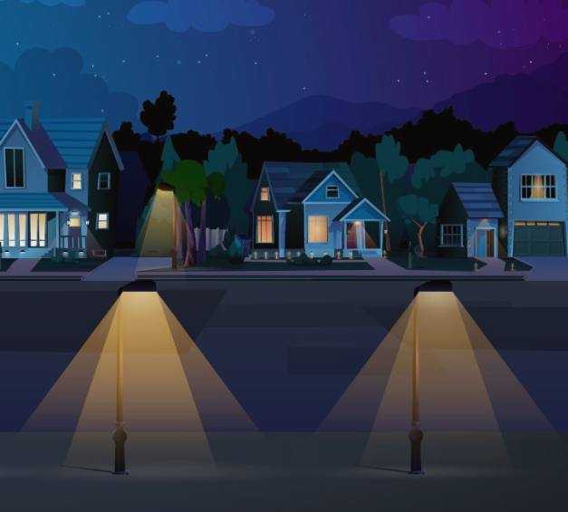
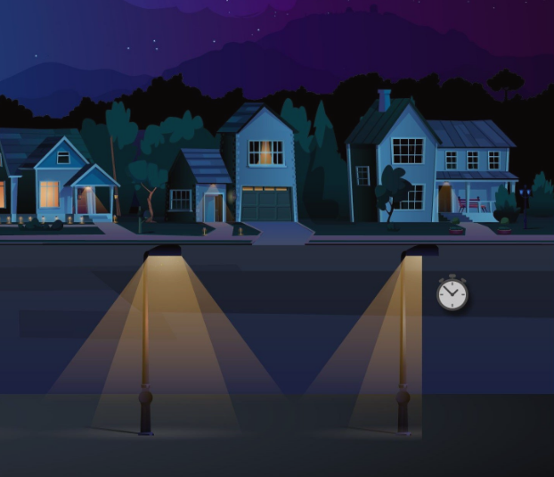
Reducing Light Pollution
Shielding
Color
https://www.bigbenddarkskyreserve.org/lighting
Intensity
Purpose & Timing

Slide 43
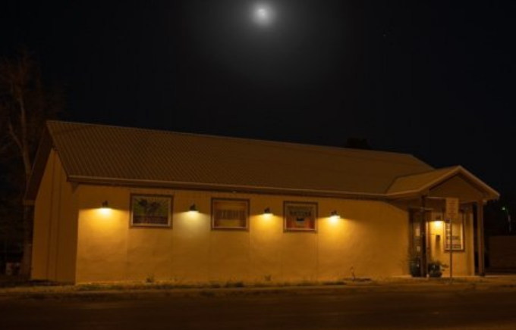
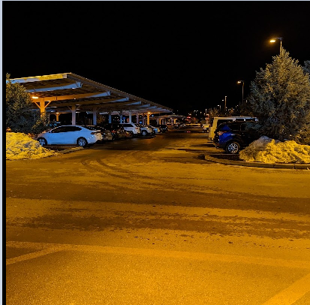
Reducing LP: Real Life Examples
Printco@Alpine, Tx
Walmart @Flagstaff, Az
Oil Tanks@ Balmorhea, Tx

Slide 44
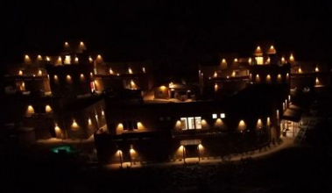
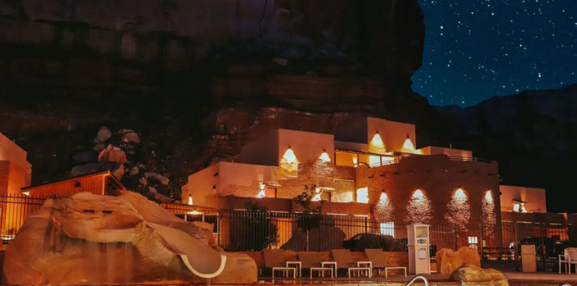
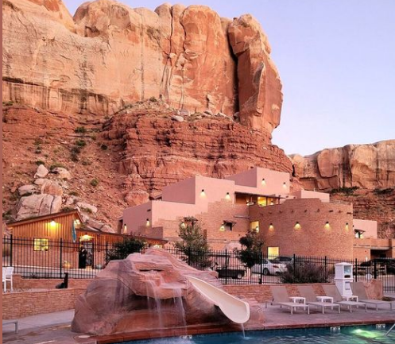
Examples: Motels
Bluff Dwellings Resort & Spa Bluff, Utah

Slide 45
Summary
What is Light Pollution?
Quantity and Quality (Directionality, Intensity, color)
Why fight light pollution?
Human health and safety
Ecology and Environment
Outdoor Lighting Practices
Technical solutions
Color, Shielding, Timers
Public Outreach & Awareness
Laws and Ordinances
As Master Naturalists, you already have the skills and passion to address one or more of these aspects.
There are citizen science opportunities to quantify both the extent of light pollution, and its affects on living things.
There are opportunities to use demos, presentations, brochures, signage etc. to increase awareness about light pollution, and its harmful effects.

Slide 46
Discussion Topic II Discuss the value of darkness at night. List of Actions YOU intend to take to protect this darkness

Slide 47
Extra Slides

Slide 48
Dark Sky Heritage
“…shadows from the starlight,
softer than a lullaby…”

Slide 49
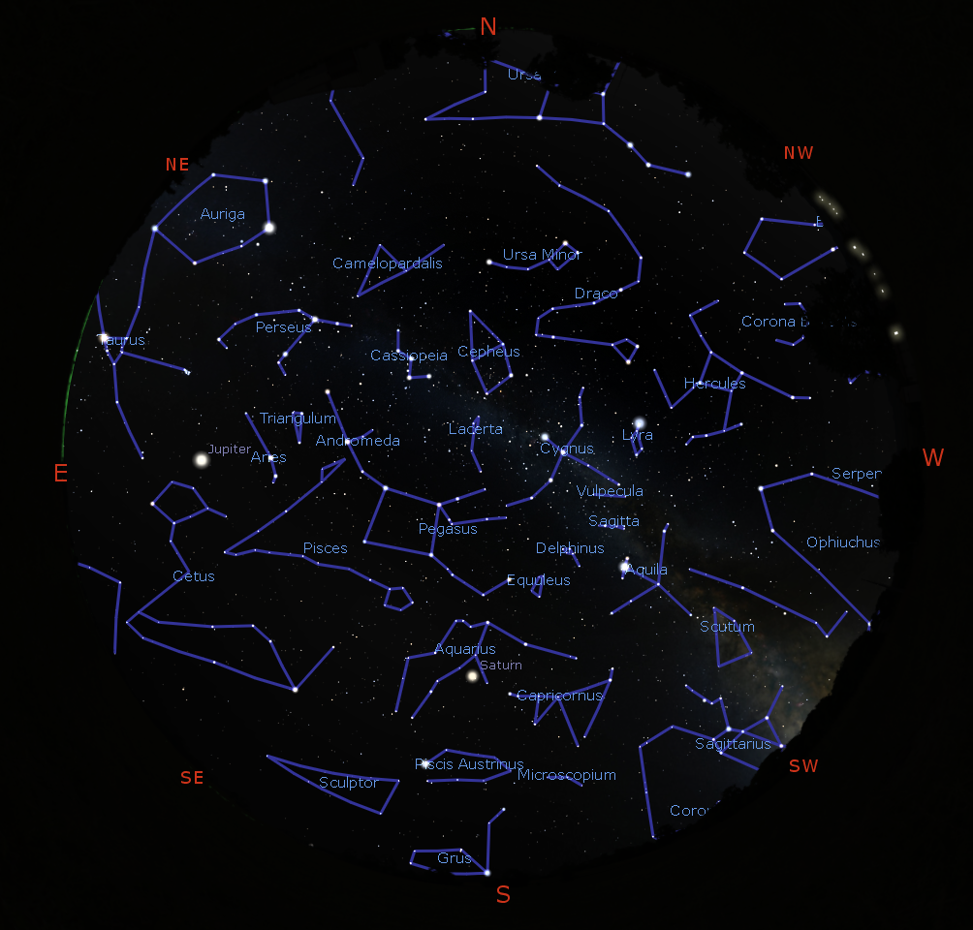
Myths & Constellations
https://stellarium.org/

Slide 50
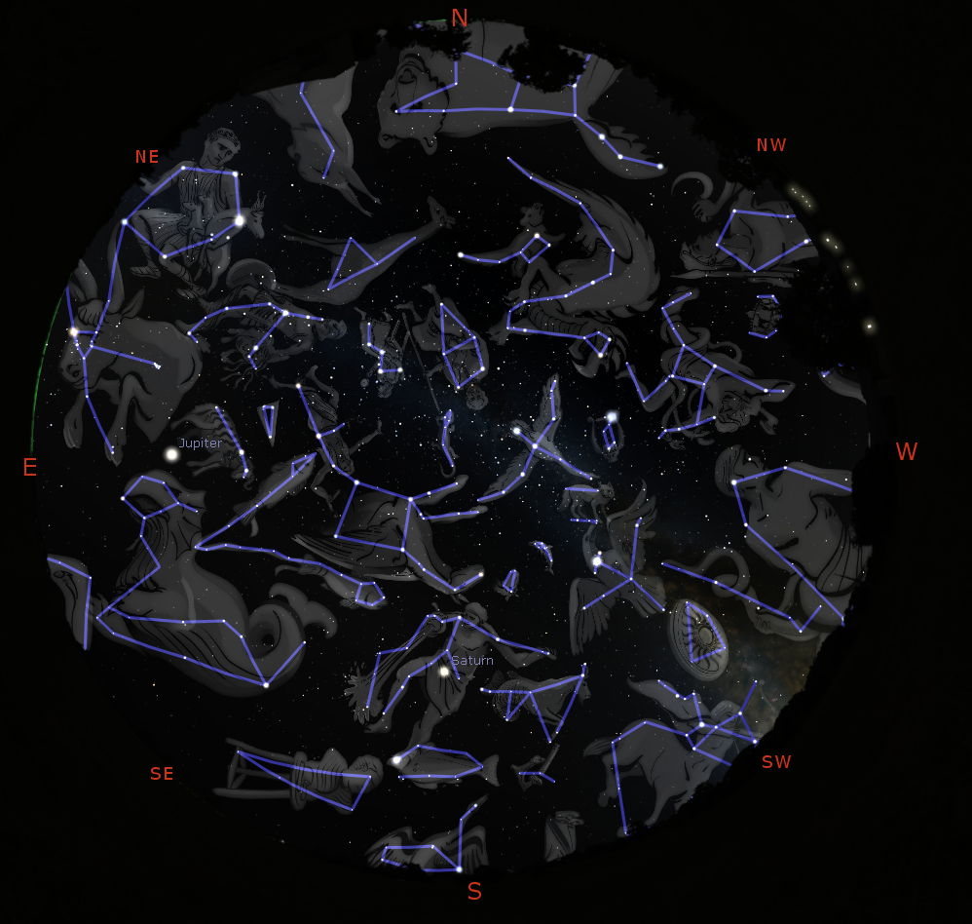
Myths & Constellations
https://stellarium.org/

Slide 51
Myths & Constellations
https://stellarium.org/

Slide 52
Myths & Constellations

Slide 53
Create your own Constellations
https://nightsky.jpl.nasa.gov/docs/ConstellationWorksheet.pdf

Slide 54
Other Nightime Phenomena

Slide 55
Organize Art Projects

Slide 56
Organize Art Projects

Slide 57
Why Combat ALAN? Or How does bad lighting affect living beings?
Let there be night…

Slide 58
Why Combat Light Pollution?
Human Health and Safety
Circadian rhythm
Vision impaired by Glare
Animal Health
Bird Migration, Sea Turtles
Bees, Fireflies, and other insects
Ecological impact
The Environment
Increased greenhouse emissions
Unnecessary waste of precious natural resources
Astronomy
Stargazing, astronomy research
Heritage & Aesthetics

Slide 59
ALAN and Insects
Thousands of moths swarm around floodlights. Photograph: Simone De Peak/Getty Images
Fireflies photobomb the all -sky-camera at the Truman State Observatory

Slide 60
ALAN and Humans
Glare affects most of us, most commonly in the context of vehicle head-lights and/or bright LEDs mounted sideways on walls and/or Electronic Billboards
LED lights, due to greater directionality, cause greater glare.
Harder to quantify the effects of glare in terms of color, and its effects on “recovery time” of eyes.
Severity of glare is related largely to the dosage (how bright?).

Slide 61
ALAN and Humans
Light Pollution is an increasing problem – urban sprawl and the increasing use of “inexpensive” LED lights is expected to make the problem worse.
“inexpensive” is doing a lot of heavy-lifting here
The inability to see stars is a symptom of the problem.
The real problem is the harm done to the ecological health, and the negative impact of LP on birds, pollinators, insects, and humans.

Slide 62
ALAN: Plants, Crops, Trees
The study found three main effects of lighting on soybean plants:
development delays,
yield reduction, and
height increase.
This study was done with typical High-pressure Sodium lights!
LEDs are expected to make the problem worse.

Slide 63
ALAN: Plants, Crops, Trees
Days
Meng et al., 2022
https://academic.oup.com/pnasnexus/article/1/2/pgac046/6569705
Temperature
ALAN profoundly disturbs the natural cycles of light and darkness that plants rely on to leaf out.
The date of breaking leaf buds advances and coloring of leaves is delayed.
In a warmer and brighter night future, breaking leaf buds will continue to shift earlier, but the coloring of leaves will show a more complex response.

Slide 64
Birds and ALAN: Bird Migration

Slide 65
ALAN And Bird Migration
Twice each year, billions of birds fly between wintering and breeding grounds, facing innumerable threats along the way.
“Live” bird migration maps!
https://birdcast.info/migration-tools/live-migration-maps/
https://www.allaboutbirds.org/news/mesmerizing-migration-watch-118-bird-species-migrate-across-a-map-of-the-western-hemisphere/

Slide 66
ALAN And Bird Migration
During the day they rely on the resources available in natural spaces to rest and refuel before taking off again the next night.
However, as they pass over big cities on their way, they can become disoriented by bright artificial lights and skyglow.
ALAN and skyglow around buildings can be fatal to migrating birds:
Some are casualties of nighttime collisions with windows and walls.
Others can circle in confusion until dawn, when they land – potentially without access to critical resources – and are subject to other urban threats.

Slide 67
ALAN And Birds
Birds trapped in light domes near Big Bend National Park (left) and Kirksville, Missouri (right)

Slide 68
Light Pollution, Moon Phase, Clouds
Clear Night
Cloudy night

Slide 69
ALAN And Bird Migration
ALAN is completely disrupting the cycles associated with moon-phase, since cloudy nights in cities mimics clear nights with Moonlight vis-à-vis sky brightness, which could severely confuse migratory birds.
Also note that birds tend to follow waterways and rivers on their migration routes, and these are locations were humans tend to settle as well.
For example: STL, KC, Chicago, Minniapolis, Memphis, Baton Rouge, New Orleans are only a few cities along just the Mississippi river!
Cities = High-rise buildings and lots of light pollution, and this is not good for migrating birds ☹

Slide 70
ALAN And Bird Migration (Horton et al., 2019)
Seasonal (a) magnitude and (b) relative rankings of the 125 largest urban areas in the continental US. Point color shaded by the mean light radiance and sizes (in [b]) are scaled by the square root of urban area. Inset in (b) depicts the top 15 (spring or fall) rankings

Slide 71
ALAN And Pollinators

Slide 72
Role of Pollinators in Nature
Virtually all of the world’s seed plants need to be pollinated.
This is just as true for cone-bearing plants, such as pine trees on Alpine peaks, as for the more colorful and familiar flowering plants we see around us in Missouri.
Pollen, looking like insignificant yellow dust, bears a plant’s male sex cells and is a vital link in the reproductive cycle.
With adequate pollination, wildflowers:
Reproduce and produce enough seeds for dispersal and propagation
Maintain genetic diversity within a population
Develop adequate fruits to entice seed dispersers
https://www.youtube.com/watch?v=chvXwNbs3SA

Slide 73
ALAN and Insects
Thousands of moths swarm around floodlights. Photograph: Simone De Peak/Getty Images
Fireflies photobomb the all -sky-camera at the Truman State Observatory

Slide 74
Bird Migration and FLAP
https://flap.org/
Fatal Light Awareness Program (FLAP) Canada is a registered Canadian charity widely recognized as the pre-eminent authority on the bird-building collision issue.
Each year in Canada, around 25 million migratory birds die as a direct result of collisions with buildings.
We can only expect that number to grow unless we all work together to help mitigate local biodiversity loss through urban development that considers wildlife species.
For almost 30 years, FLAP Canada has engaged millions of people with dozens of campaigns and initiatives with one goal: keep birds safe from deadly collisions with buildings.

Slide 75
Preventing Birds Hitting Buildings
Apply markings in a dense pattern, leaving no gaps more than 5 cm by 5 cm (2 inches by 2 inches). If gaps are any larger, birds may try to fly through them and still hit the window.
Apply markings to the outside surface of the glass, NOT the inside. Reflections of trees or sky on the outside of the window may render any internal window markings invisible.
Markings must be of high contrast so that they stand out on the window. Markings with poor contrast, for example black dots on a very dark window, might not be noticed by birds.
Each marking should be no less than 6 mm (1/4 inch) in diameter.
Markings must cover the entire surface of the glass.
https://flap.org/stop-birds-from-hitting-windows/

Slide 76
Birds at Night (Horton et al., 2019)
Of the nearly 630 terrestrial species of birds regularly occurring in North America, approximately 70% are considered migratory, and of these more than 80% migrate at night.
Trillions of flying organisms (eg birds, bats, insects) occupy the airspace within the troposphere during different periods of their annual cycles.
The recent recognition of airspace as vital habitat – one that is subject to increasing modification by humans – highlights the fundamental need to understand how organisms cope with such alterations.
Positive phototaxis is of particular concern for the conservation of migrating birds. Bright lighting in cities can become a beacon to some species, drawing them away from their migratory routes.

Slide 77
ALAN And Bird Migration
Why do land birds migrate at night?
Birds’ instinct to migrate is largely influenced by sudden shifts in temperature, available daylight (photo period), moon phases and light tail winds.
The evaluation of land bird migration has determined that flying conditions for long-distance travel are most favorable under the cover of darkness.
These favorable conditions include less potential for predation, cooler temperatures to help maintain body temperature and less inclement weather.

Slide 78
Birds at Night (Horton et al., 2019)
FLAP estimates that in Canada, approximately 25 million birds die due to bird collisions with buildings.
The Smithsonian reported that collisions likely kill between 365 million and 1 billion birds annually in the United States, with a median estimate of 599 million.
Homes and other buildings one to three stories tall accounted for 44 percent of all bird fatalities, about 253 million bird deaths annually
Larger, low-rise buildings four to 11 stories high caused 339 million deaths
And high-rise buildings, 11 floors and higher, kill 508,000 total birds annually.
https://flap.org/
https://abcbirds.org/

Slide 79
Birds at Night (Cabrera-Cruz et al., 2018)
“Our results suggest that migratory birds may be subject to the effects of light pollution particularly during migration, the most critical stage in their annual cycle. We hope these results will spur further research on how light pollution affects not only migrating birds, but also other highly mobile animals throughout their annual cycle.”

Slide 80
ALAN And Bird Migration
During the day they rely on the resources available in natural spaces to rest and refuel before taking off again the next night.
However, as they pass over big cities on their way, they can become disoriented by bright artificial lights and skyglow.
ALAN and skyglow around buildings can be fatal to migrating birds.
Some are casualties of nighttime collisions with windows and walls.
Others can circle in confusion until dawn, when they land – potentially without access to critical resources – and are subject to other urban threats.

Slide 81
ALAN And Bird Migration: References
https://www.audubon.org/lights-out-program
https://www.audubon.org/news/four-decades-building-strike-records-point-super-collider-birds
https://www.darksky.org/light-pollution-poses-threat-to-migrating-birds/
https://flap.org/
https://flap.org/wp-content/uploads/2019/11/US-Fish-and-Wildlife-Best-Practices.pdf
https://www.nature.com/articles/s41598-018-21577-6.pdf
https://birdcast.info/

Slide 82
Dark Skies: Resources
Dark Sky Heritage: Stargazing, myths, constellations, loss of night
https://figuresinthesky.visualcinnamon.com/
https://stellarium.org/
https://www.lightpollutionmap.info/
https://facstaff.bloomu.edu/mshepard/star_deck/star_deck_uses.htm
Darkness and Human wellbeing (see https://www.rasc.ca/lpa/resources and the publicly accessible google-drive linked there)
Circadian Rhythm
Direct glare
Darkness at night: Impact on living beings: Trees, Birds and bird migration; Insects and pollinators
https://academic.oup.com/pnasnexus/article/1/2/pgac046/6569705
https://flap.org/
https://birdcast.info/
https://www.lightsoutheartland.org/
Solutions & Resources:
Big Bend Dark Sky Reserve: https://www.bigbenddarkskyreserve.org/lighting-tips-and-tricks
Colorado Plateau Dark Skies: https://extension.usu.edu/iort/cp-darkskies/
Flagstaff Dark Sky Coalition: https://flagstaffdarkskies.org/
DarkSky Texas: https://darkskytexas.org/

Slide 83
!! BECOME DARK SKY ADVOCATES !!
FACEBOOK: DARKSKYMISSOURI

Slide 84
!! BECOME DARK SKY ADVOCATES !!
INSTAGRAM: DARKSKYMISSOURI

Slide 85
Advanced Training & Volunteer Opportunities
The purpose of advanced training is to provide Missouri Master Naturalists an opportunity to focus on specific topics of interest and to support local service projects.

Slide 86
Let there be Light…
…the brightest lights cast the darkest shadows.

