Slide 1
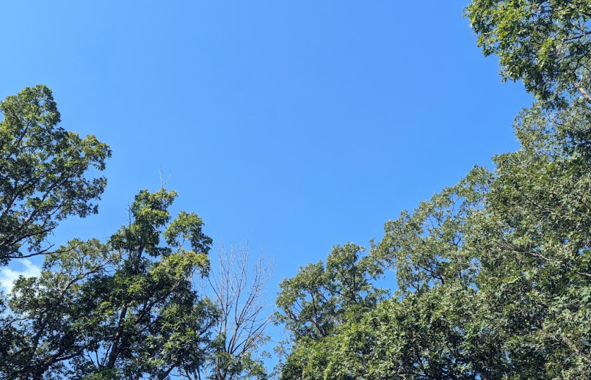
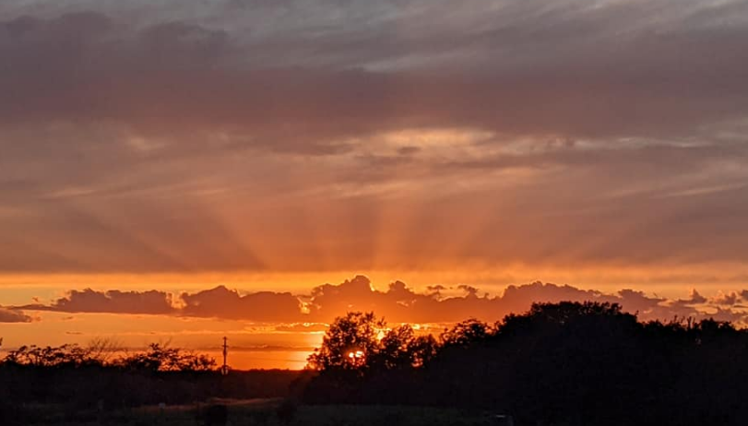
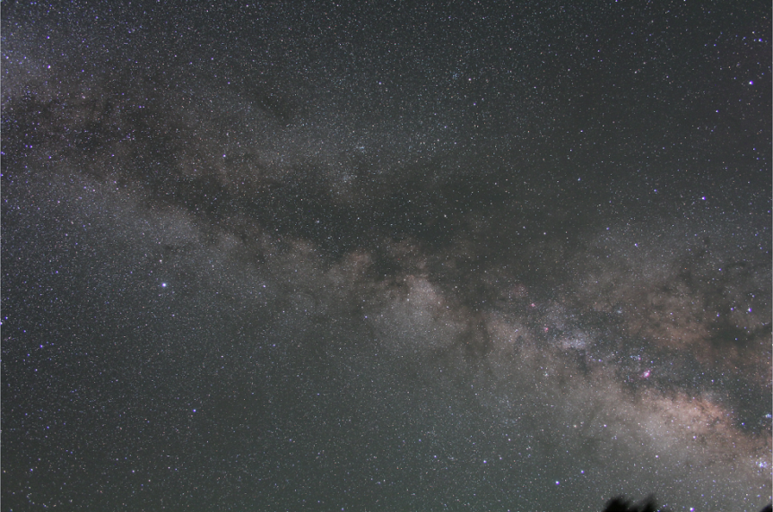
“Let there be Night”
Vayujeet Gokhale
Professor of Physics and Astronomy, Truman State University
https://darksky.truman.edu/
Chair,
DarkSky Missouri
https://darkskymissouri.org/

Slide 2
Outline of this Talk
Very Basic Background on Light Pollution, specifically in the context of college campuses,
One quick science result about how to think about impacts of light pollution,
Overview of what we have achieved at Truman State University and,
Resources and tools to develop and implement plans for improving lighting in your community.

Slide 3
Use of Artificial Light at Night, is a form of Pollution
Light Pollution

Slide 4
Goals of this Talk What I would like you to do!
Students: Set up ‘dark sky group’ on campus,
Faculty: Incorporate some of the resources (projects, labs, assignments, etc.) into your curriculum (links below),
Faculty: Please contact me (gokhale@truman.edu) with your ideas about how to address and combat LP,
Admins: Explore possibility of a “Light Management Plan” that minimizes cost, increases campus safety, and make campus more environmentally friendly.
Others: Help us accomplish some of this! ☺

Slide 5
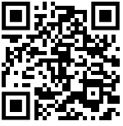
College Campuses: Action Plan
Scan to reach https://darksky.truman.edu/campus-resources/ for light-pollution related resources

Slide 6
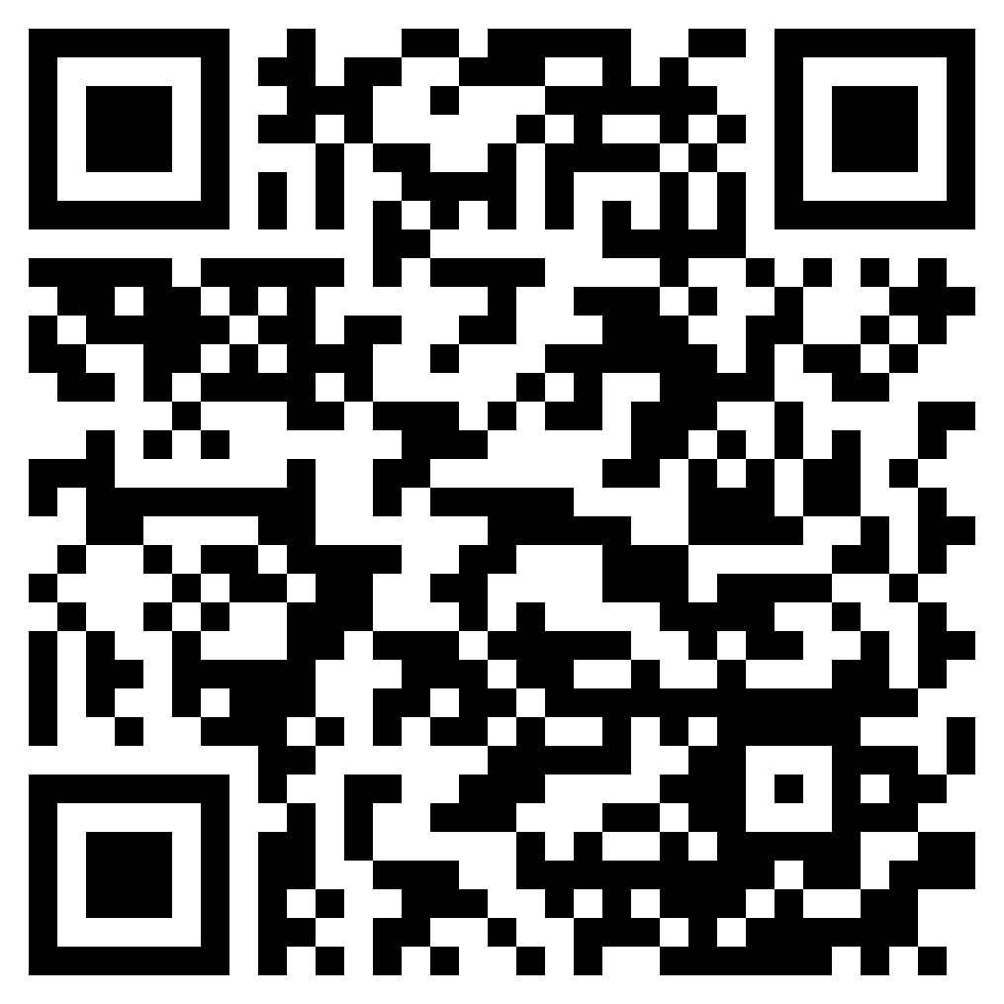
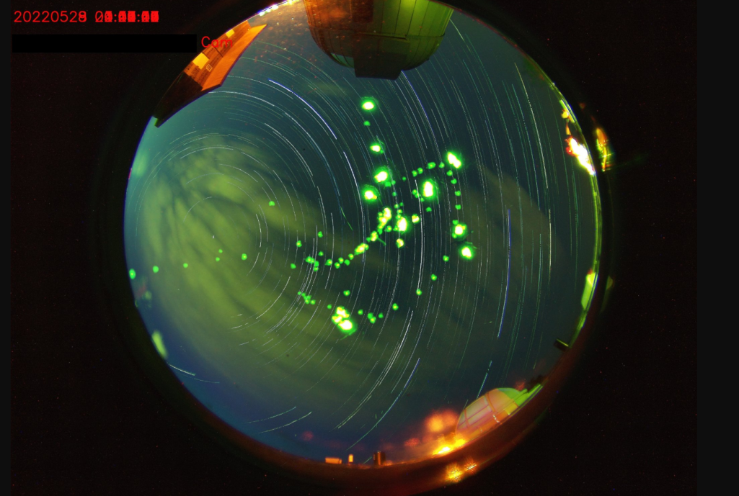
!! BECOME A MEMBER OF DARK SKY Missouri!!
!! SUPPORT US !!

Slide 7
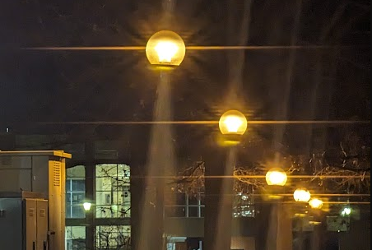
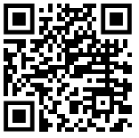
!! BECOME DARK SKY ADVOCATES !!
FACEBOOK: DARKSKYMISSOURI

Slide 8
Goals of this Talk What we can help with
DarkSky Missouri can help:
Do talks and outreach events in your community to increase awareness about light pollution,
Talk to city officials (councilmembers, alderman etc.),
Provide evidence about harmful effects of light pollution,
Help craft laws and ordinances for your community
DarkSky Truman (student group @ TSU) can help with:
Curricular materials for different courses (not just astronomy),
Project ideas for assessing outdoor lighting,
Support to student organizations to start dark-sky group,
Campus surveys,
Campus light management plan.

Slide 9
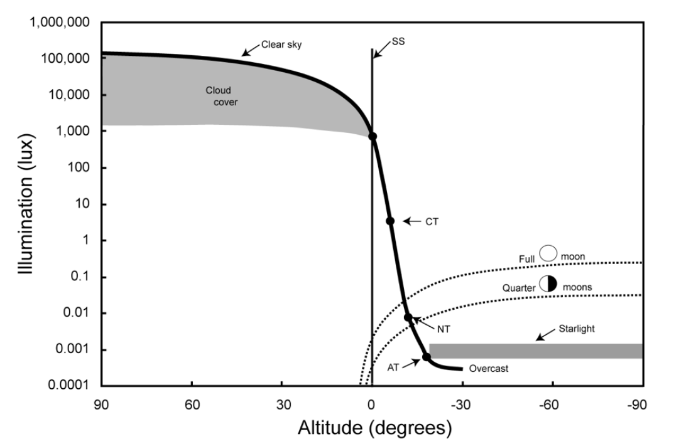
Natural Illumination Night and Day
Urban Lighting
Credit: T. Longcore
Parking Lots
Billboards
Urban Parks
Sky Glow
Dark Sky International: State of the Science 2023, John Barentine

Slide 10
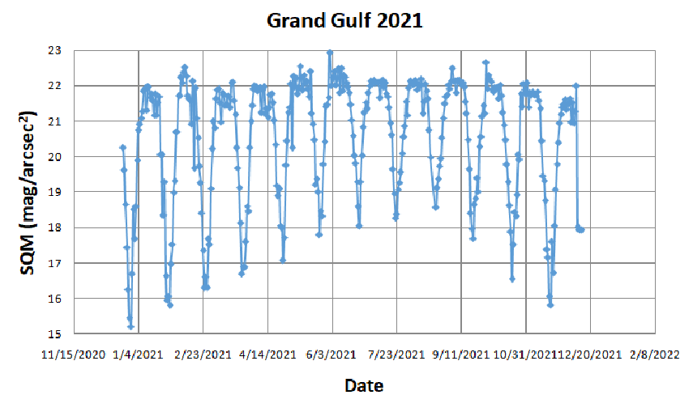
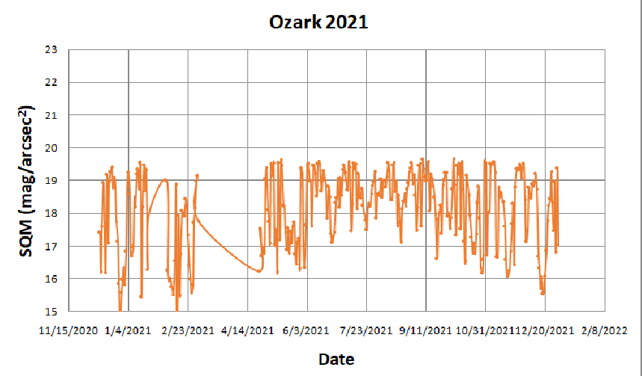
ALAN and Moon Phase Sky Brightness Measurements
DARKER
SKIES
BRIGHTER
SKIES

Slide 11
ALAN and Moon Phase
Contact me if you are interested in starting a sky brightness measuring program in your community.

Slide 12
ALAN & Light Pollution

Slide 13
Light pollution is the human-made alteration of outdoor light levels from those occurring naturally.

Slide 14
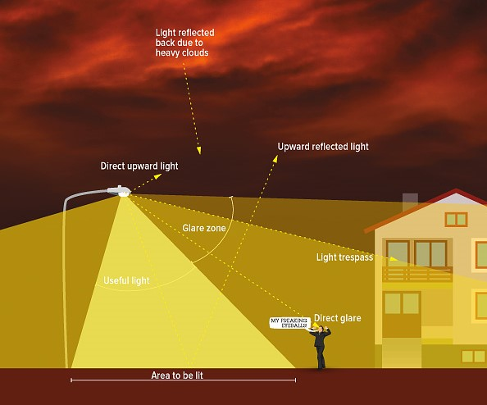
What is Light Pollution? [ALAN = Artificial Light At Night]
Photo Credit: IDA

Slide 15
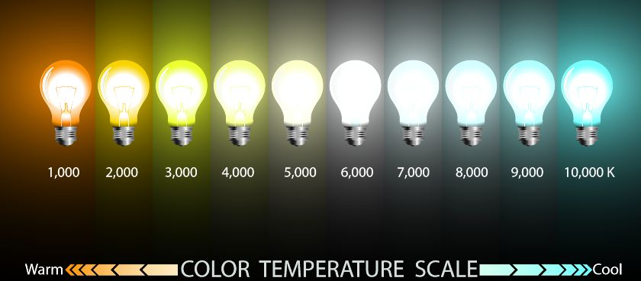
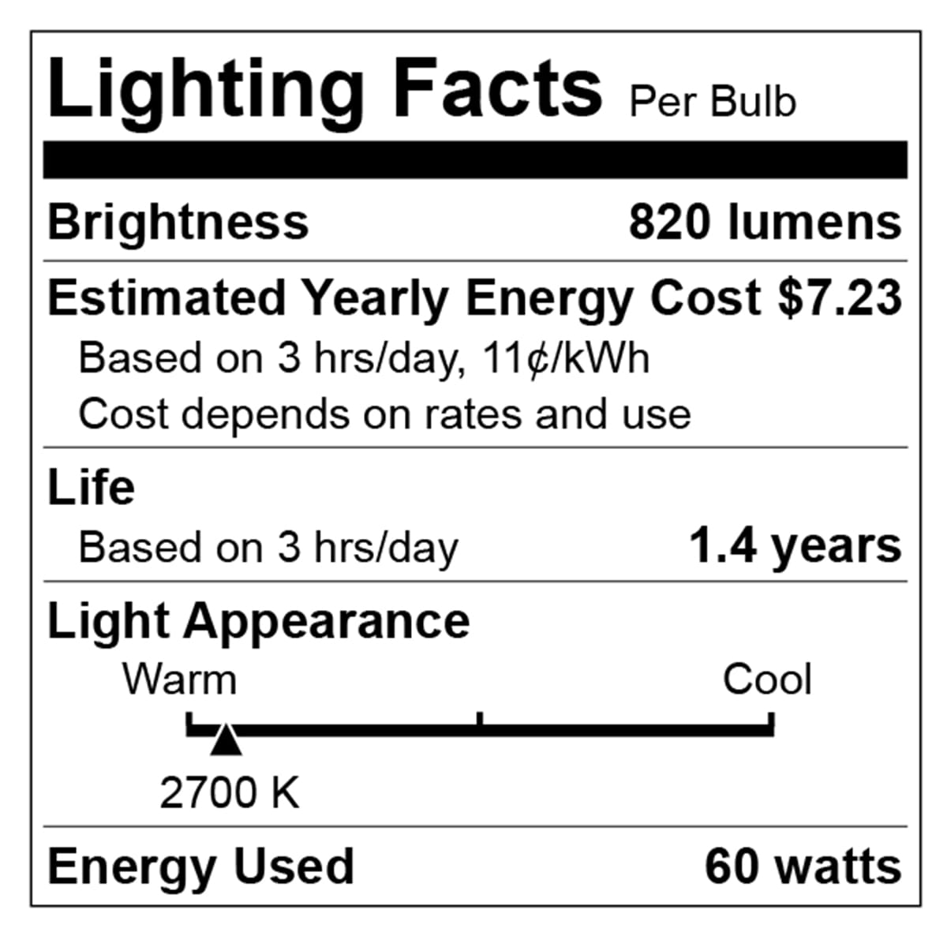
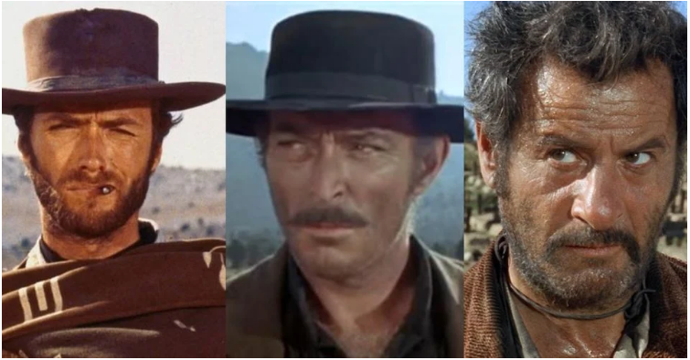
Light Intensity and Color are both important
For outdoor lighting, aim for 3000 K and below, preferably about 2000 K.
Orange/Red good, yellow bad, blue light ugly

Slide 16
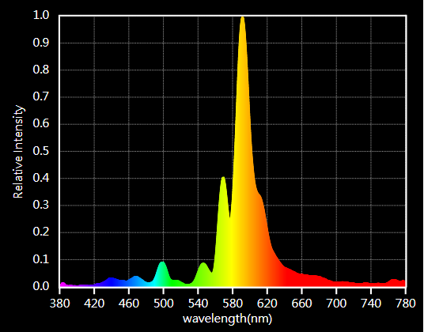
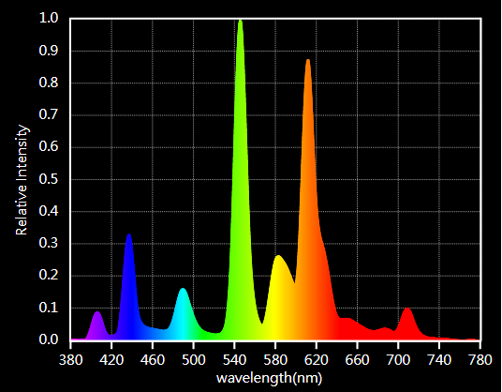
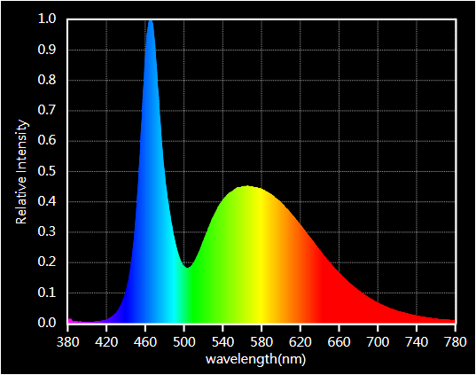
Color is important but check spectrum!

Slide 17
How to Reduce Light Pollution

Slide 18
How to combat Light Pollution?

Slide 19
Reducing Light Pollution
The technical solutions to light pollution are rather straight-forward: minimize use of outdoor light, direct it where it is needed, and use amber/red light instead of blue-white light.
The bigger challenge is to overcome individual and institutional inertia and make people change their habits.

Slide 20
Reducing Light Pollution
This requires dark sky advocates to take the initiative and engage the public to create awareness about the issues involved, and to move people to act and demand change [bottom-up approach].
Additionally, dark sky advocates need to talk to administrators and lawmakers to help them pass laws and ordinances that prohibit the unnecessary and indiscriminate use of outdoor lights [top-down approach].

Slide 21
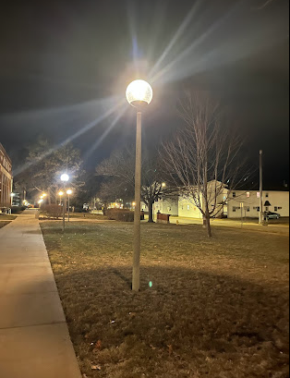
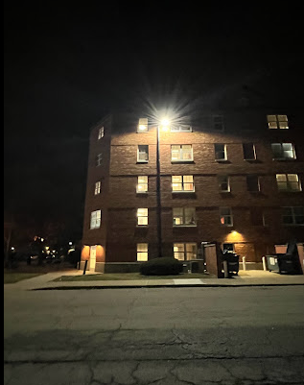
College Campus Lighting The Problem

Slide 22
Campus Light Pollution
Most college campuses are over-lit.
Lights are too bright,
Light fixtures are badly designed,
Light color is too-blue (CCT > 4000K)

Slide 23
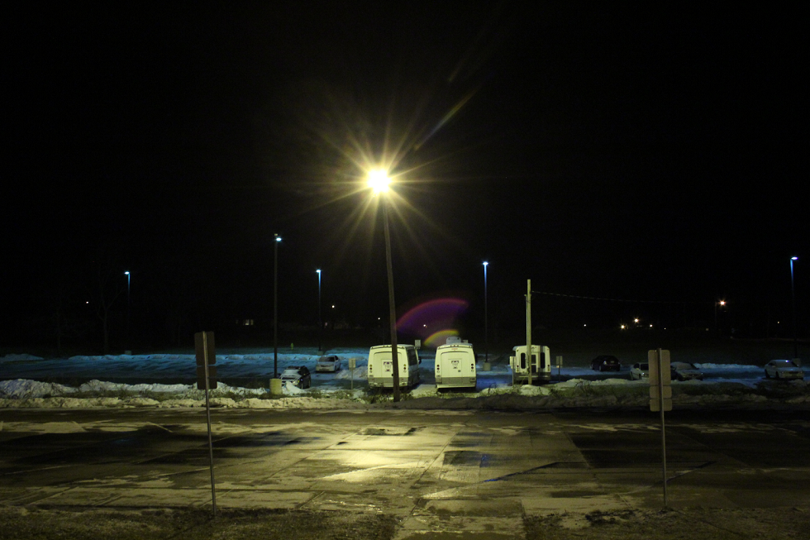
Good and Bad Lighting
Who is paying for this wasted light?

Slide 24
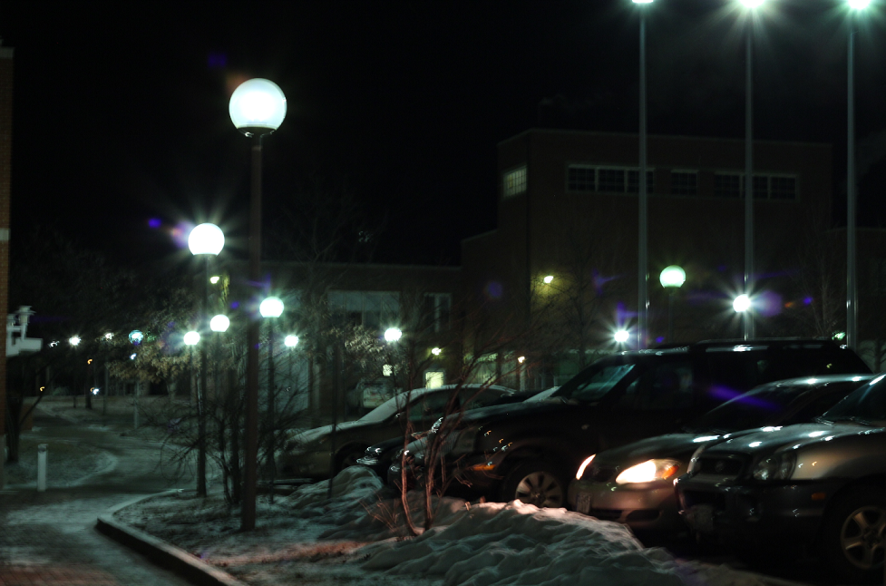
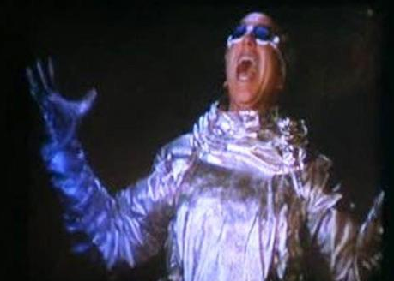
Glare Bombs Galore: Truman Campus
Flaming Globes of Sigmund!

Slide 25
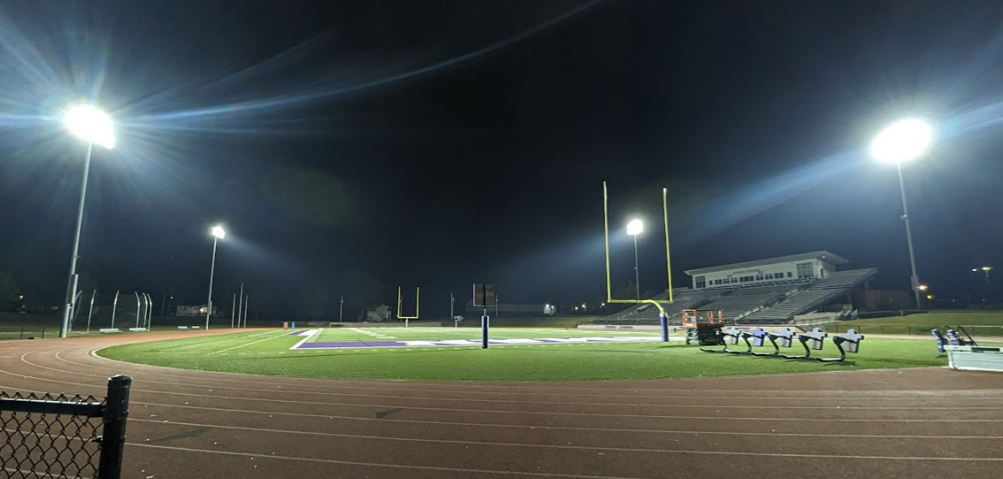
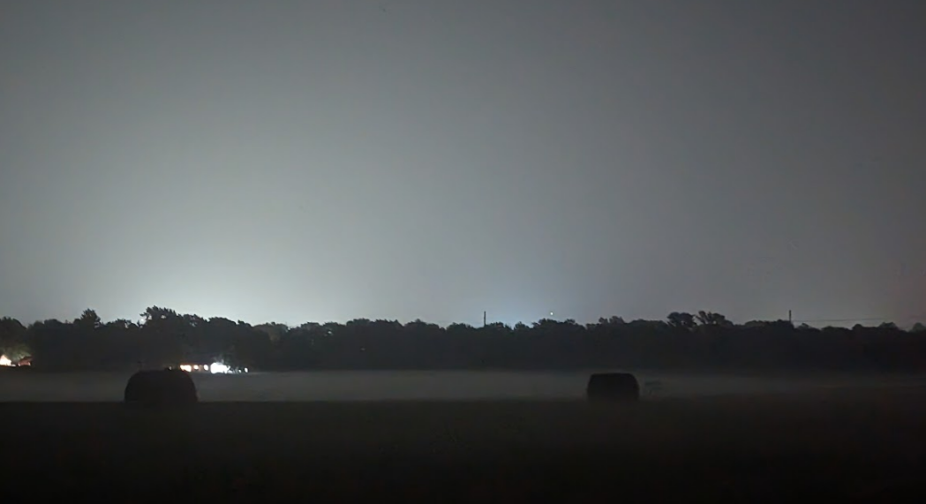
Sky Glow: 2 miles W from campus

Slide 26
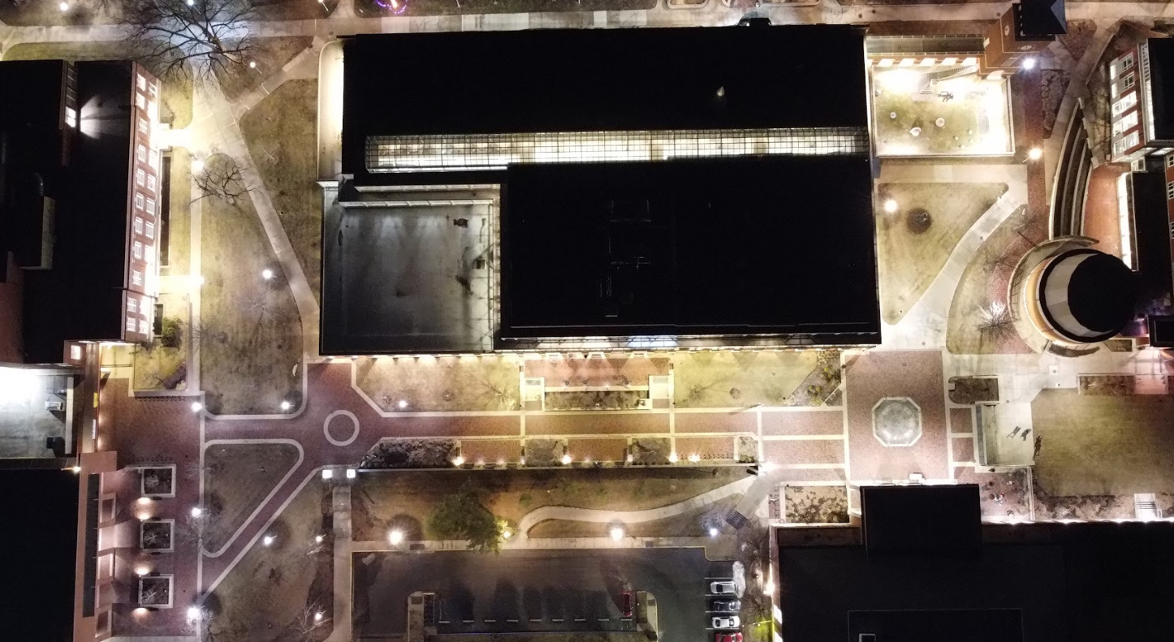
Typical Campus Lighting

Slide 27
Campus Light Pollution
Consequences of bad lighting on campuses
Badly designed fixtures cause glare, which decreases visual acuity and endangers pedestrians and drivers.
Excessive blue-white light shining into student dorms and other residential neighborhoods are a health concern
Blue-white light spreads farther due to scattering in the atmosphere, which is harmful for all living beings
The resulting skyglow results in increased sky brightness, which decreases our ability to enjoy the wonders of the night sky.

Slide 28
College Campuses
Research
Quantifying sources of light pollution (lighting inventories)
Measuring sky brightness (affects of light pollution)
Bird-window collisions
Outreach
Raising awareness in community (tabling, coursework)
Star-parties and Planetarium events
International Dark Sky Week
Activism
Raising funds for better lights
Student Government and Environmental Sustenance committee
Light Management plan for campus

Slide 29
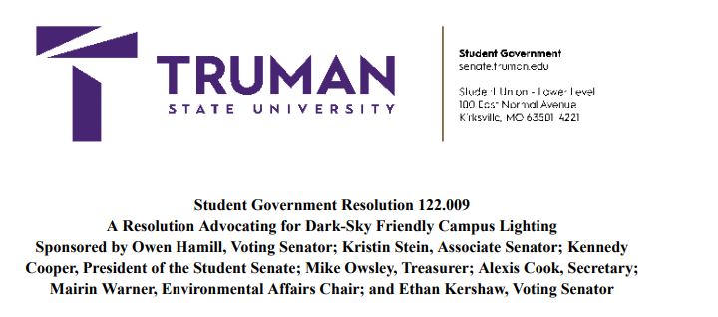
College Campuses: Action Plan
Set up a “dark sky student group” in collaboration with environmental groups, biologists (birders and pollinators), astronomers (stargazers), and faculty across disciplines.
Involve students in all aspects (research, outreach, activism)
Projects, coursework related to light pollution
Reach out to local city administrators, high-schools, businesses, and similar establishments

Slide 30
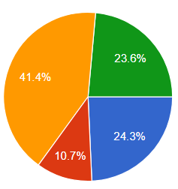
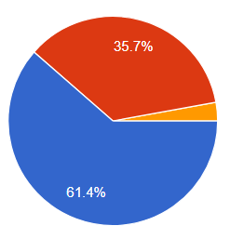
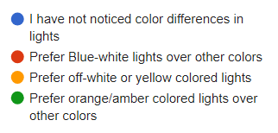
College Campuses: Action Plan
Student surveys regarding outdoor lighting on campus

Slide 31
College Campuses: Action Plan
Lighting inventory tools:
Opple Lightmaster (for lux-level and CCT temperature, $50) https://www.amazon.com/OPPLE-Illuminometer-Bluetooth-Flashlight-Lighting/dp/B0B4B1T3ZZ
Light meter digital luxmeter ($50) https://www.amazon.com/Illuminance-LX1330B-Digital-Luxmeter-Luminometer/dp/B07MCTY8H8
Unihedron Sky Quality Meter ($120) http://www.unihedron.com/projects/darksky/

Slide 32
College Campuses: Action Plan
Course Materials and projects:
Globe at Night
Satellite data
Hand-held SQM
Campus Lighting inventory (indoor and/or outdoor)
5-principles home inventory
Scan to reach https://darksky.truman.edu/campus-resources/ for light-pollution related resources

Slide 33
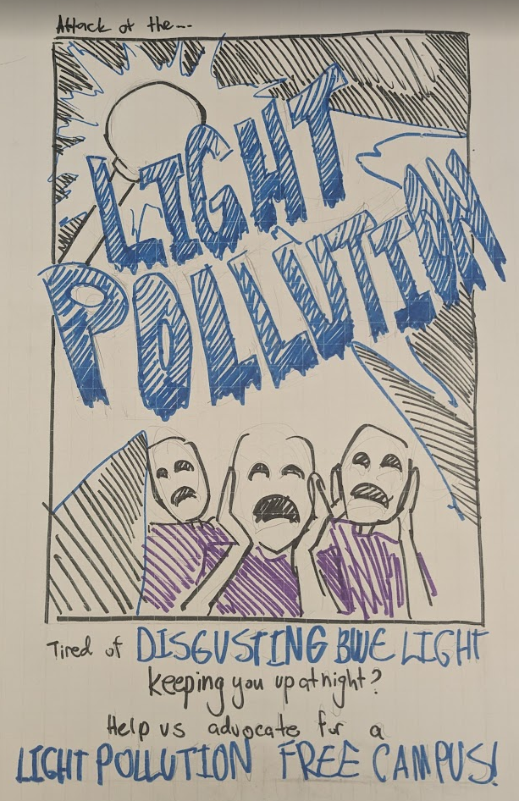
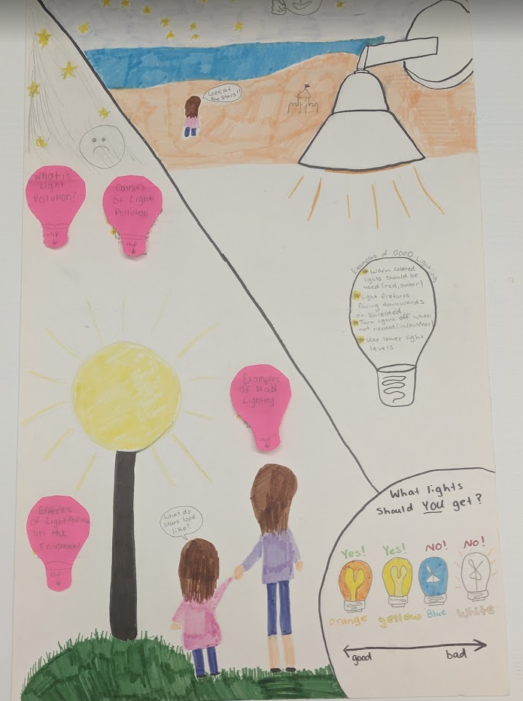
Organize Art Projects

Slide 34
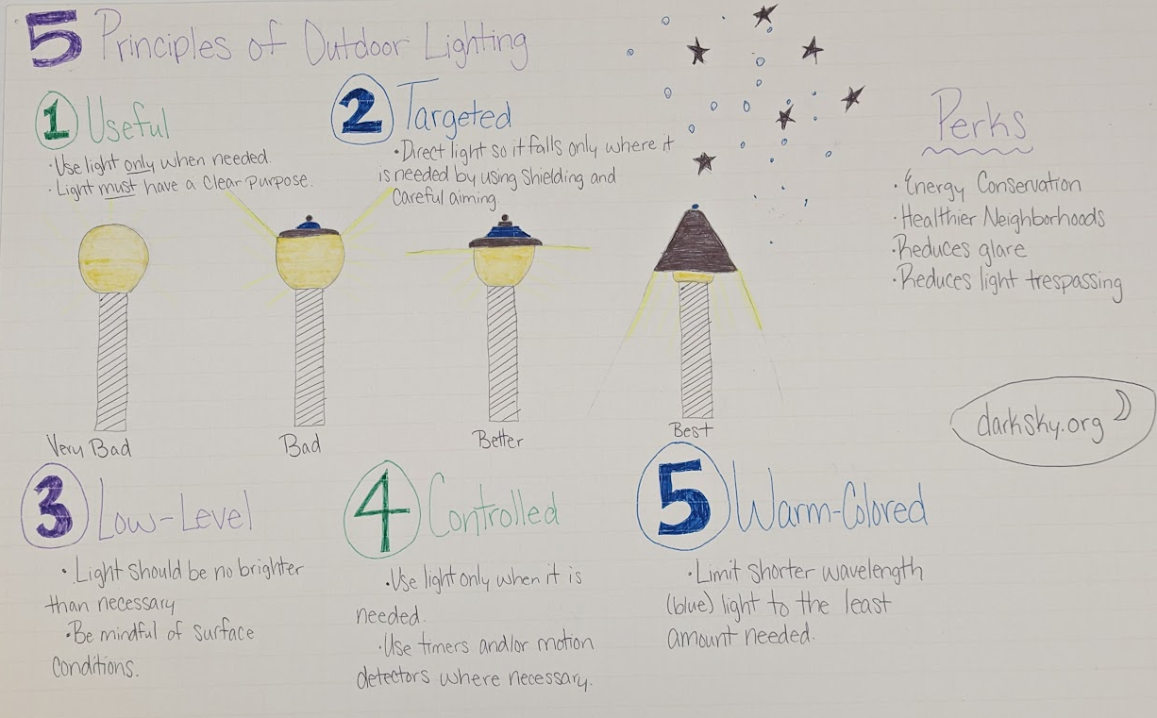
Organize Art Projects

Slide 35
College Campus Lighting Campus Inventory

Slide 36
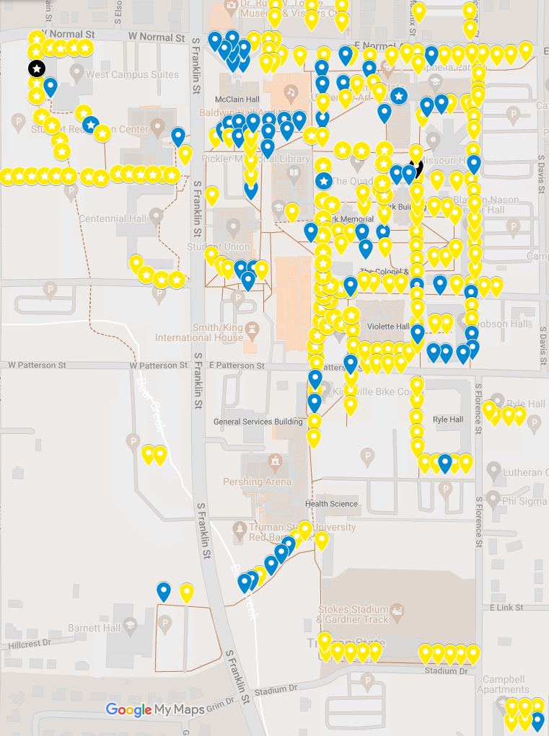
Campus Inventory GLOBE LIGHTS
Compiled from student maps from Fall 2022, Summer 2023, and Fall 2023
302 total “globe lights”
Almost half are now CCT ~3000 K
About half have “dark sky reflectors”

Slide 37
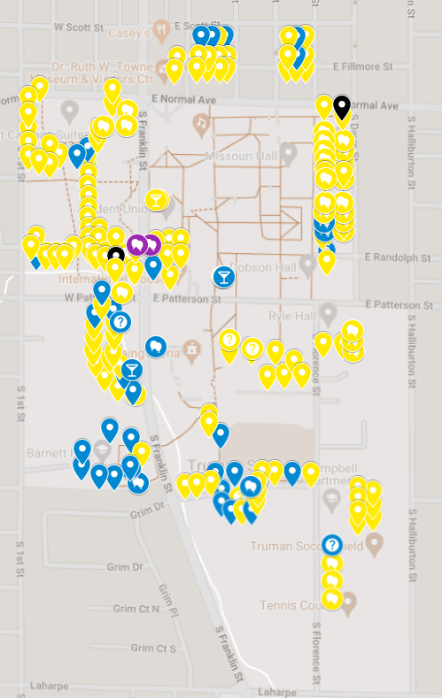
Campus Inventory Parking Lot Lights
Compiled from student maps from Fall 2022, Summer 2023, and Fall 2023
About 200 parking lot lights
Most are well-shielded
Color Temperature >= 4000K

Slide 38
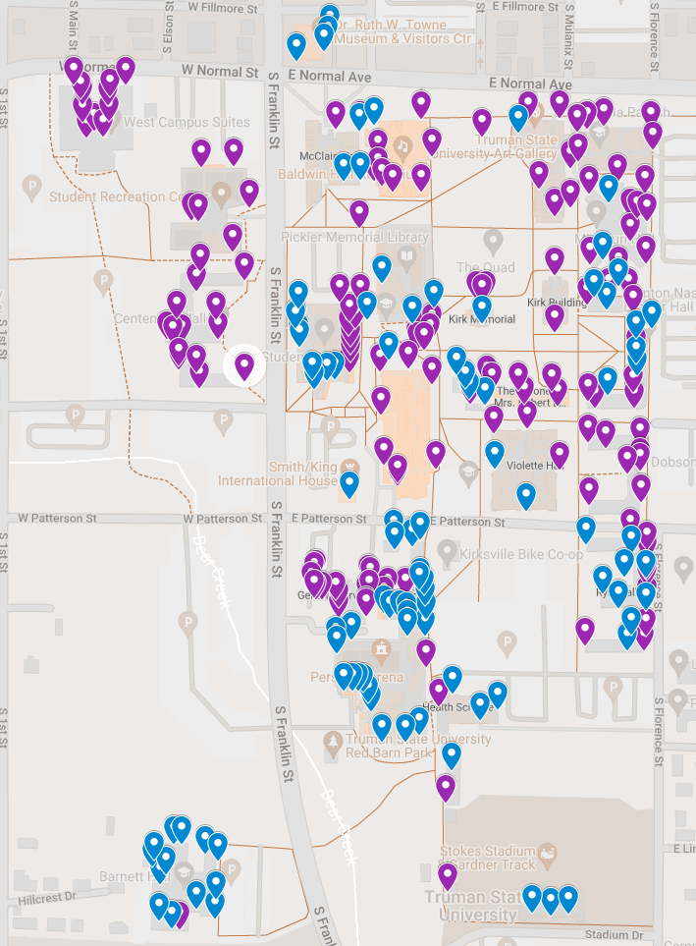
Campus Inventory Other-lights
Compiled from student maps from Fall 2022, Summer 2023, and Fall 2023
About 250 “other” lights: Lights on sides of buildings
Different colors (CCT temperatures) and different intensities
Fixture-type variable as well

Slide 39
Summary
What is Light Pollution?
Quantity and Quality (Directionality, Intensity, color)
Why fight light pollution?
Human health and safety
Ecology and Environment
Outdoor Lighting Practices
Technical solutions
Color, Shielding, Timers
Public Outreach & Awareness
Laws and Ordinances
Many of you already have the skills and passion to address one or more of these aspects.
There are citizen science opportunities to quantify both the extent of light pollution, and its affects on living things.
There are opportunities to use demos, presentations, brochures, signage etc. to increase awareness about light pollution, and its harmful effects.

Slide 40
!! BECOME A MEMBER OF DARK SKY Missouri!!

Slide 41
!! BECOME DARK SKY ADVOCATES !!
FACEBOOK: DARKSKYMISSOURI

Slide 42
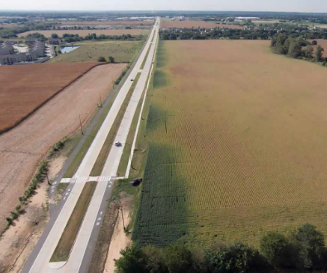
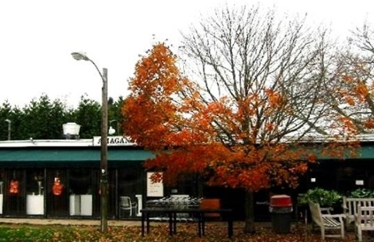
Why Combat Light Pollution: A Summary

Slide 43
Why Combat Light Pollution?
Human Health and Safety
Circadian rhythm
Vision impaired by Glare
Animal Health
Bird Migration, Sea Turtles
Bees, Fireflies, and other insects
Ecological impact
The Environment
Increased greenhouse emissions
Unnecessary waste of precious natural resources
Astronomy
Stargazing, astronomy research
Aesthetics
Fireflies photobomb the all -sky-camera at the Truman State Observatory

Slide 44
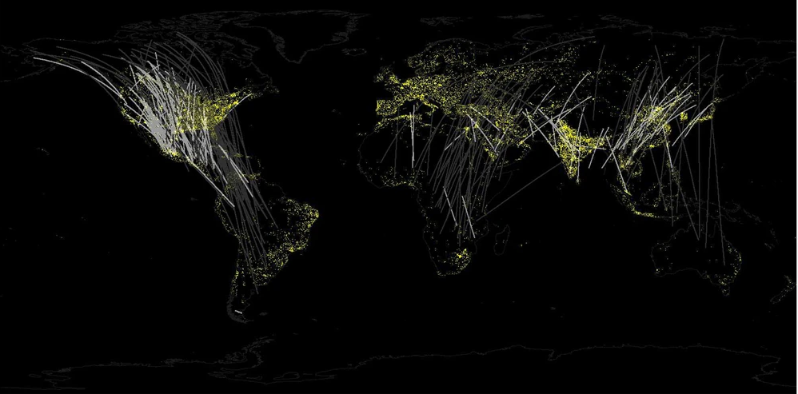
Birds and ALAN: Bird Migration

Slide 45
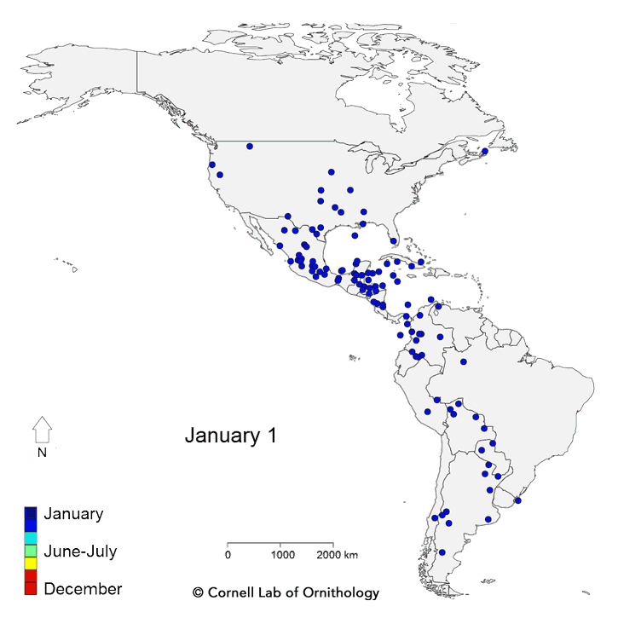
ALAN And Bird Migration
Twice each year, billions of birds fly between wintering and breeding grounds, facing innumerable threats along the way.
“Live” bird migration maps!
https://birdcast.info/migration-tools/live-migration-maps/
https://www.allaboutbirds.org/news/mesmerizing-migration-watch-118-bird-species-migrate-across-a-map-of-the-western-hemisphere/

Slide 46
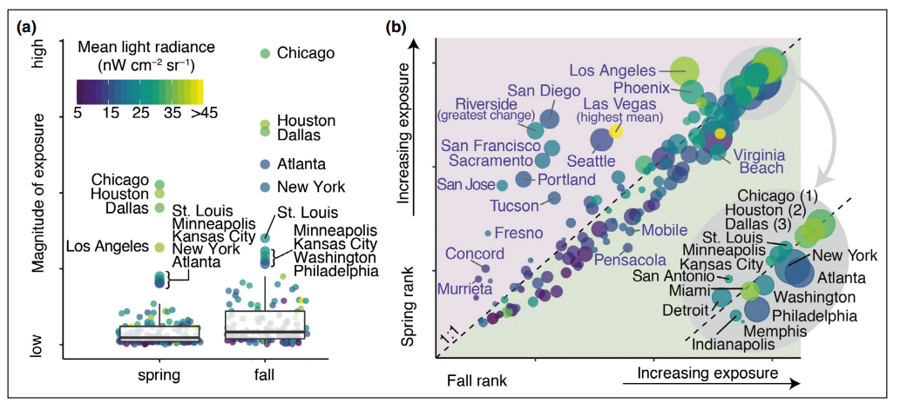
ALAN And Bird Migration (Horton et al., 2019)
Seasonal (a) magnitude and (b) relative rankings of the 125 largest urban areas in the continental US. Point color shaded by the mean light radiance and sizes (in [b]) are scaled by the square root of urban area. Inset in (b) depicts the top 15 (spring or fall) rankings

Slide 47
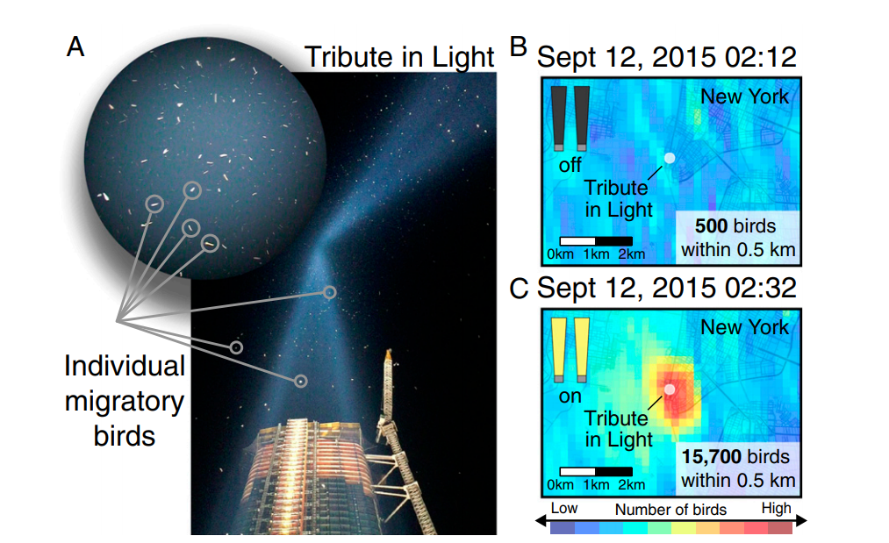
ALAN And Bird Migration Example: 9/11 Tribute in Light site.

Slide 48
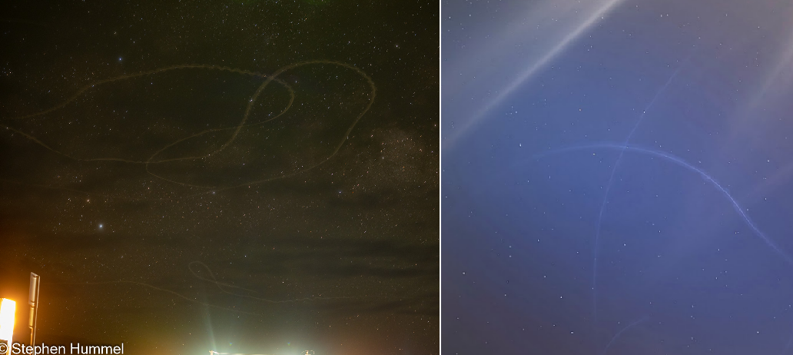
ALAN And Birds
Birds trapped in light domes near Big Bend National Park (left) and Kirksville, Missouri (right)

Slide 49
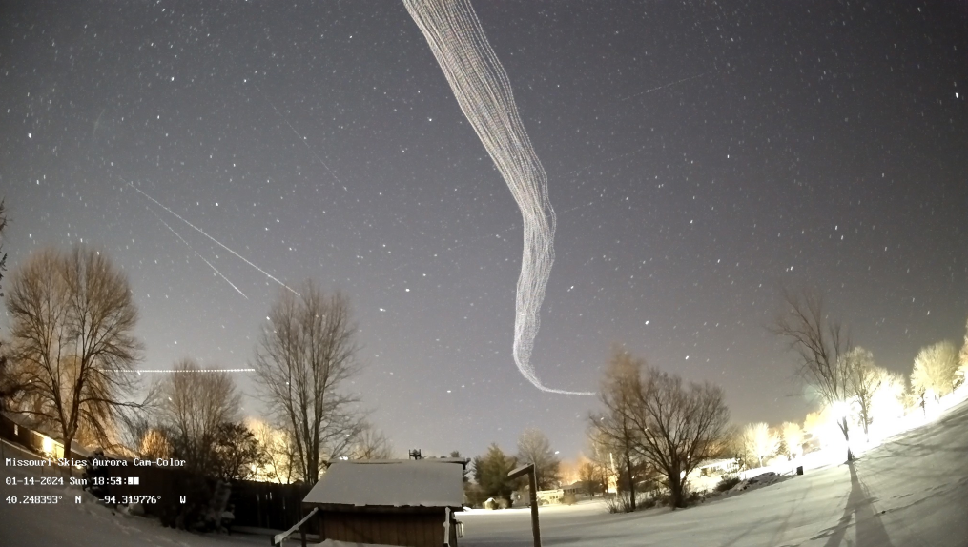
ALAN And Birds
Birds belly’s are lit up by upward pointing light (and also due to reflection off the snow). These birds should be “invisible” at night, but are not.
Picture Credit: http://www.missouriskies.org/

Slide 50
ALAN and Natural Cycles of Darkness

Slide 51
ALAN And Bird Migration
So, ALAN is completely disrupting the cycles associated with moon-phase, since cloudy nights in cities mimics clear nights with Moonlight vis-à-vis sky brightness, which could severely confuse migratory birds.
Also note that birds tend to follow waterways and rivers on their migration routes, and these are locations were humans tend to settle as well.
For example: STL, KC, Chicago, Minniapolis, Memphis, Baton Rouge, New Orleans are only a few cities along just the Mississippi river!
Cities = High-rise buildings and lots of light pollution, and this is not good for migrating birds ☹

Slide 52
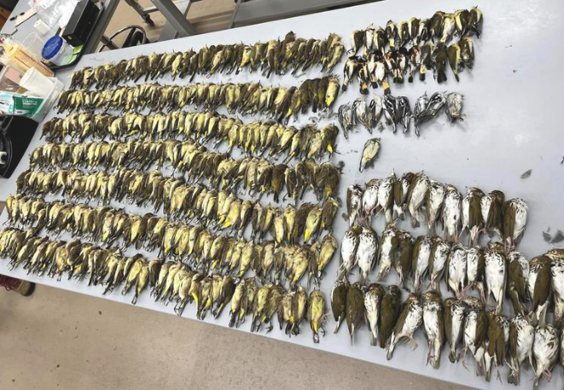
One Example, Chicago: October 2023
https://birdcast.info/news/major-collision-event-in-chicago-4-5-october-2023

Slide 53
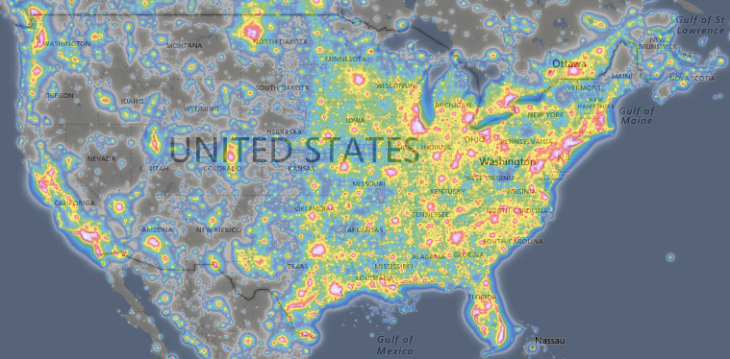
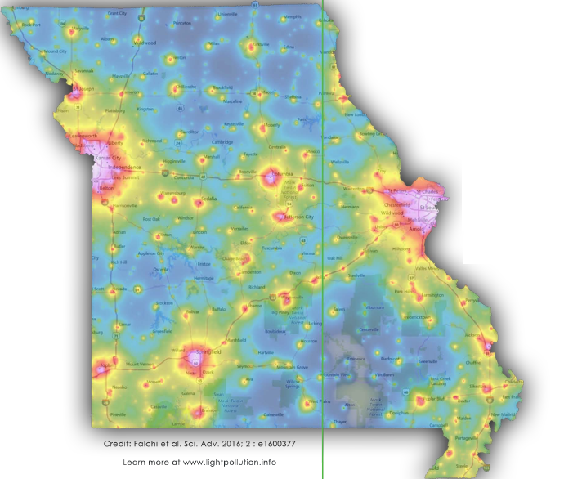
The Challenge
https://lightpollutionmap.info/
“The loss of the night sky is placed in the broader context of society’s difficulty in fully articulating non-consumptive values such as natural beauty.”
Terrell Gallaway (Missouri State University; IDA-Mo Board Member)
How to bridge this gap!?

