Slide 1
“Let there be Night”
Vayujeet Gokhale
Professor of Physics and Astronomy, Truman State University
Chair,
DarkSky Missouri

Slide 2
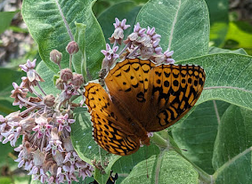
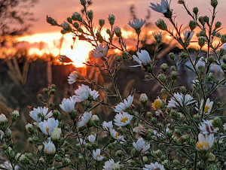
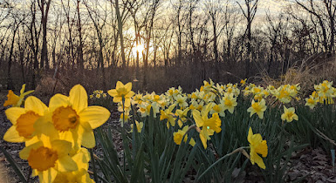
Spring time in America

Slide 3
Use of Artificial Light at Night, is a form of Pollution
Light Pollution

Slide 4
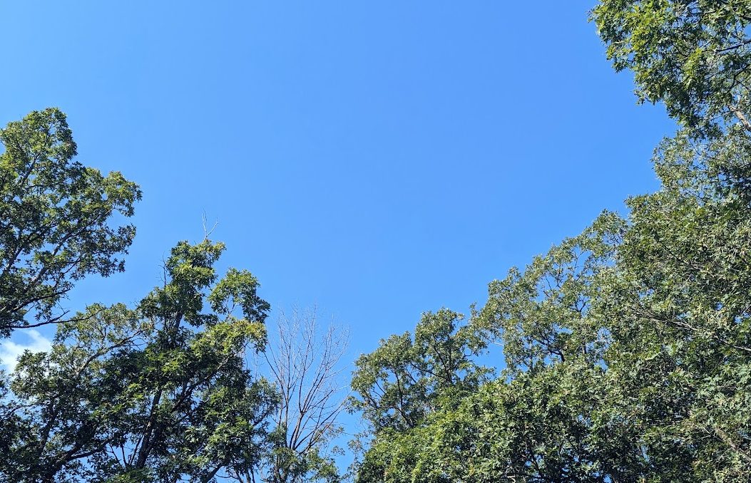
Blue Skies, Twilight, and Darkness at Night

Slide 5
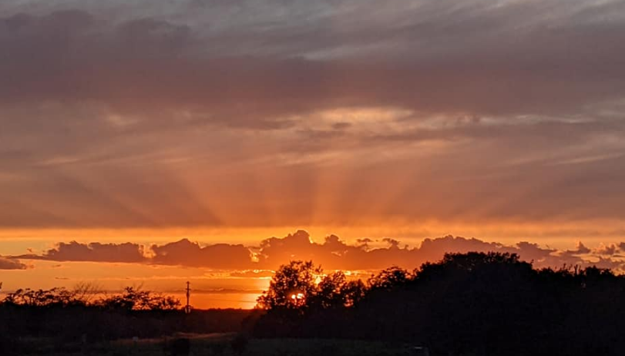
Blue Skies, Twilight, and Darkness at Night

Slide 6
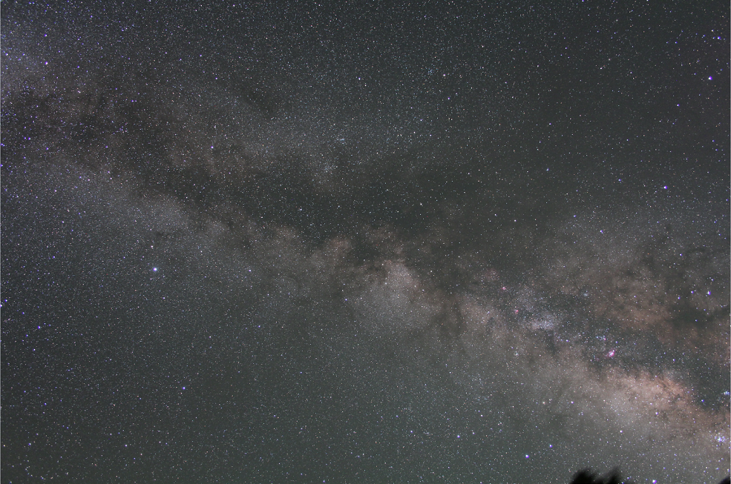
“Darkness” at night
Flagstaff, Az 5 minute exposure, tracking ‘on’

Slide 7
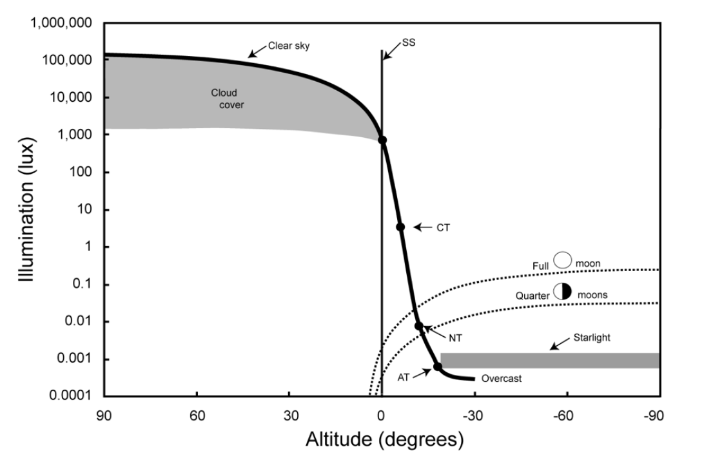
Natural Illumination Night and Day
Urban Lighting
Credit: T. Longcore
Parking Lots
Billboards
Urban Parks
Sky Glow
Dark Sky International: State of the Science 2023, John Barentine

Slide 8
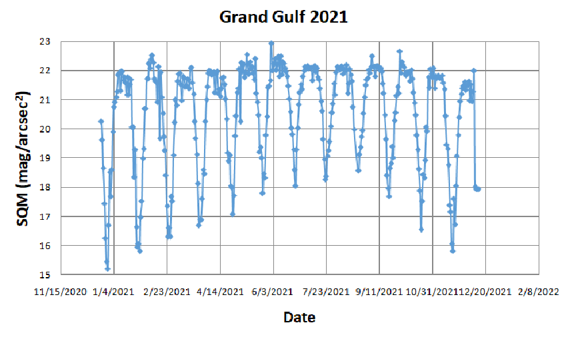
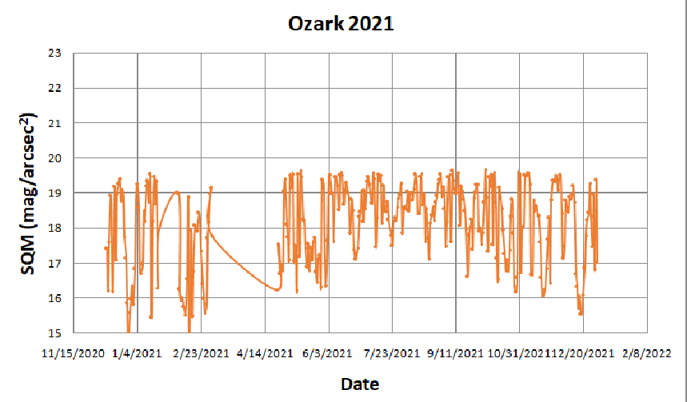
ALAN and Moon Phase Sky Brightness Measurements
DARKER
SKIES
BRIGHTER
SKIES

Slide 9
ALAN and Moon Phase

Slide 10
ALAN & Light Pollution

Slide 11
Light pollution is the human-made alteration of outdoor light levels from those occurring naturally.

Slide 12
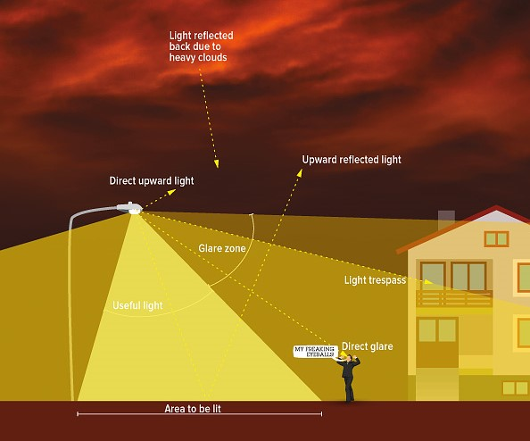
What is Light Pollution? [ALAN = Artificial Light At Night]
Photo Credit: IDA

Slide 13
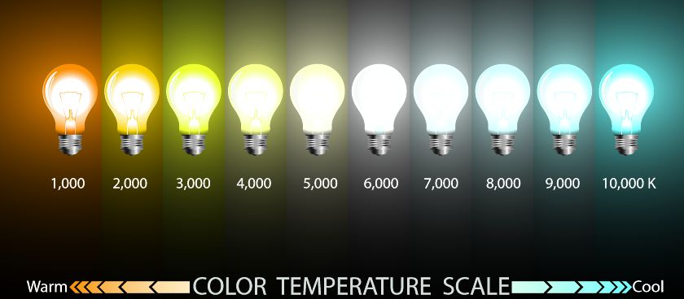
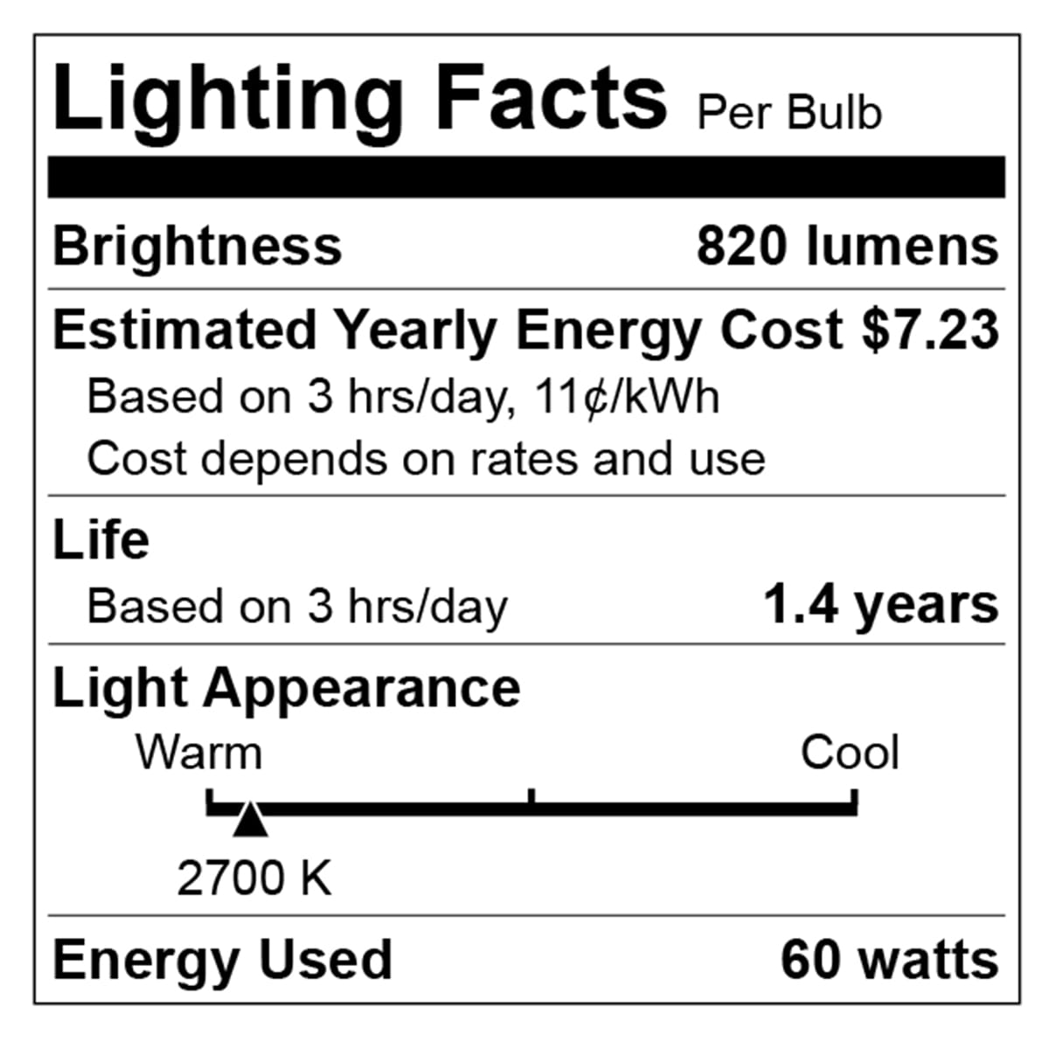
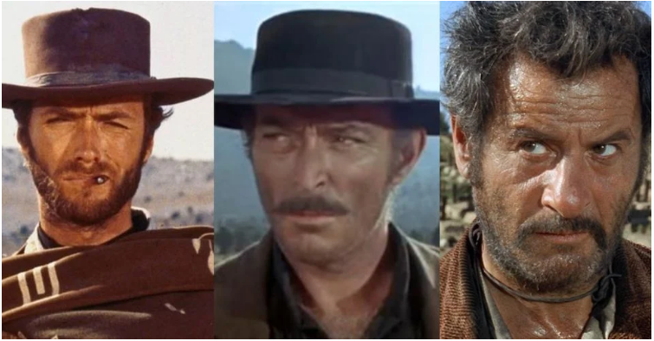
Light Intensity and Color are both important
For outdoor lighting, aim for 3000 K and below, preferably about 2000 K.
Orange/Red good, yellow bad, blue light ugly

Slide 14
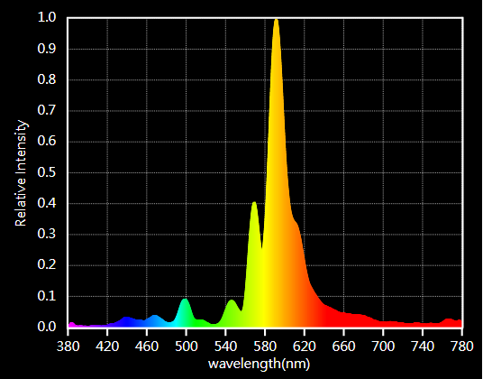
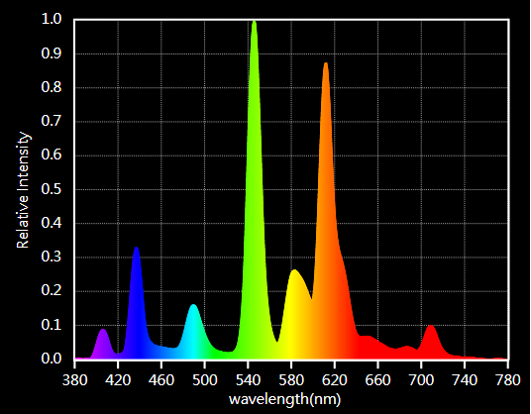
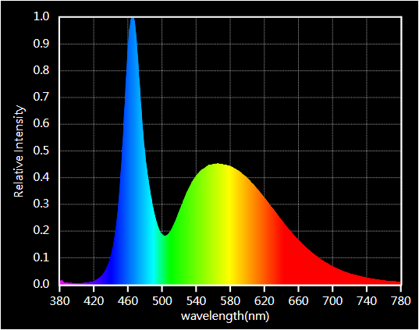
Color is important but check spectrum!

Slide 15
How to Reduce Light Pollution

Slide 16
How to combat Light Pollution?

Slide 17
Reducing Light Pollution
The technical solutions to light pollution are rather straight-forward: minimize use of outdoor light, direct it where it is needed, and use amber/red light instead of blue-white light.
The bigger challenge is to overcome individual and institutional inertia and make people change their habits.
This requires dark sky advocates to take the initiative and engage the public to create awareness about the issues involved, and to move people to act and demand change [bottom-up approach].
Additionally, dark sky advocates need to talk to administrators and lawmakers to help them pass laws and ordinances that prohibit the unnecessary and indiscriminate use of outdoor lights [top-down approach].

Slide 18
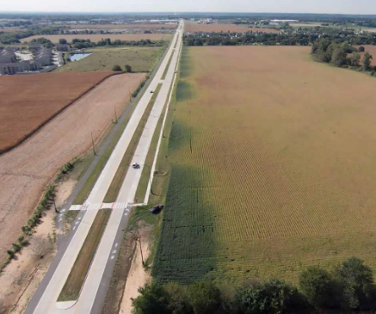
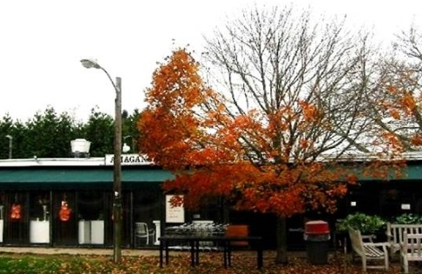
Why Combat Light Pollution: A Summary

Slide 19
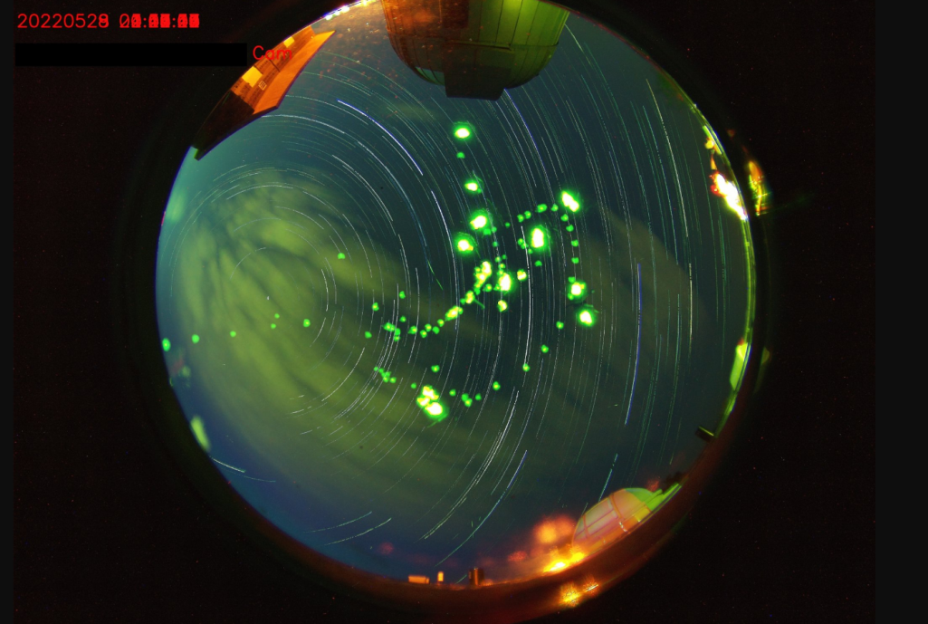
Why Combat Light Pollution?
Human Health and Safety
Circadian rhythm
Vision impaired by Glare
Animal Health
Bird Migration, Sea Turtles
Bees, Fireflies, and other insects
Ecological impact
The Environment
Increased greenhouse emissions
Unnecessary waste of precious natural resources
Astronomy
Stargazing, astronomy research
Aesthetics
Fireflies photobomb the all -sky-camera at the Truman State Observatory

Slide 20
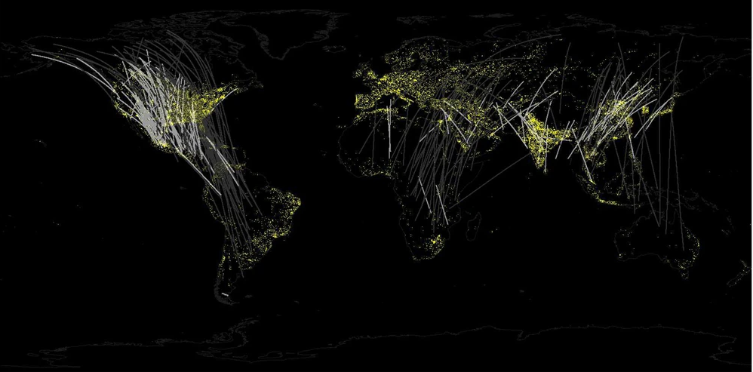
Birds and ALAN: Bird Migration

Slide 21
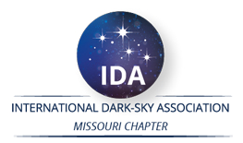
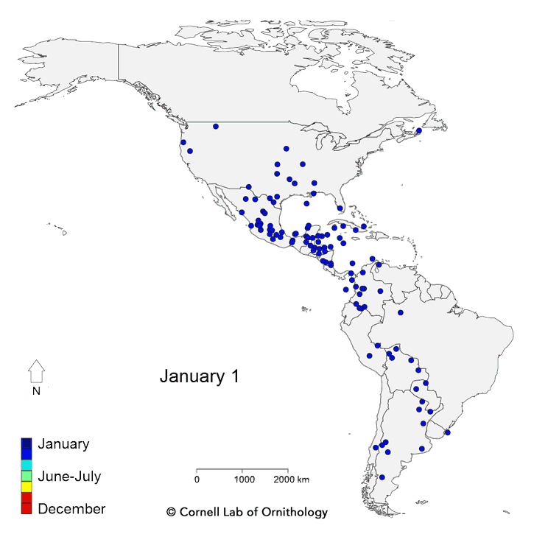
ALAN And Bird Migration
Twice each year, billions of birds fly between wintering and breeding grounds, facing innumerable threats along the way.
“Live” bird migration maps!
https://birdcast.info/migration-tools/live-migration-maps/
https://www.allaboutbirds.org/news/mesmerizing-migration-watch-118-bird-species-migrate-across-a-map-of-the-western-hemisphere/

Slide 22
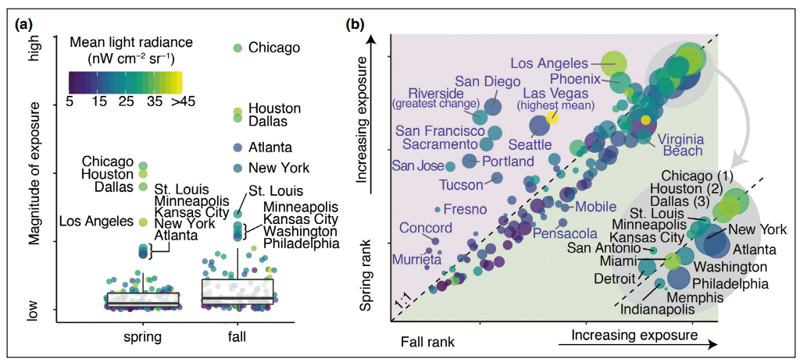
ALAN And Bird Migration (Horton et al., 2019)
Seasonal (a) magnitude and (b) relative rankings of the 125 largest urban areas in the continental US. Point color shaded by the mean light radiance and sizes (in [b]) are scaled by the square root of urban area. Inset in (b) depicts the top 15 (spring or fall) rankings

Slide 23
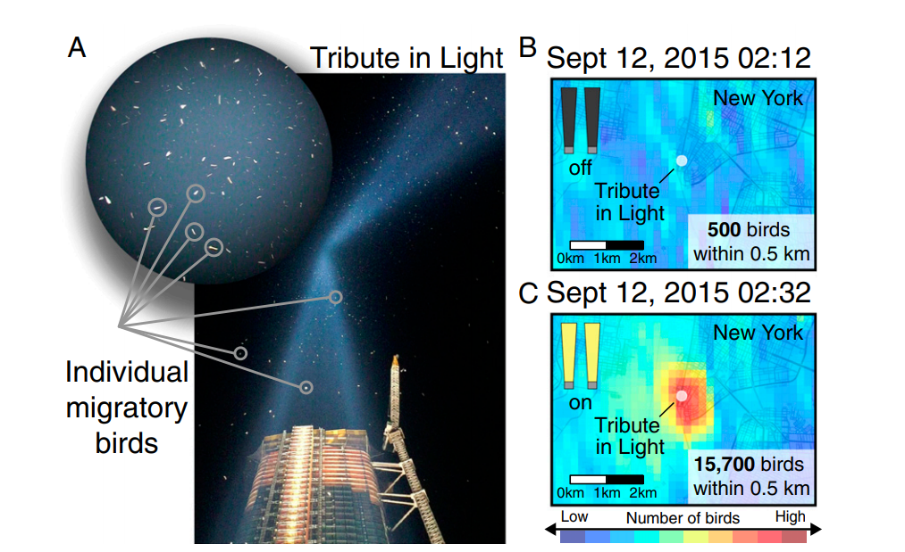
ALAN And Bird Migration Example: 9/11 Tribute in Light site.

Slide 24
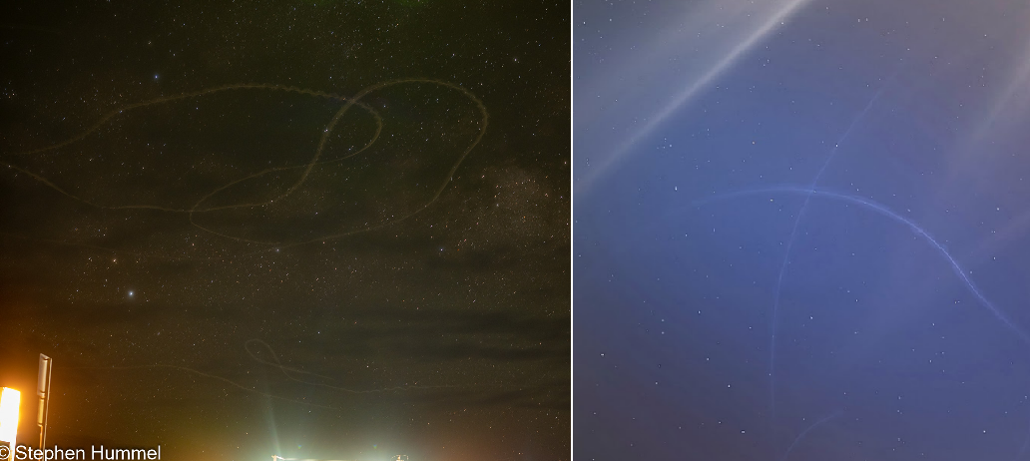
ALAN And Birds
Birds trapped in light domes near Big Bend National Park (left) and Kirksville, Missouri (right)

Slide 25
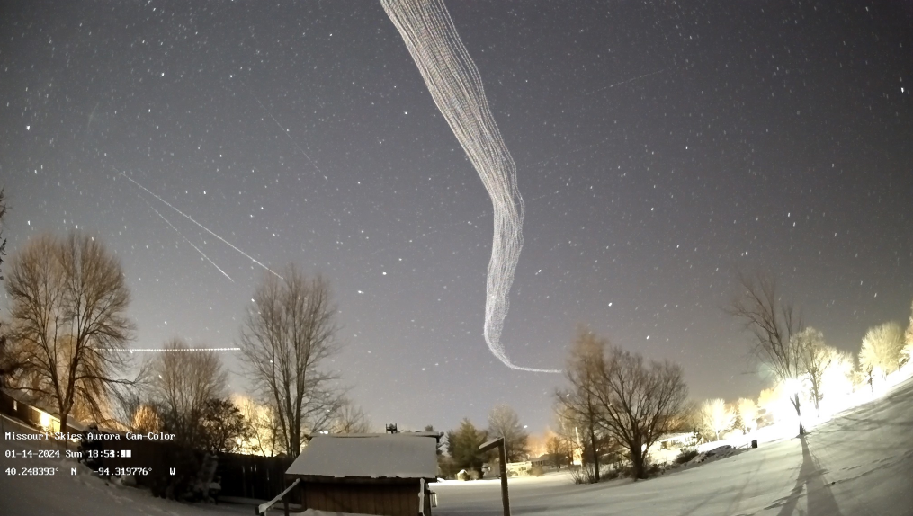
ALAN And Birds
Birds belly’s are lit up by upward pointing light (and also due to reflection off the snow). These birds should be “invisible” at night, but are not.
Picture Credit: http://www.missouriskies.org/

Slide 26
ALAN and Natural Cycles of Darkness

Slide 27
ALAN And Bird Migration
So, ALAN is completely disrupting the cycles associated with moon-phase, since cloudy nights in cities mimics clear nights with Moonlight vis-à-vis sky brightness, which could severely confuse migratory birds.
Also note that birds tend to follow waterways and rivers on their migration routes, and these are locations were humans tend to settle as well.
For example: STL, KC, Chicago, Minniapolis, Memphis, Baton Rouge, New Orleans are only a few cities along just the Mississippi river!
Cities = High-rise buildings and lots of light pollution, and this is not good for migrating birds ☹

Slide 28
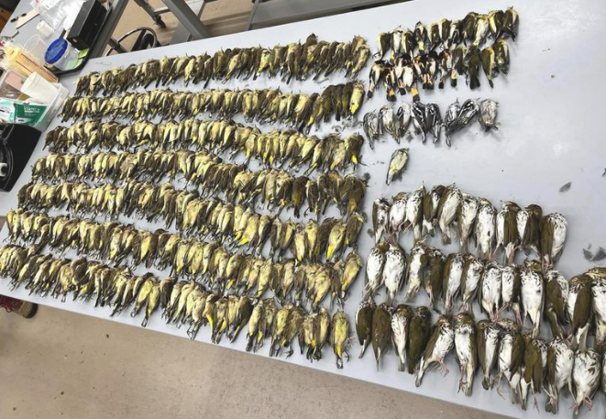
One Example, Chicago: October 2023
https://birdcast.info/news/major-collision-event-in-chicago-4-5-october-2023

Slide 29
Challenges to bringing about Change

Slide 30
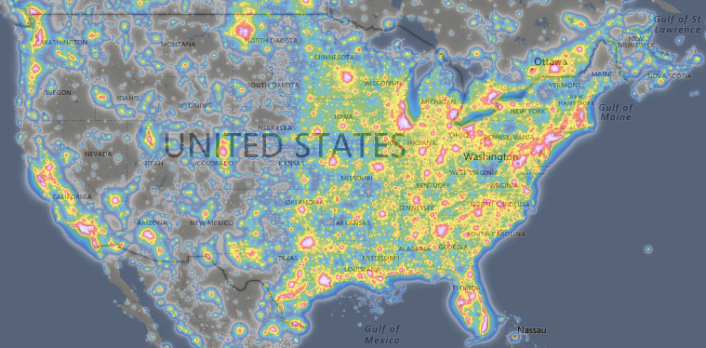
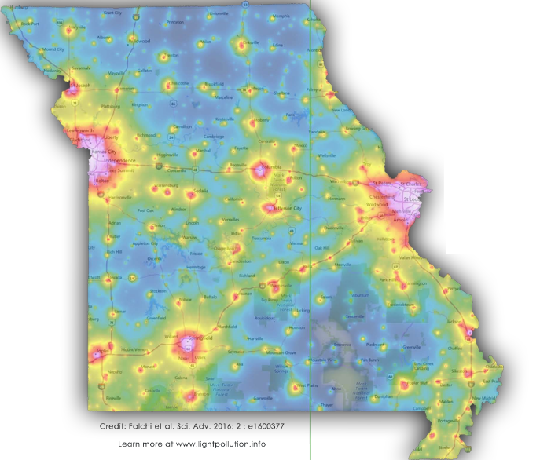
The Challenge
https://lightpollutionmap.info/
“The loss of the night sky is placed in the broader context of society’s difficulty in fully articulating non-consumptive values such as natural beauty.”
Terrell Gallaway (Missouri State University; IDA-Mo Board Member)
How to bridge this gap!?

Slide 31
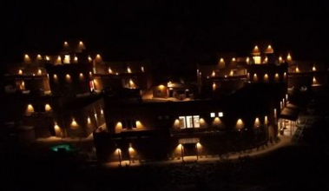
!! BECOME A MEMBER OF DARK SKY Missouri!!

Slide 32
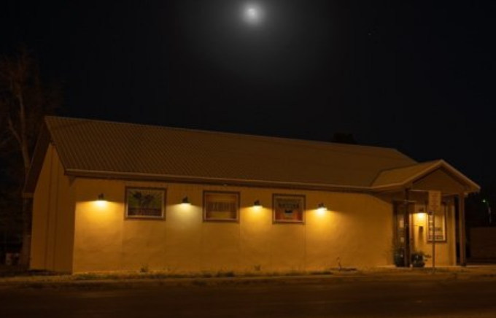
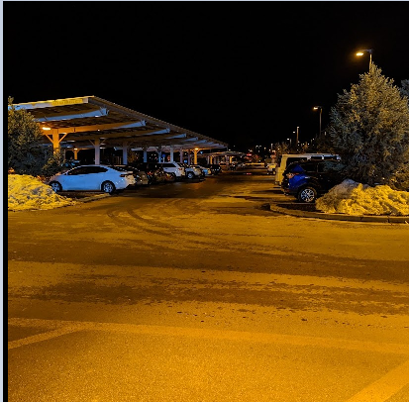
!! BECOME DARK SKY ADVOCATES !!
Printco@Alpine, Tx
Walmart @Flagstaff, Az
FACEBOOK: DARKSKYMISSOURI

Slide 33
Extra Slides

Slide 34
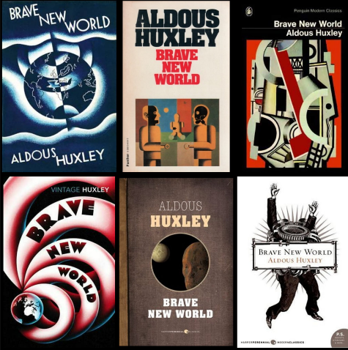
1984 Or Brave New World?

Slide 35
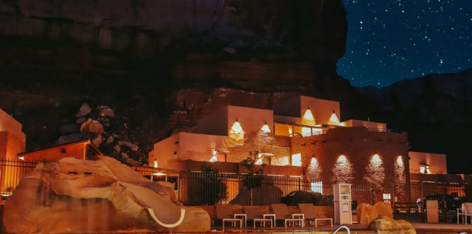
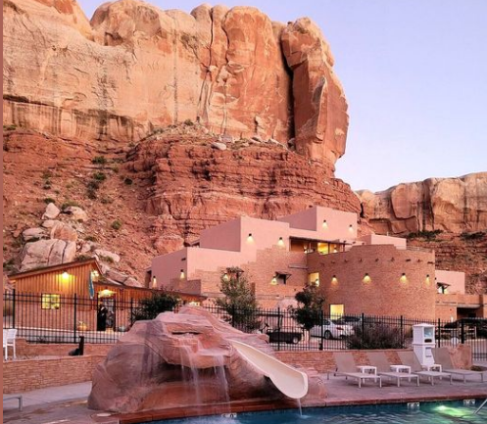
Examples: Motels
Bluff Dwellings Resort & Spa Bluff, Utah

Slide 36
ALAN And Bird Migration: Mitigation Efforts
So, when it comes to bird migration light pollution is a problem – but high rise buildings are a particularly urgent problem that needs to be fixed.
The National Audubon Society is an American non-profit environmental organization dedicated to conservation of birds and their habitat.
The Audubon Society has teamed up with the Dark Sky International (DSI) on the “Lights-Out Program” aimed at creating awareness about bird-migration and to implement mitigation efforts to minimize the dangers posed by LP and high-rise buildings to birds.
https://www.audubon.org/ lights-out-program
https://www.lightsoutheartland.org/

Slide 37
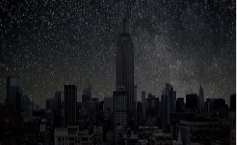
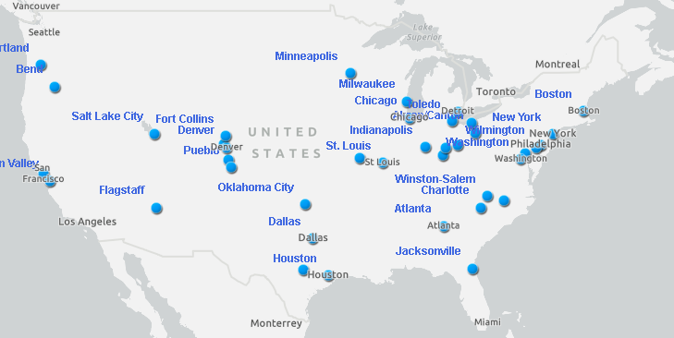
Lights-Out Program: How to Contribute?
Turn off exterior decorative lighting
Extinguish pot and flood-lights
Substitute strobe lighting wherever possible
Reduce atrium lighting wherever possible
Turn off interior lighting especially on higher stories
https://www.audubon.org/lights-out-program

Slide 38
Lights-Out Program: How to Contribute?
Substitute task and area lighting for workers staying late or pull window coverings
Down-shield exterior lighting to eliminate horizontal glare and all light directed upward
Install automatic motion sensors and controls wherever possible
When converting to new lighting assess quality and quantity of light needed, avoiding over-lighting with newer, brighter technology.
https://www.audubon.org/lights-out-program

Slide 39
Protecting the Night
How to bring about change?
One of the most difficult things to do is to get people to change their behavior
INDIVIDUALS WILL HAVE TO BEAR THE BURDEN OF CHANGE TILL INSTITUTIONS CATCH UP
Consider starting a Dark Sky Group:
Involve individuals from diverse backgrounds,
Work towards establishing a “dark sky park” in your community

Slide 40
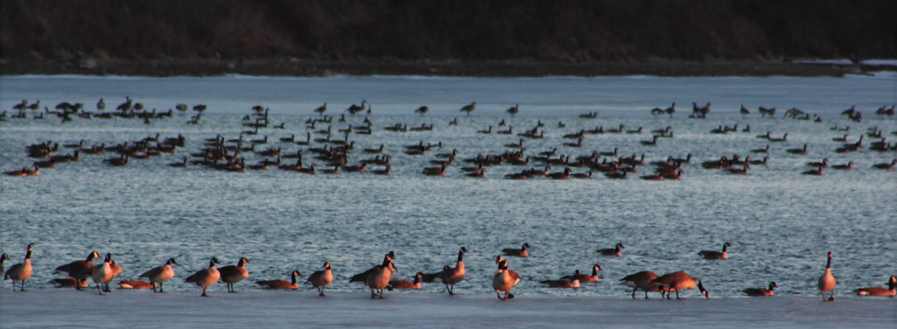
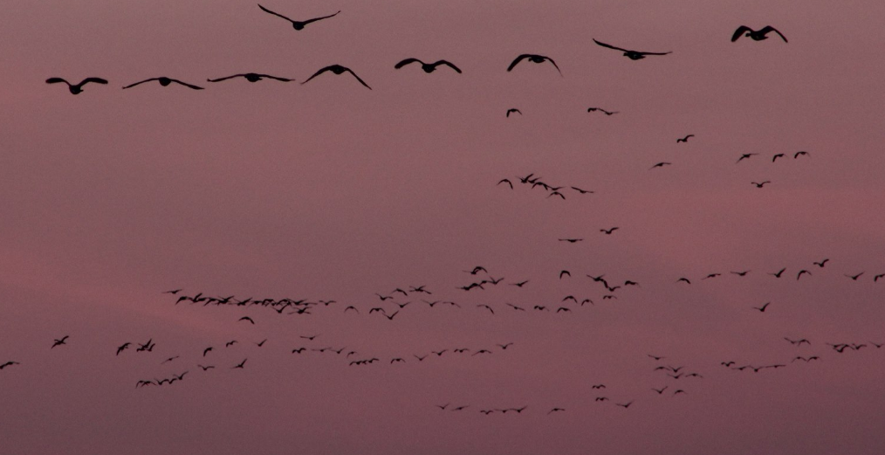
ALAN And Bird Migration Thousand Hills State Park

Slide 41
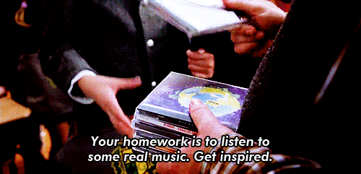
What can I do?
Audit of your property/neighborhood https://www.darksky.org/wp-content/uploads/bsk-pdf-manager/2020/01/Home-Lighting-Assessment-Print.pdf
Use dark sky friendly lighting at your home and business https://www.darksky.org/our-work/lighting/lighting-for-industry/fsa/fsa-products/
Advocate for a lighting ordinance in your town https://www.darksky.org/our-work/lighting/public-policy/lighting-ordinances/

Slide 42
What can I do?
Explore the darkskymissouri.org website and get involved https://www.darkskymissouri.org/
Watch ‘Saving the Dark’ Documentary by Sriram Murali (55 mins) https://www.youtube.com/watch?v=6fHxNn-FEnc
Participate in the Globe at Night (GaN) program https://www.globeatnight.org/

Slide 43
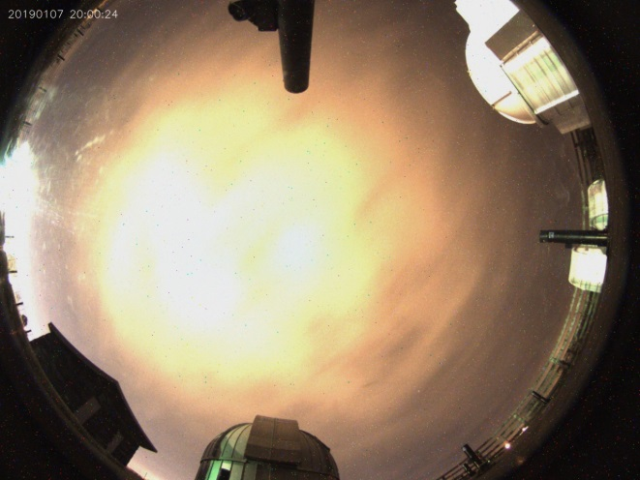
Summary
Most obvious and measurable symptom of LP is skyglow: Skyglow affects close to 80% of all people on the planet, and about 99% of US/European peoples.
You can help quantify light pollution via the GaN program and/or the Missouri SQM program.
Most of the quantifying methods we have seen measure skyglow: how much light is finding its way into the night sky?

Slide 44
Summary
Glare affects most of us, most commonly in the context of vehicle head-lights and/or bright LEDs mounted sideways on walls and/or Electronic Billboards
LED lights, due to greater directionality, cause greater glare.
Harder to quantify the effects of glare in terms of color, and its effects on “recovery time” of eyes.
Severity of glare is related largely to the dosage (how bright?).

Slide 45
Summary
Light Pollution is an increasing problem – urban sprawl and the increasing use of “inexpensive” LED lights is expected to make the problem worse.
“inexpensive” is doing a lot of heavy-lifting here
The inability to see stars is a symptom of the problem.
The real problem is the harm done to the ecological health, and the negative impact of LP on birds, pollinators, insects, and humans.

Slide 46
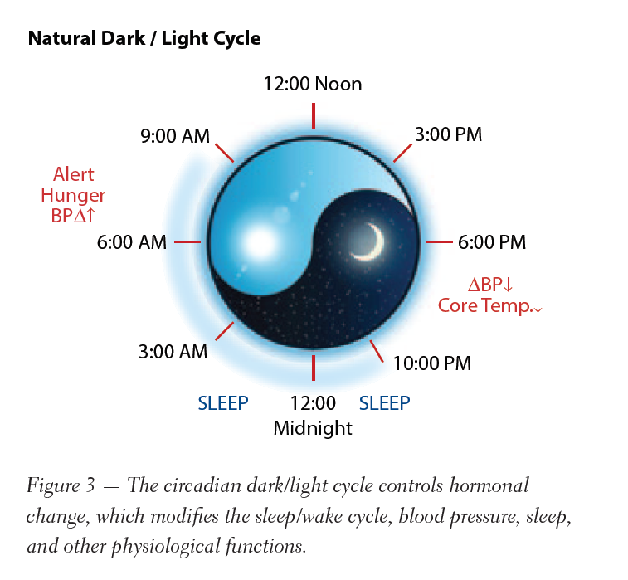
Why combat Light Pollution? The Circadian Rhythm
https://www.youtube.com/watch?v=BKQH6T1DZvI

Slide 47
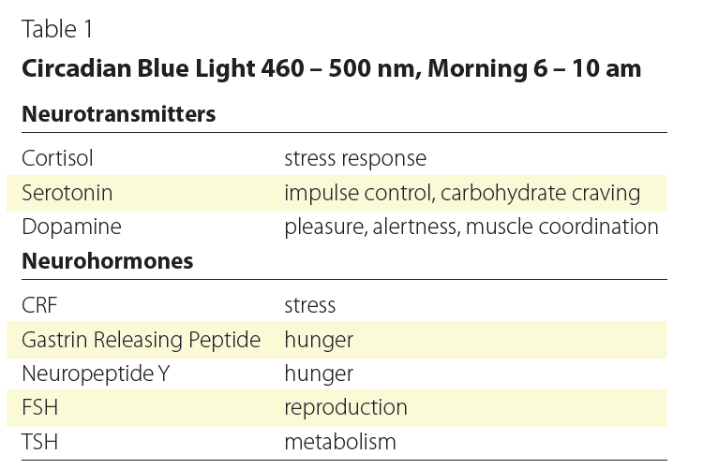
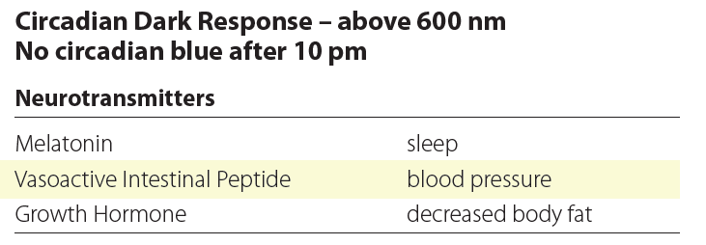
The Circadian Rhythm

Slide 48
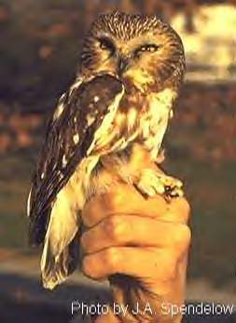
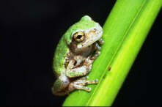
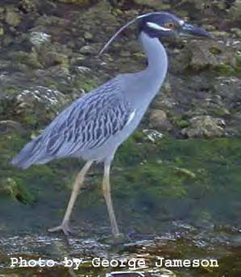
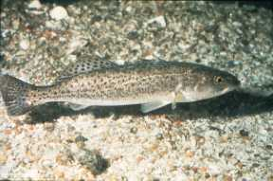
ALAN And Wildlife
Active at night, roost by day.
Some species are rare, threatened and endangered species.
Some species provide human and ecological health benefits.
Some species provide economic benefits
What are the effects of light pollution on their habitat and behavior?

Slide 49
ALAN & Habitat Disturbance Observations
Disruption of natural day-night illumination cycle in natural areas.
Replacement of nocturnal (night) cycle by elevated levels of continuous artificial lighting over broad natural areas.
Greatest exposure of terrestrial habitats is mostly under tree canopy and over ground level areas, which is the preferred zone of most terrestrial wildlife inhabitation.
Aquatic habitats subject to light trespass from upland and shoreline human habitation. Water surface reflections magnify light pollution.
Light pollution in wildlife habitats mimic extended daylight conditions causing wildlife behavior to be unnaturally modified.
Exposure of wildlife circadian rhythms to light pollution.
Wildlife biodiversity at risk in light polluted nocturnal habitats.
Diminished habitat function (e.g., shelter, protection, food).

Slide 50
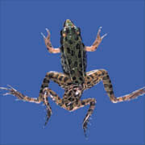
COMMONLY OBSERVED EFFECTS OF HARMFUL POLLUTANTS
Behavior
Growth
Reproduction
Survival
Death
Habitat Modification
Pollutant Environmental Fate
Population Effects

Slide 51
Similarities between Chemical and Light Pollution
Organism Impact Chemical* Light** LP Examples
Human Exposure yes yes urban/industrial settings
Wildlife Exposure yes yes urban/industrial settings
Abnormal behavior yes yes migrations, attraction/avoidance
Growth yes yes plants, cancer cells
Reproduction yes yes mammals, amphibians
Survival yes yes sea turtles, birds
Death yes yes sea turtles, birds
* Sufficient data generated by studies on numerous chemicals.
** Insufficient data; repeated observations of incidences and correlation to
presence of artificial lighting.

Slide 52
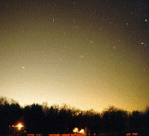
Similarities between Chemical and Light Pollution
Chemical Light Examples
Habitat Modification yes yes coastal ecosystems*
Population Effects yes yes sea turtles, birds
Pollutant Environmental Fate persistent persistent ubiquitous in urban/
or short-lived industrial environments
Ecological Imbalance yes yes coastal ecosystems *
Environmental Restoration*** expensive$$$ cheap$ Florida coasts**
Cedar River, WA****
Restoration benefits long term immediate Florida coasts**
Cedar River, WA****
* = Chesapeake Bay
** = Sea turtle nesting habitats
*** = See next slide for explanations
**** = See ‘fish slide ‘– sockeye salmon habitat

Slide 53
Environmental Restoration Comparison “Cleaning the Problem Up”
Hypothetical scenario – compare 10 acres of land in watershed environment contaminated by either hazardous chemicals or light pollution
Chemical Pollution ($$$$$$$$$$$$$$$)
Source – residual presence may persist after source is eliminated
Environmental noncompliance fines
Civil/criminal litigation costs
Remediation/clean-up/disposal costs
High Manpower/equipment costs
Chemical Monitoring/recovery costs
Long term recovery usually required
Certain conditions may impede full recovery
Public and wildlife health could potentially continue to be impacted after restoration.
Light Pollution ($)
Source – on/off; no residual presence after source is eliminated
Planning and design costs
Equipment retrofit costs
Disposal/recycle of old equipment
Less manpower/equipment demand
Low/no monitoring requirement
Short term recovery anticipated
Minimum impediment to full recovery
Public and wildlife health could potentially be significantly improved after restoration.

Slide 54
LOOKING AT THE TOP OF THE FOOD CHAIN
HUMAN HEALTH IMPACTS
A MODEL FOR WILDLIFE EXPOSURE?
Circadian rhythms set to natural cycle of day and night
Light controls body’s internal clock or “circadian rhythm”
Immune System is circadian
Correlation between low melatonin levels and cancer in humans
Wildlife in or near urban areas may have more exposure to light pollution than humans
What are the physiological effects of light pollution on wildlife?
Could possible physiological changes resulting from light
pollution exposure result in the decline of wildlife species?

Slide 55
PUBLIC POLLUTION REGULATION
Chemical pollution tightly regulated by public law and multiple agencies
Light pollution is not regulated by environmental agencies.
Most agencies and many environmental interest groups are dead asleep on the issue
The States of Florida, for example, has set the precedent to regulate outdoor lighting strictly for wildlife conservation purposes.

Slide 56
PUBLIC POLLUTION REGULATION
Agencies put the burden on local governments to control light pollution.
WRONG APPROACH!!!!!
Light pollution needs the same attention as
chemical pollution
Environmental agencies need to address light pollution as a regional ecosystem and wildlife management approach.
Examples: Chesapeake Bay Program
Florida Everglades Program
Great Lakes Program

Slide 57
Specific Example of ALAN
Affecting Insects and Pollinators

Slide 58
ALAN And Pollinators

Slide 59
Role of Pollinators in Nature
Virtually all of the world’s seed plants need to be pollinated.
This is just as true for cone-bearing plants, such as pine trees on Alpine peaks, as for the more colorful and familiar flowering plants we see around us in Missouri.
Pollen, looking like insignificant yellow dust, bears a plant’s male sex cells and is a vital link in the reproductive cycle.
With adequate pollination, wildflowers:
Reproduce and produce enough seeds for dispersal and propagation
Maintain genetic diversity within a population
Develop adequate fruits to entice seed dispersers
https://www.youtube.com/watch?v=chvXwNbs3SA

Slide 60
Pollinators
https://www.fs.fed.us/wildflowers/pollinators/importance.shtml
The flower type, shape, color, odor, nectar, and structure vary by the type of pollinator that visits them.
Such characteristics are considered pollination syndromes and can be used to predict the type of pollinator that will aid the flower in successful reproduction.

Slide 61
ALAN And Pollinators

Slide 62
Bird Migration and FLAP
https://flap.org/
Fatal Light Awareness Program (FLAP) Canada is a registered Canadian charity widely recognized as the pre-eminent authority on the bird-building collision issue.
Each year in Canada, around 25 million migratory birds die as a direct result of collisions with buildings.
We can only expect that number to grow unless we all work together to help mitigate local biodiversity loss through urban development that considers wildlife species.
For almost 30 years, FLAP Canada has engaged millions of people with dozens of campaigns and initiatives with one goal: keep birds safe from deadly collisions with buildings.

Slide 63
Preventing Birds Hitting Buildings
Apply markings in a dense pattern, leaving no gaps more than 5 cm by 5 cm (2 inches by 2 inches). If gaps are any larger, birds may try to fly through them and still hit the window.
Apply markings to the outside surface of the glass, NOT the inside. Reflections of trees or sky on the outside of the window may render any internal window markings invisible.
Markings must be of high contrast so that they stand out on the window. Markings with poor contrast, for example black dots on a very dark window, might not be noticed by birds.
Each marking should be no less than 6 mm (1/4 inch) in diameter.
Markings must cover the entire surface of the glass.
https://flap.org/stop-birds-from-hitting-windows/

Slide 64
ALAN And Bird Migration: References
https://www.audubon.org/lights-out-program
https://www.audubon.org/news/four-decades-building-strike-records-point-super-collider-birds
https://www.darksky.org/light-pollution-poses-threat-to-migrating-birds/
https://flap.org/
https://flap.org/wp-content/uploads/2019/11/US-Fish-and-Wildlife-Best-Practices.pdf
https://www.nature.com/articles/s41598-018-21577-6.pdf
https://birdcast.info/

Slide 65
Springtime in America…
THERE WAS ONCE a town in the heart of America where all life seemed to live in harmony with its surroundings. The town lay in the midst of a checkerboard of prosperous farms, with fields of grain and hillsides of orchards where, in spring, white clouds of bloom drifted above the green fields. In autumn, oak and maple and birch set up a blaze of color that flamed and flickered across a backdrop of pines. Then foxes barked in the hills and deer silently crossed the fields, half hidden in the mists of the fall mornings.
….
Then a strange blight crept over the area and everything began to change. Some evil spell had settled on the community: mysterious maladies swept the flocks of chickens; the cattle and sheep sickened and died. Everywhere was a shadow of death. The farmers spoke of much illness among their families. In the town the doctors had become more and more puzzled by new kinds of sickness appearing among their patients….

Slide 66
Springtime in America…
Only within the moment of time represented by the present century has one species—man—acquired significant power to alter the nature of his world. During the past quarter century this power has not only increased to one of disturbing magnitude but it has changed in character. The most alarming of all man’s assaults upon the environment is the contamination of air, earth, rivers, and sea with dangerous and even lethal materials...
….
All this has been risked—for what? Future historians may well be amazed by our distorted sense of proportion. How could intelligent beings seek to control a few unwanted species by a method that contaminated the entire environment and brought the threat of disease and death even to their own kind? Yet this is precisely what we have done.

Slide 67
Birds at Night (Horton et al., 2019)
Of the nearly 630 terrestrial species of birds regularly occurring in North America, approximately 70% are considered migratory, and of these more than 80% migrate at night.
Trillions of flying organisms (eg birds, bats, insects) occupy the airspace within the troposphere during different periods of their annual cycles.
The recent recognition of airspace as vital habitat – one that is subject to increasing modification by humans – highlights the fundamental need to understand how organisms cope with such alterations.
Positive phototaxis is of particular concern for the conservation of migrating birds. Bright lighting in cities can become a beacon to some species, drawing them away from their migratory routes.

Slide 68
ALAN And Bird Migration
Why do land birds migrate at night?
Birds’ instinct to migrate is largely influenced by sudden shifts in temperature, available daylight (photo period), moon phases and light tail winds.
The evaluation of land bird migration has determined that flying conditions for long-distance travel are most favorable under the cover of darkness.
These favorable conditions include less potential for predation, cooler temperatures to help maintain body temperature and less inclement weather.

Slide 69
Birds at Night (Horton et al., 2019)
FLAP estimates that in Canada, approximately 25 million birds die due to bird collisions with buildings.
The Smithsonian reported that collisions likely kill between 365 million and 1 billion birds annually in the United States, with a median estimate of 599 million.
Homes and other buildings one to three stories tall accounted for 44 percent of all bird fatalities, about 253 million bird deaths annually
Larger, low-rise buildings four to 11 stories high caused 339 million deaths
And high-rise buildings, 11 floors and higher, kill 508,000 total birds annually.
https://flap.org/
https://abcbirds.org/

Slide 70
Birds at Night (Cabrera-Cruz et al., 2018)
“Our results suggest that migratory birds may be subject to the effects of light pollution particularly during migration, the most critical stage in their annual cycle. We hope these results will spur further research on how light pollution affects not only migrating birds, but also other highly mobile animals throughout their annual cycle.”

Slide 71
ALAN And Bird Migration
During the day they rely on the resources available in natural spaces to rest and refuel before taking off again the next night.
However, as they pass over big cities on their way, they can become disoriented by bright artificial lights and skyglow.
ALAN and skyglow around buildings can be fatal to migrating birds.
Some are casualties of nighttime collisions with windows and walls.
Others can circle in confusion until dawn, when they land – potentially without access to critical resources – and are subject to other urban threats.

