Slide 1
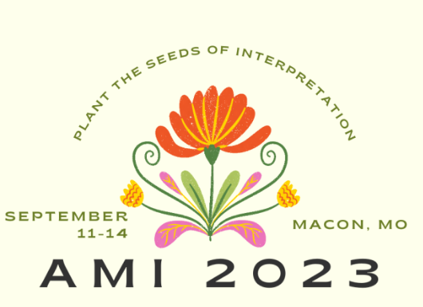
Let there be night
Vayujeet Gokhale
Professor of Physics and Astronomy
Truman State University

Slide 2
!! BECOME DARK SKY ADVOCATES !!
FACEBOOK: DARKSKYMISSOURI

Slide 3
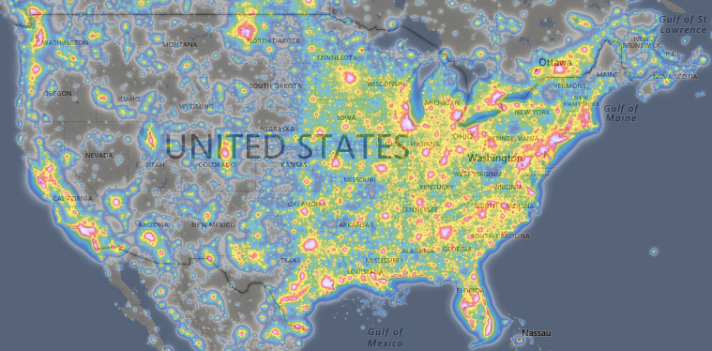
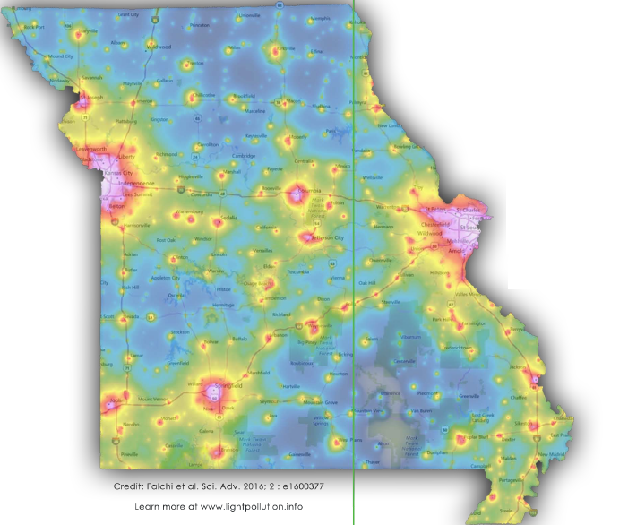
The Challenge
https://lightpollutionmap.info/
“The loss of the night sky is placed in the broader context of society’s difficulty in fully articulating non-consumptive values such as natural beauty.”
Terrell Gallaway (Missouri State University; IDA-Mo Board Member)
How to bridge this gap!?

Slide 4
Interpreting Dark Skies
Dark Sky Heritage: Stargazing, myths, constellations, loss of night, light pollution
Darkness and Human wellbeing
Circadian Rhythm (Color of light bulb)
Direct glare (Intensity of light and directionality of fixture)
Darkness at night: Impact on living beings
Birds and bird migration
Insects and pollinators
Light pollution versus other forms of Pollution
Similarities: waste, carbon footprint, “bad neighbor”
Differences: expense, Local solutions, win-win for all parties

Slide 5
Natural Illumination Night and Day Discussion topic 0: Discuss the value of darkness at night
“…shadows from the starlight,
softer than a lullaby…”

Slide 6
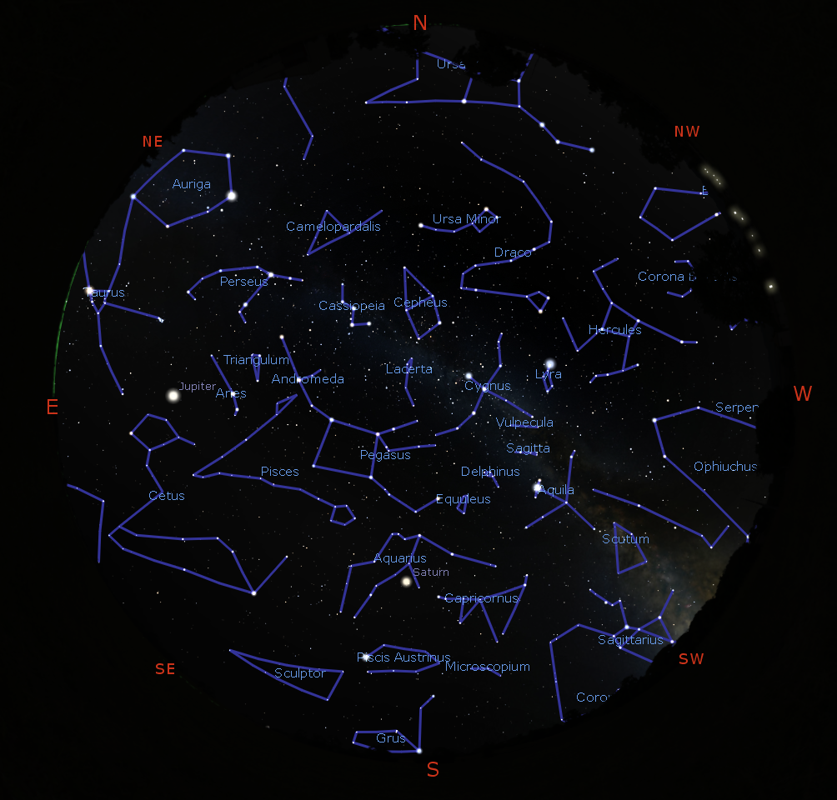
Myths & Constellations
https://stellarium.org/

Slide 7
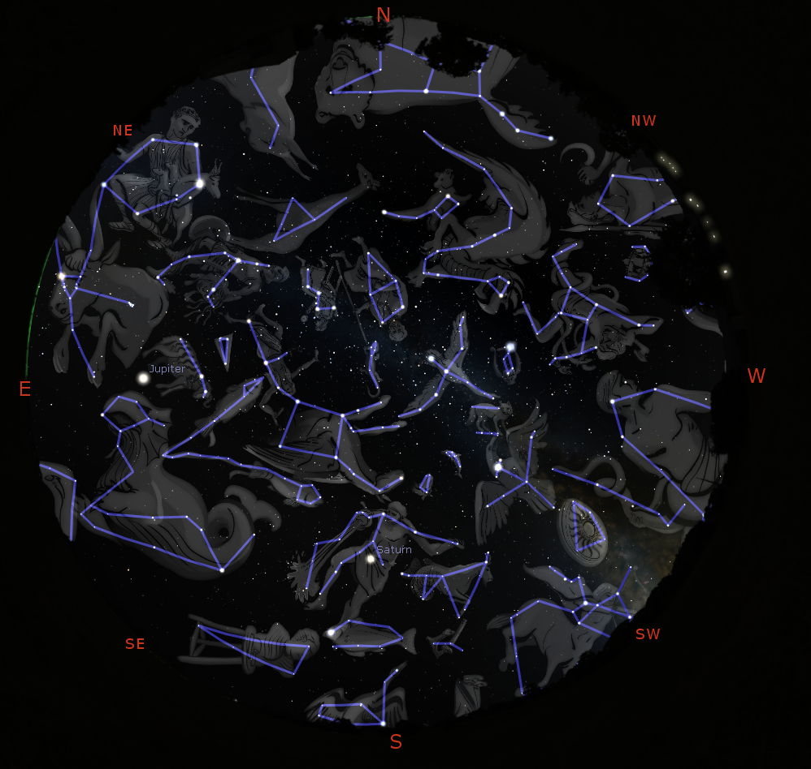
Myths & Constellations
https://stellarium.org/

Slide 8
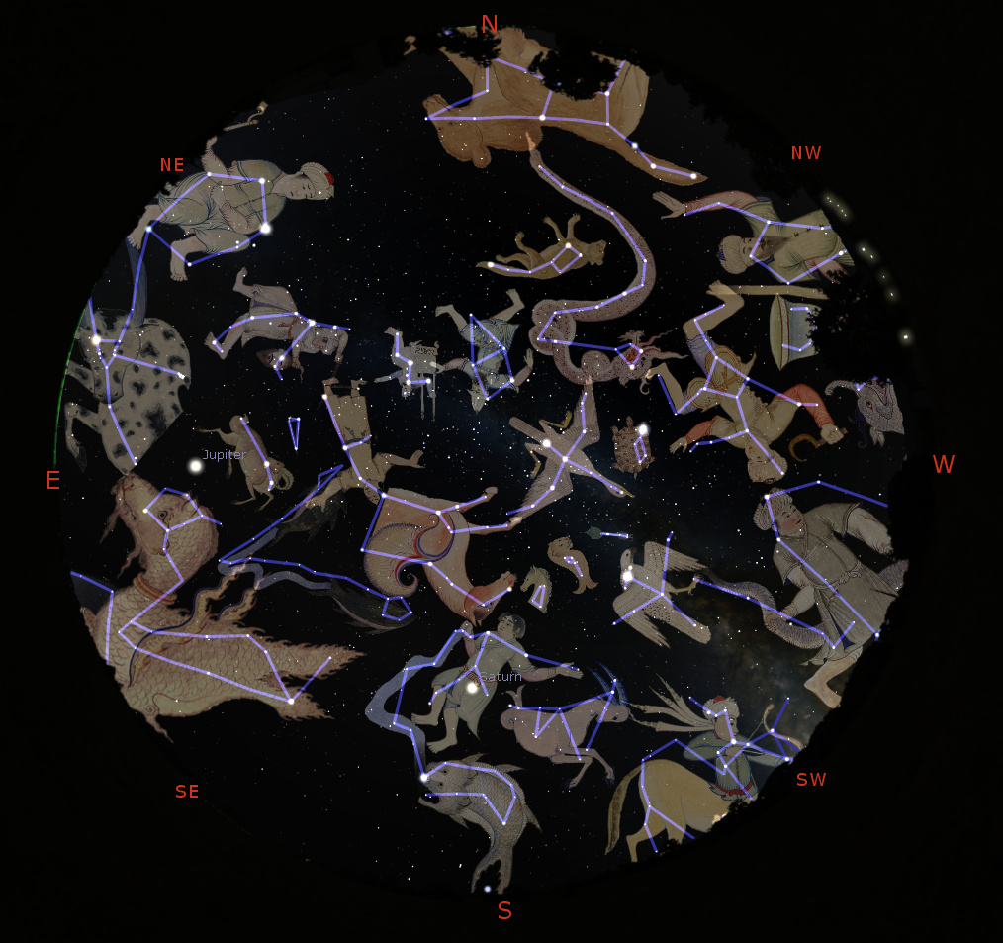
Myths & Constellations
https://stellarium.org/

Slide 9
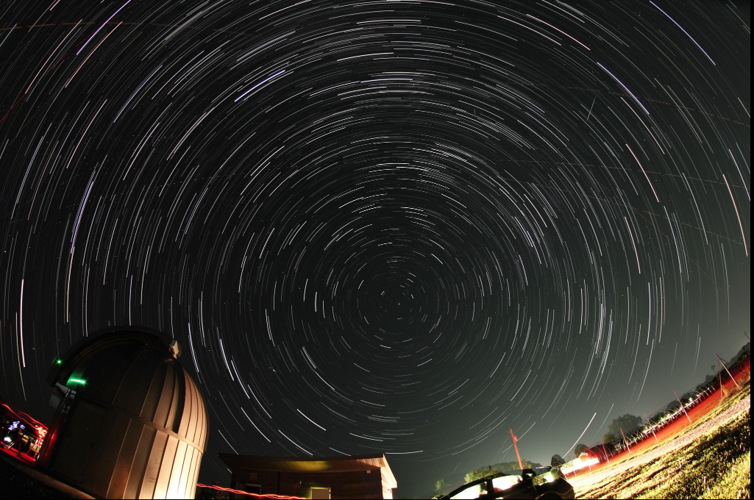
Myths & Constellations

Slide 10
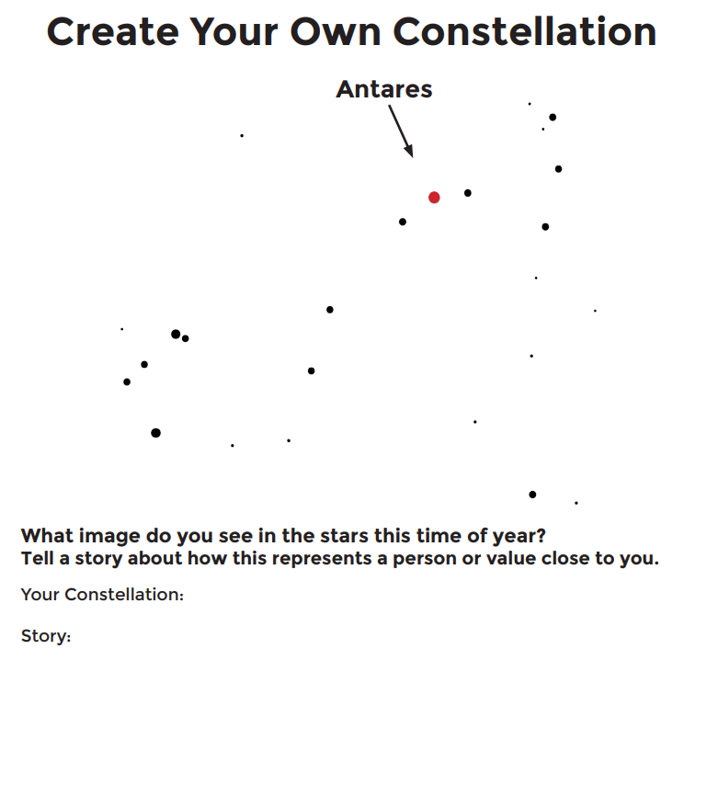
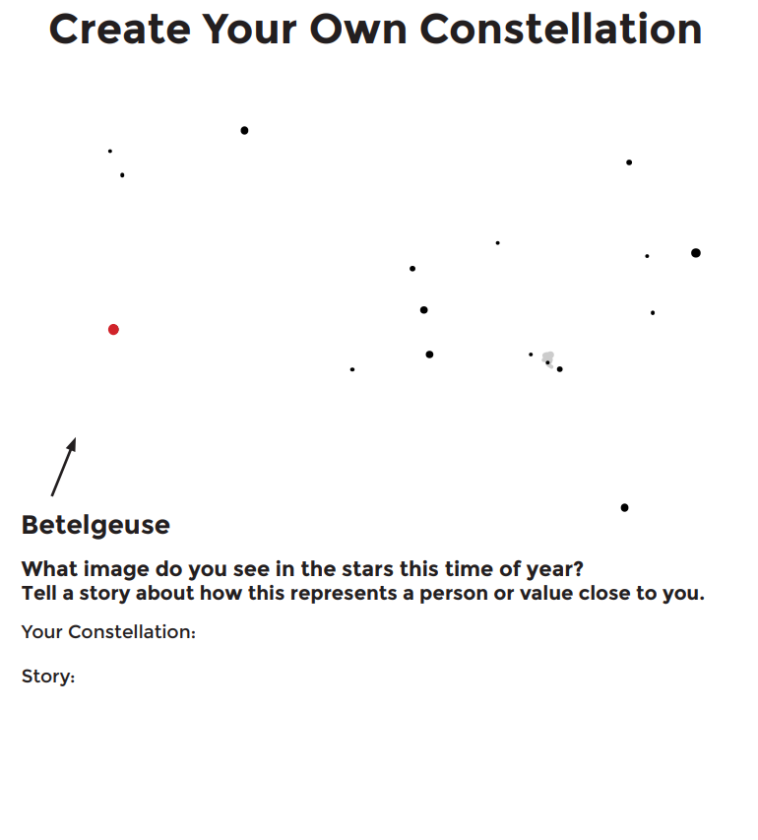
Create your own Constellations
https://nightsky.jpl.nasa.gov/docs/ConstellationWorksheet.pdf

Slide 11
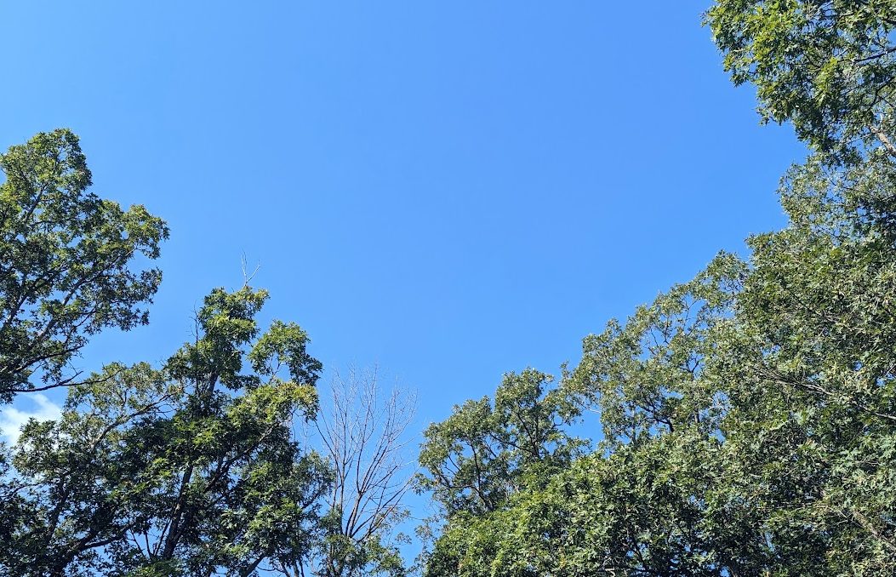
Blue Skies, Twilight, and Darkness at Night

Slide 12
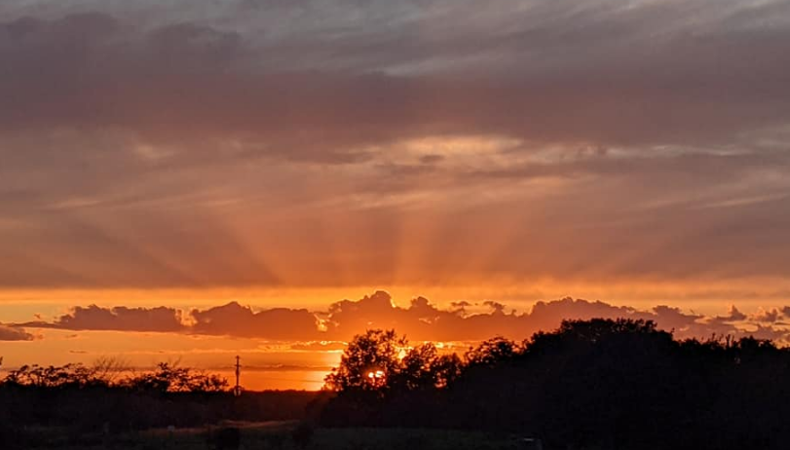
Blue Skies, Twilight, and Darkness at Night

Slide 13
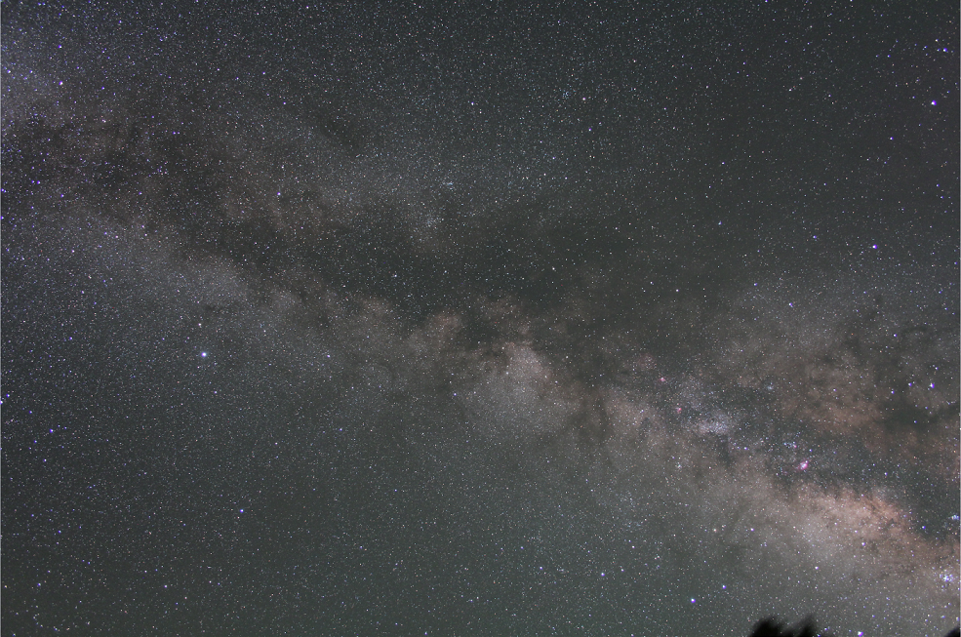
“Darkness” at night
Flagstaff, Az 5 minute exposure, tracking ‘on’

Slide 14
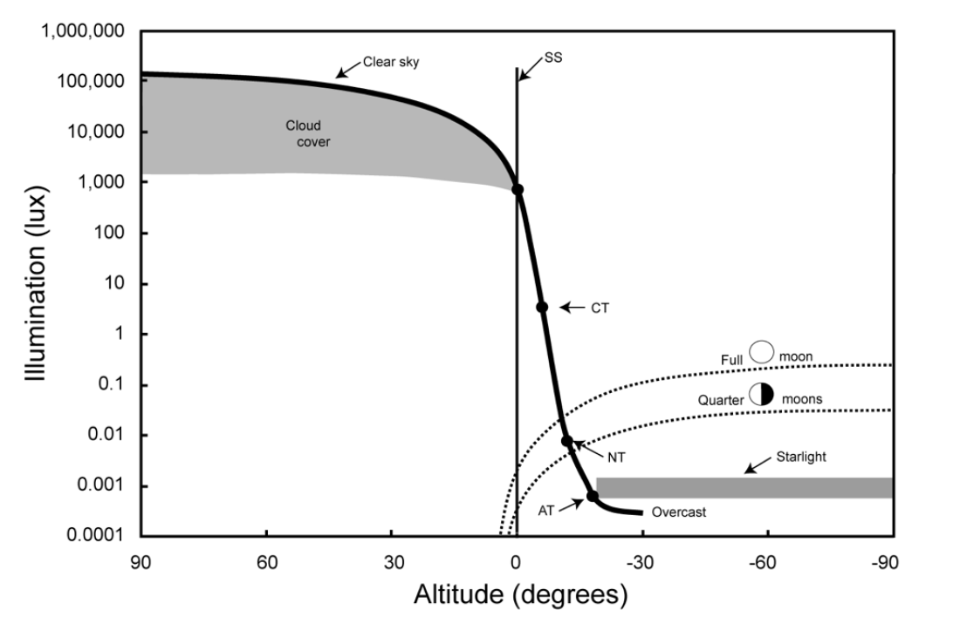
Natural Illumination Night and Day
Urban Lighting
Credit: T. Longcore
Parking Lots
Billboards
Urban Parks
Sky Glow
Dark Sky International: State of the Science 2023, John Barentine

Slide 15
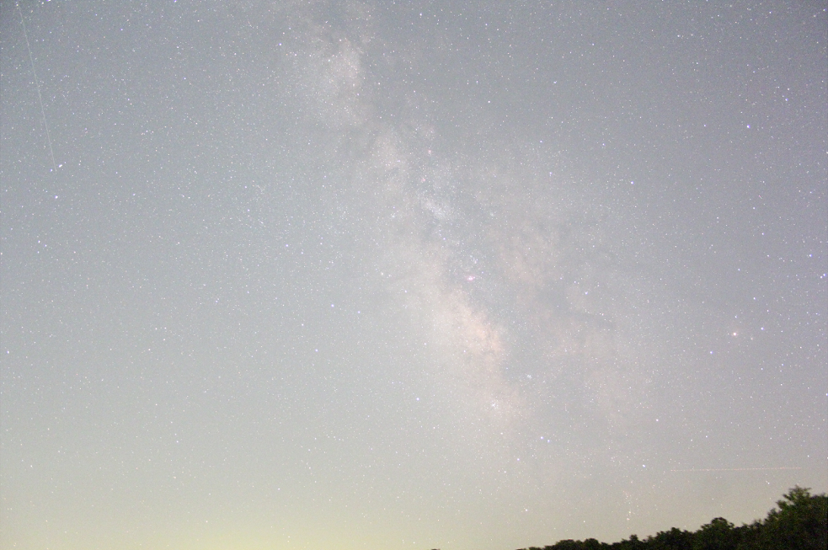
“Darkness” at night: Sky Glow
Kirksville, Mo 1 minute exposure, tracking ‘on’

Slide 16
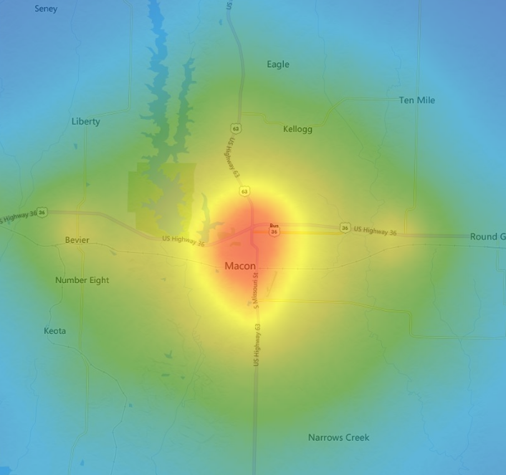
https://www.lightpollutionmap.info/

Slide 17
Lighting Color
Look at the stars, Look how they shine for you…

Slide 18
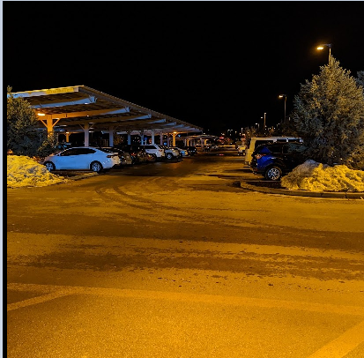
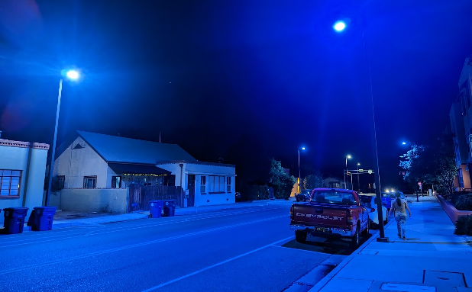
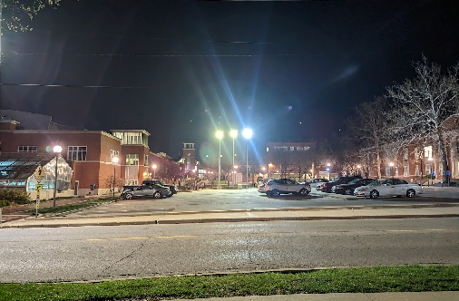
Amber, Blue, and White Light
Residential Neighborhood Albuquerque, NM
Walmart @Flagstaff, Az
Parking lot @ Truman State

Slide 19
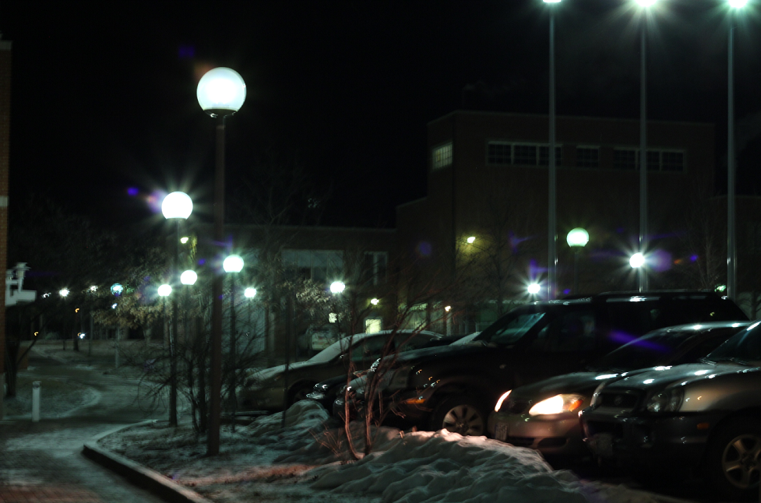
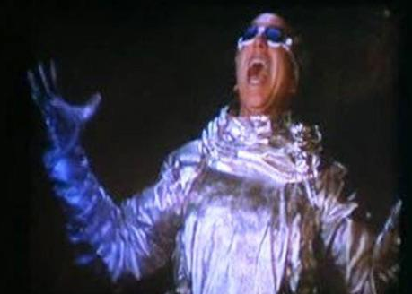
Glare Bombs Galore: Truman Campus
Flaming Globes of Sigmund!

Slide 20
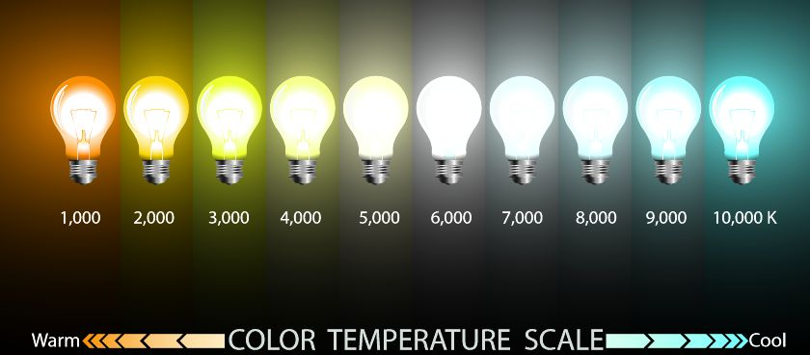
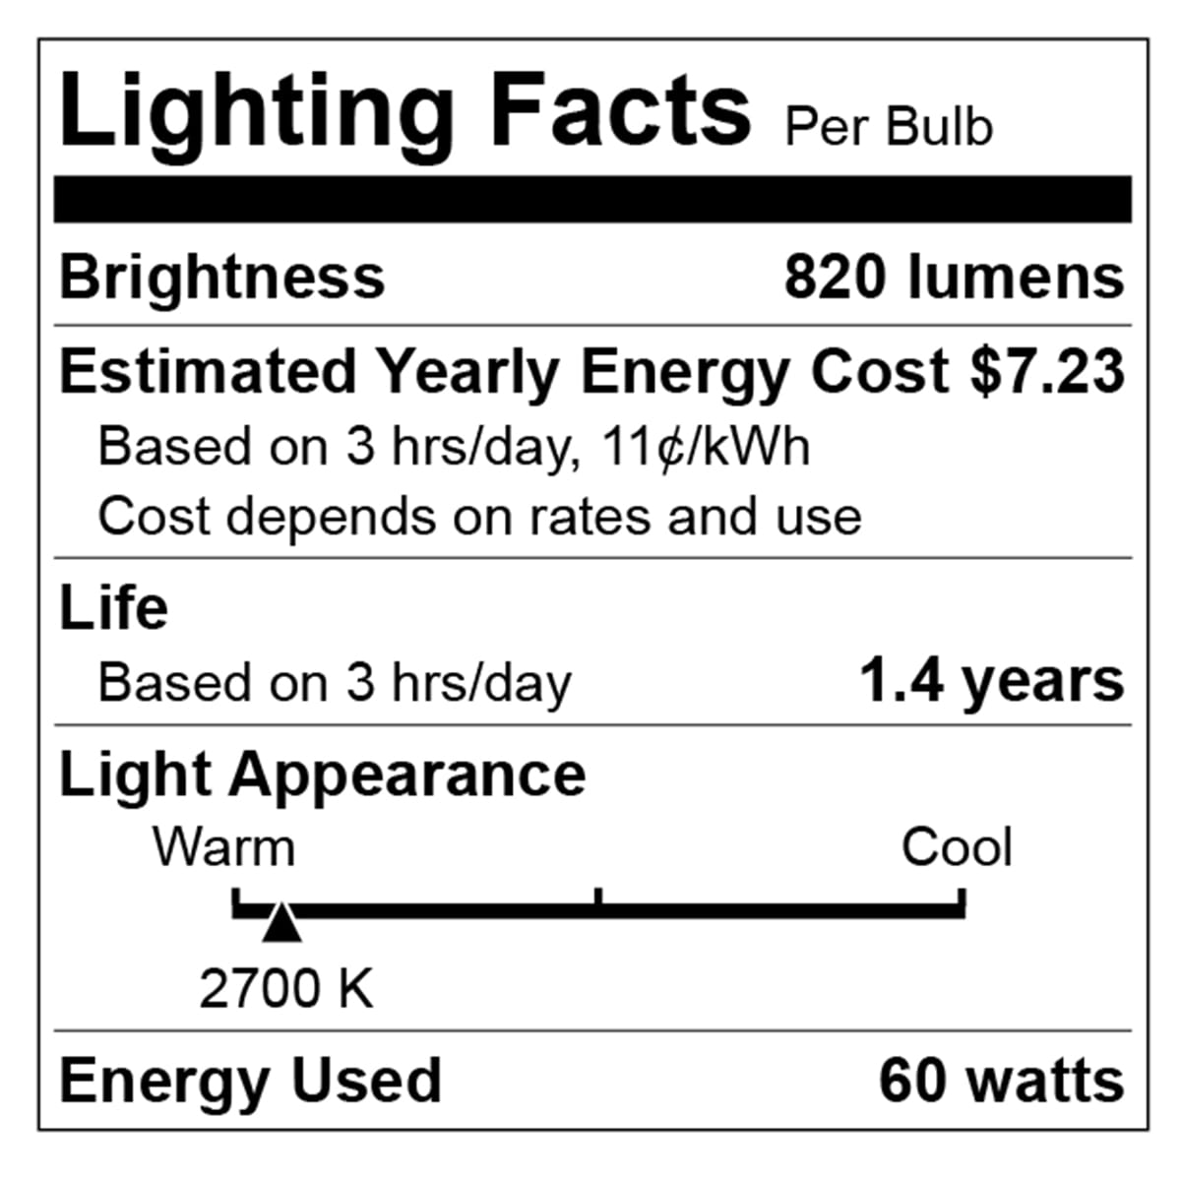
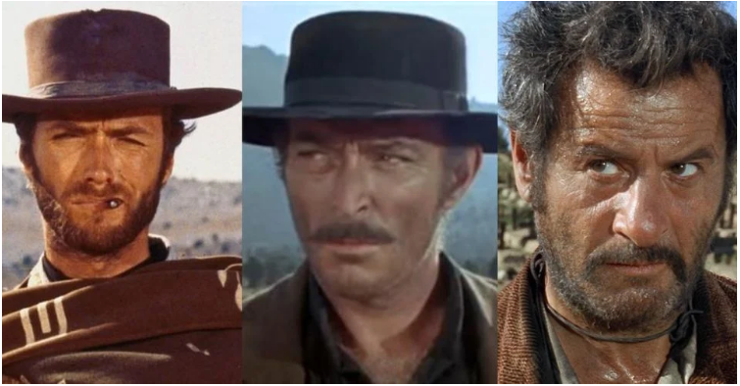
Light Intensity and Color are both important
For outdoor lighting, aim for 3000 K and below, preferably about 2000 K.
Orange/Red good, yellow bad, blue light ugly

Slide 21
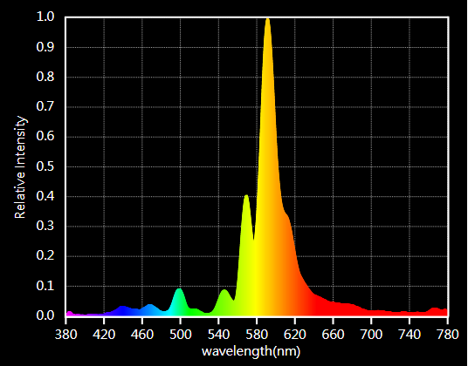
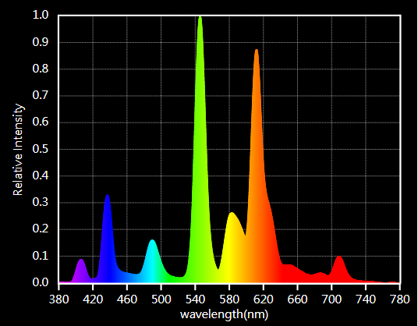
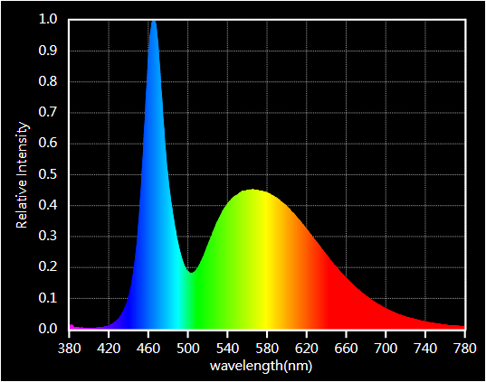
Color is important but check spectrum!

Slide 22
Discussion Topic I Where and How would you include the impact of (“bad” and “good”) ALAN into your role as interpreter?
Lighting Demo
Glare
Color

Slide 23
Reducing Light Pollution
Efficiency versus over-consumption
Between the swan and Hercules, Where even dark clouds glow…

Slide 24
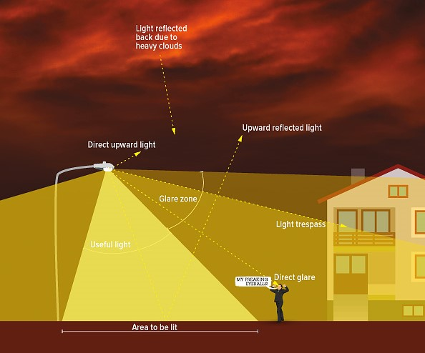
What is Light Pollution? [ALAN = Artificial Light At Night]
Color?
Photo Credit: Dark Sky International
Directionality?
Utility?
Intensity

Slide 25
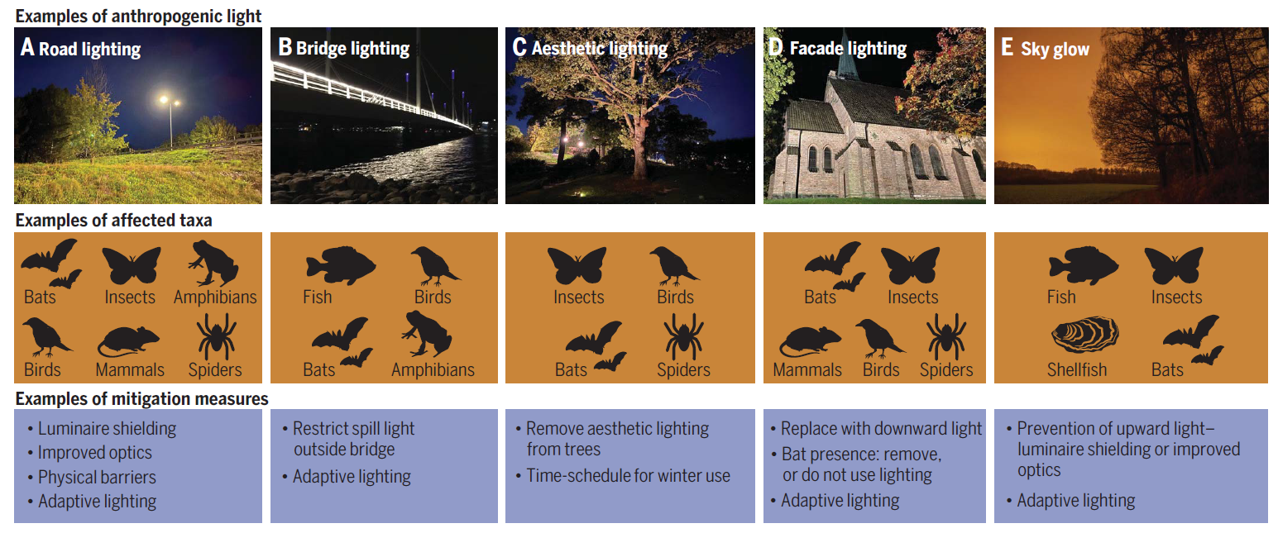
What is Light Pollution? [ALAN = Artificial Light At Night]
“Effects of anthropogenic light on species and ecosystems” -- Annika K. Jägerbrand and Kamiel Spoelstra, Science: Light Pollution Special Issue 2023

Slide 26
Reducing Light Pollution
The technical solutions to light pollution are rather straight-forward: minimize use of outdoor light, direct it where it is needed, and use amber/red light instead of blue-white light.
The bigger challenge is to overcome individual and institutional inertia and make people change their habits.
This requires dark sky advocates to take the initiative and engage the public to create awareness about the issues involved, and to move people to act and demand change [bottom-up approach].
Additionally, dark sky advocates need to talk to administrators and lawmakers to help them pass laws and ordinances that prohibit the unnecessary and indiscriminate use of outdoor lights [top-down approach].

Slide 27
How to combat Light Pollution?

Slide 28
What Questions do you have about lighting solutions?
The brightest light casts the darkest shadow…

Slide 29
Discussion Topic II What immediate solutions would you recommend to others and/or to your own organization vis-à-vis nighttime lighting?

Slide 30
Why Combat ALAN? Or How does bad lighting affect living beings?
Let there be night…

Slide 31
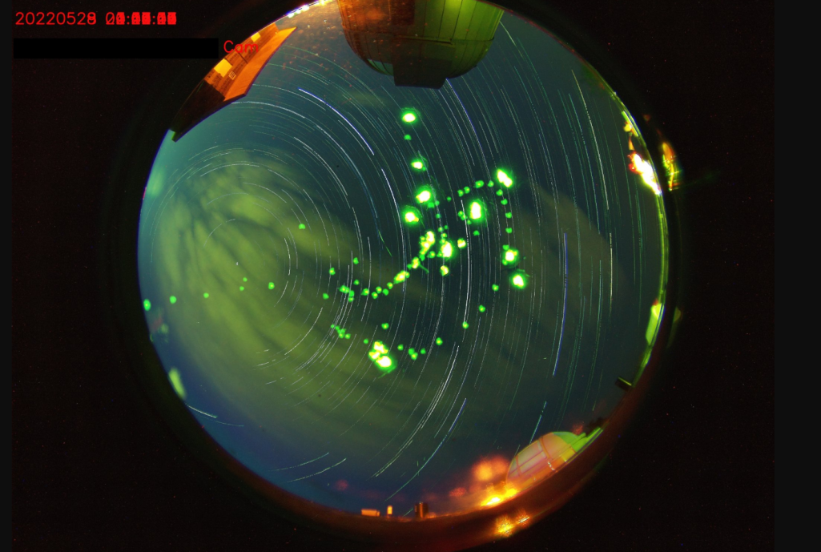
Why Combat Light Pollution?
Human Health and Safety
Circadian rhythm
Vision impaired by Glare
Animal Health
Bird Migration, Sea Turtles
Bees, Fireflies, and other insects
Ecological impact
The Environment
Increased greenhouse emissions
Unnecessary waste of precious natural resources
Astronomy
Stargazing, astronomy research
Heritage & Aesthetics
Fireflies photobomb the all -sky-camera at the Truman State Observatory

Slide 32
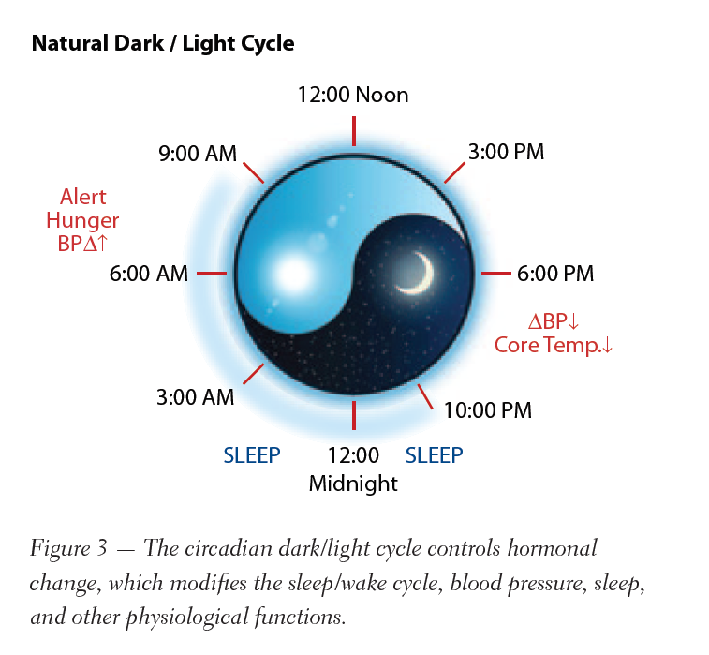
Why combat Light Pollution? The Circadian Rhythm
https://www.youtube.com/watch?v=BKQH6T1DZvI

Slide 33
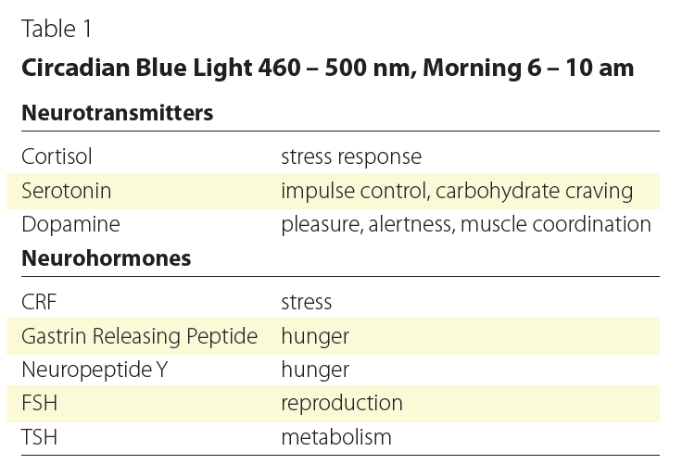
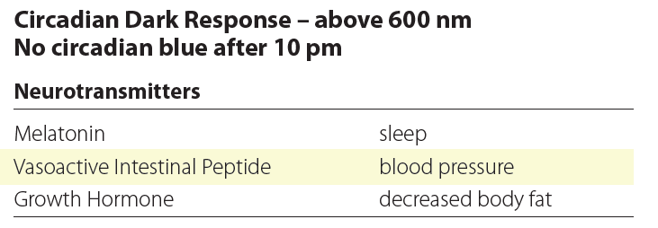
The Circadian Rhythm

Slide 34
ALAN and Humans
Glare affects most of us, most commonly in the context of vehicle head-lights and/or bright LEDs mounted sideways on walls and/or Electronic Billboards
LED lights, due to greater directionality, cause greater glare.
Harder to quantify the effects of glare in terms of color, and its effects on “recovery time” of eyes.
Severity of glare is related largely to the dosage (how bright?).

Slide 35
ALAN and Humans
Light Pollution is an increasing problem – urban sprawl and the increasing use of “inexpensive” LED lights is expected to make the problem worse.
“inexpensive” is doing a lot of heavy-lifting here
The inability to see stars is a symptom of the problem.
The real problem is the harm done to the ecological health, and the negative impact of LP on birds, pollinators, insects, and humans.

Slide 36
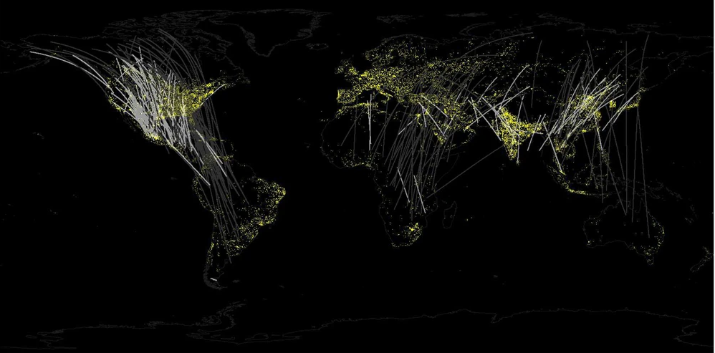
Birds and ALAN: Bird Migration

Slide 37
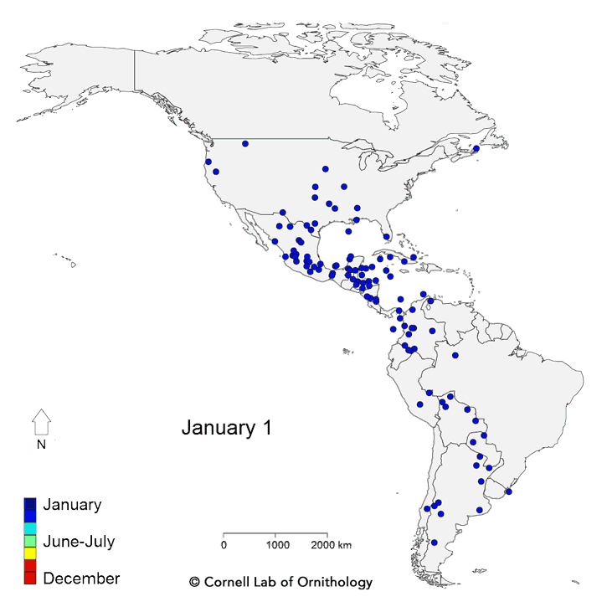
ALAN And Bird Migration
Twice each year, billions of birds fly between wintering and breeding grounds, facing innumerable threats along the way.
“Live” bird migration maps!
https://birdcast.info/migration-tools/live-migration-maps/
https://www.allaboutbirds.org/news/mesmerizing-migration-watch-118-bird-species-migrate-across-a-map-of-the-western-hemisphere/

Slide 38
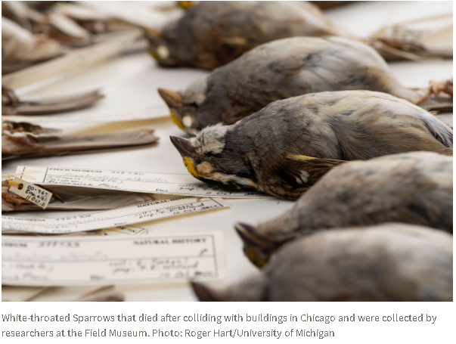
ALAN And Bird Migration
During the day they rely on the resources available in natural spaces to rest and refuel before taking off again the next night.
However, as they pass over big cities on their way, they can become disoriented by bright artificial lights and skyglow.
ALAN and skyglow around buildings can be fatal to migrating birds:
Some are casualties of nighttime collisions with windows and walls.
Others can circle in confusion until dawn, when they land – potentially without access to critical resources – and are subject to other urban threats.

Slide 39
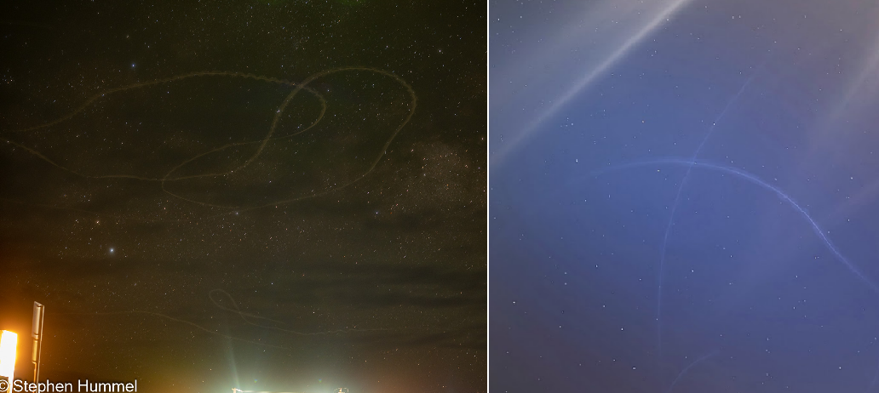
ALAN And Birds
Birds trapped in light domes near Big Bend National Park (left) and Kirksville, Missouri (right)

Slide 40
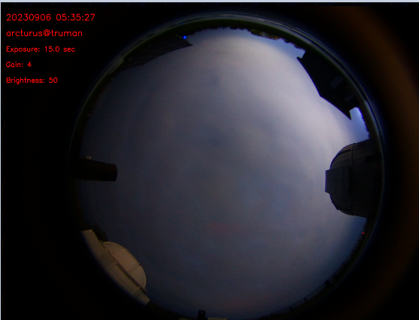
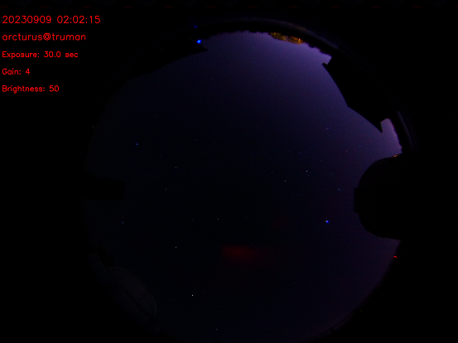
Light Pollution, Moon Phase, Clouds
Clear Night
Cloudy night

Slide 41
ALAN And Bird Migration
ALAN is completely disrupting the cycles associated with moon-phase, since cloudy nights in cities mimics clear nights with Moonlight vis-à-vis sky brightness, which could severely confuse migratory birds.
Also note that birds tend to follow waterways and rivers on their migration routes, and these are locations were humans tend to settle as well.
For example: STL, KC, Chicago, Minniapolis, Memphis, Baton Rouge, New Orleans are only a few cities along just the Mississippi river!
Cities = High-rise buildings and lots of light pollution, and this is not good for migrating birds ☹

Slide 42
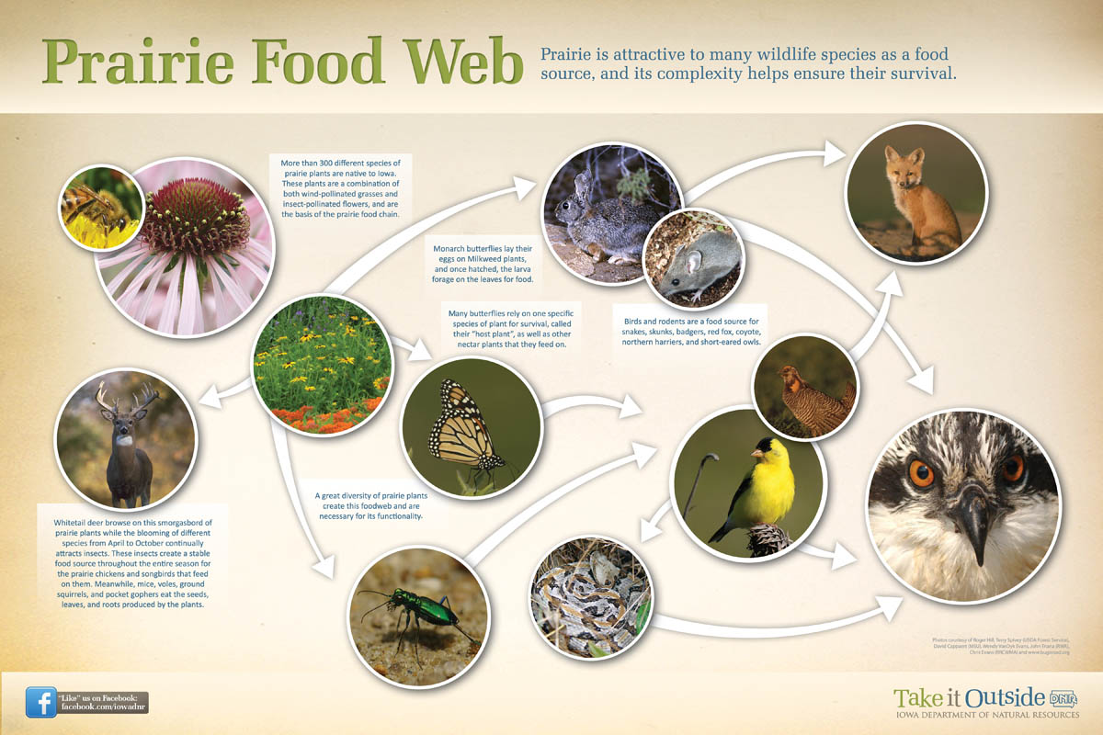
ALAN And Pollinators

Slide 43
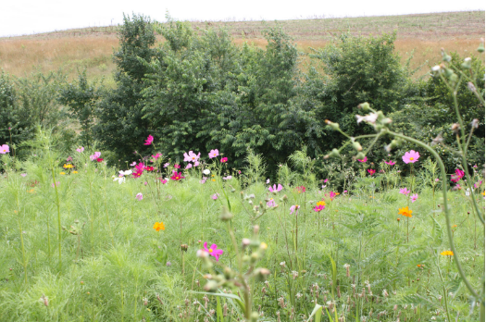
Role of Pollinators in Nature
Virtually all of the world’s seed plants need to be pollinated.
This is just as true for cone-bearing plants, such as pine trees on Alpine peaks, as for the more colorful and familiar flowering plants we see around us in Missouri.
Pollen, looking like insignificant yellow dust, bears a plant’s male sex cells and is a vital link in the reproductive cycle.
With adequate pollination, wildflowers:
Reproduce and produce enough seeds for dispersal and propagation
Maintain genetic diversity within a population
Develop adequate fruits to entice seed dispersers
https://www.youtube.com/watch?v=chvXwNbs3SA

Slide 44
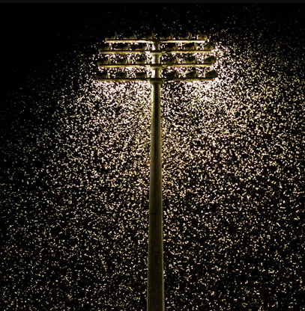
ALAN and Insects
Thousands of moths swarm around floodlights. Photograph: Simone De Peak/Getty Images
Fireflies photobomb the all -sky-camera at the Truman State Observatory

Slide 45
Light “pollution” versus Other forms of pollution (Air, Water, etc.)
Light Pollution is Global problem with local solutions…

Slide 46
ALAN & Habitat Disturbance Observations
Disruption of natural day-night illumination cycle in natural areas.
Replacement of nocturnal (night) cycle by elevated levels of continuous artificial lighting over broad natural areas.
Greatest exposure of terrestrial habitats is mostly under tree canopy and over ground level areas, which is the preferred zone of most terrestrial wildlife inhabitation.
Aquatic habitats subject to light trespass from upland and shoreline human habitation. Water surface reflections magnify light pollution.

Slide 47
ALAN & Habitat Disturbance Observations
Light pollution in wildlife habitats mimic extended daylight conditions causing wildlife behavior to be unnaturally modified.
Exposure of wildlife circadian rhythms to light pollution.
Wildlife biodiversity at risk in light polluted nocturnal habitats.
Diminished habitat function (e.g., shelter, protection, food).

Slide 48
Similarities between Chemical and Light Pollution
Organism Impact Chemical* Light** LP Examples
Human Exposure yes yes urban/industrial settings
Wildlife Exposure yes yes urban/industrial settings
Abnormal behavior yes yes migrations, attraction/avoidance
Growth yes yes plants, cancer cells
Reproduction yes yes mammals, amphibians
Survival yes yes sea turtles, birds
Death yes yes sea turtles, birds
* Sufficient data generated by studies on numerous chemicals.
** Insufficient data; repeated observations of incidences and correlation to
presence of artificial lighting.

Slide 49
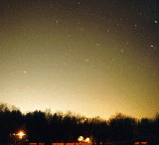
Similarities between Chemical and Light Pollution
Chemical Light Examples
Habitat Modification yes yes coastal ecosystems*
Population Effects yes yes sea turtles, birds
Pollutant Environmental Fate persistent persistent ubiquitous in urban/
or short-lived industrial environments
Ecological Imbalance yes yes coastal ecosystems *
Environmental Restoration*** expensive$$$ cheap$ Florida coasts**
Cedar River, WA****
Restoration benefits long term immediate Florida coasts**
Cedar River, WA****
* = Chesapeake Bay
** = Sea turtle nesting habitats
*** = See next slide for explanations
**** = See ‘fish slide ‘– sockeye salmon habitat

Slide 50
Environmental Restoration Comparison “Cleaning the Problem Up”
Hypothetical scenario – compare 10 acres of land in watershed environment contaminated by either hazardous chemicals or light pollution
Chemical Pollution ($$$$$$$$$$$$$$$)
Source – residual presence may persist after source is eliminated
Environmental noncompliance fines
Civil/criminal litigation costs
Remediation/clean-up/disposal costs
High Manpower/equipment costs
Chemical Monitoring/recovery costs
Long term recovery usually required
Certain conditions may impede full recovery
Public and wildlife health could potentially continue to be impacted after restoration.
Light Pollution ($)
Source – on/off; no residual presence after source is eliminated
Planning and design costs
Equipment retrofit costs
Disposal/recycle of old equipment
Less manpower/equipment demand
Low/no monitoring requirement
Short term recovery anticipated
Minimum impediment to full recovery
Public and wildlife health could potentially be significantly improved after restoration.

Slide 51
PUBLIC POLLUTION REGULATION
Chemical pollution tightly regulated by public law and multiple agencies
Light pollution is not regulated by environmental agencies.
Most agencies and many environmental interest groups are dead asleep on the issue
The States of Florida, and increasingly the mountain states, are setting the precedent to regulate outdoor lighting strictly for wildlife conservation purposes.

Slide 52
Discussion Topic III Discuss the value of darkness at night. List of Actions YOU intend to take to protect this darkness

Slide 53
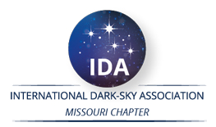
!! BECOME DARK SKY ADVOCATES !!
INSTAGRAM: DARKSKYMISSOURI

Slide 54
Extra Slides

Slide 55
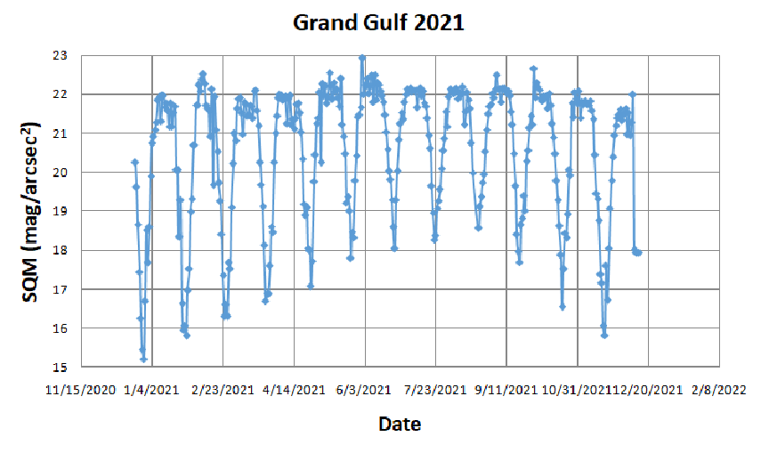
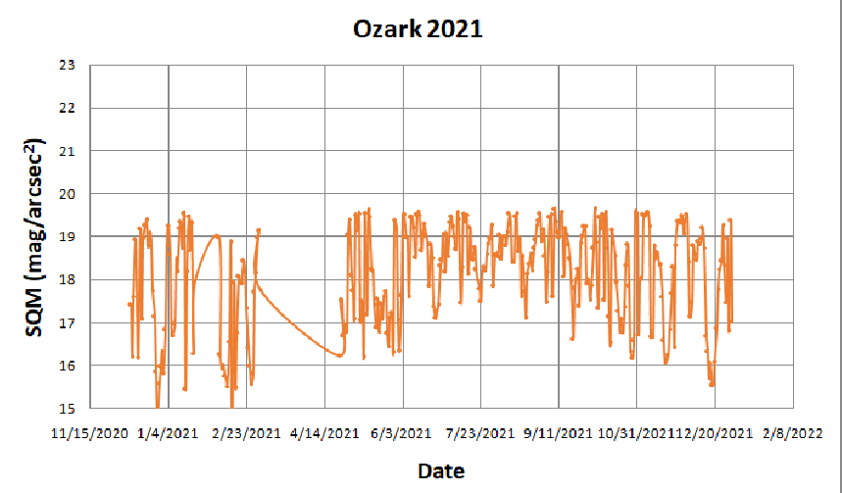
ALAN and Moon Phase Sky Brightness Measurements
DARKER
SKIES
BRIGHTER
SKIES

Slide 56
ALAN and Moon Phase

Slide 57
Birds at Night (Horton et al., 2019)
Of the nearly 630 terrestrial species of birds regularly occurring in North America, approximately 70% are considered migratory, and of these more than 80% migrate at night.
Trillions of flying organisms (eg birds, bats, insects) occupy the airspace within the troposphere during different periods of their annual cycles.
Positive phototaxis is of particular concern for the conservation of migrating birds. Bright lighting in cities can become a beacon to some species, drawing them away from their migratory routes.

Slide 58
Birds at Night (Horton et al., 2019)
FLAP estimates that in Canada, approximately 25 million birds die due to bird collisions with buildings.
The Smithsonian reported that collisions likely kill between 365 million and 1 billion birds annually in the United States, with a median estimate of 599 million.
Homes and other buildings one to three stories tall accounted for 44 percent of all bird fatalities, about 253 million bird deaths annually
Larger, low-rise buildings four to 11 stories high caused 339 million deaths
And high-rise buildings, 11 floors and higher, kill 508,000 total birds annually.
https://flap.org/
https://abcbirds.org/

Slide 59
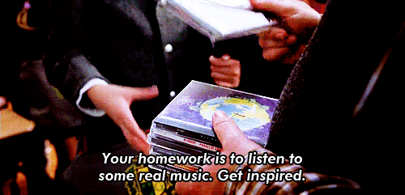
What can I do?
Audit of your property/neighborhood https://www.darksky.org/wp-content/uploads/bsk-pdf-manager/2020/01/Home-Lighting-Assessment-Print.pdf
Use dark sky friendly lighting at your home and business https://www.darksky.org/our-work/lighting/lighting-for-industry/fsa/fsa-products/
Advocate for a lighting ordinance in your town https://www.darksky.org/our-work/lighting/public-policy/lighting-ordinances/

Slide 60
What can I do?
Explore the darkskymissouri.org website and get involved https://www.darkskymissouri.org/
Watch ‘Saving the Dark’ Documentary by Sriram Murali (55 mins) https://www.youtube.com/watch?v=6fHxNn-FEnc
Participate in the Globe at Night (GaN) program https://www.globeatnight.org/

Slide 61
ALAN And Bird Migration: Mitigation Efforts
So, when it comes to bird migration light pollution is a problem – but high rise buildings are a particularly urgent problem that needs to be fixed.
The National Audubon Society is an American non-profit environmental organization dedicated to conservation of birds and their habitat.
The Audubon Society has teamed up with the Dark Sky International (DSI) on the “Lights-Out Program” aimed at creating awareness about bird-migration and to implement mitigation efforts to minimize the dangers posed by LP and high-rise buildings to birds.
https://www.audubon.org/ lights-out-program
https://www.lightsoutheartland.org/

Slide 62
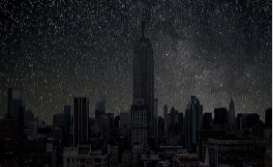
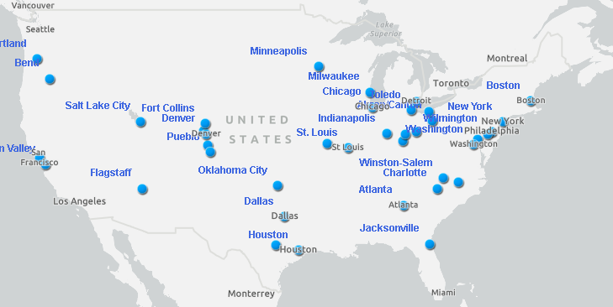
Lights-Out Program: How to Contribute?
Turn off exterior decorative lighting
Extinguish pot and flood-lights
Substitute strobe lighting wherever possible
Reduce atrium lighting wherever possible
Turn off interior lighting especially on higher stories
https://www.audubon.org/lights-out-program

Slide 63
Lights-Out Program: How to Contribute?
Substitute task and area lighting for workers staying late or pull window coverings
Down-shield exterior lighting to eliminate horizontal glare and all light directed upward
Install automatic motion sensors and controls wherever possible
When converting to new lighting assess quality and quantity of light needed, avoiding over-lighting with newer, brighter technology.
https://www.audubon.org/lights-out-program

Slide 64
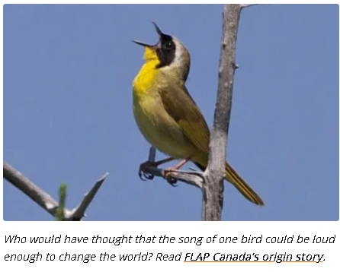
Bird Migration and FLAP
https://flap.org/
Fatal Light Awareness Program (FLAP) Canada is a registered Canadian charity widely recognized as the pre-eminent authority on the bird-building collision issue.
Each year in Canada, around 25 million migratory birds die as a direct result of collisions with buildings.
We can only expect that number to grow unless we all work together to help mitigate local biodiversity loss through urban development that considers wildlife species.
For almost 30 years, FLAP Canada has engaged millions of people with dozens of campaigns and initiatives with one goal: keep birds safe from deadly collisions with buildings.

Slide 65
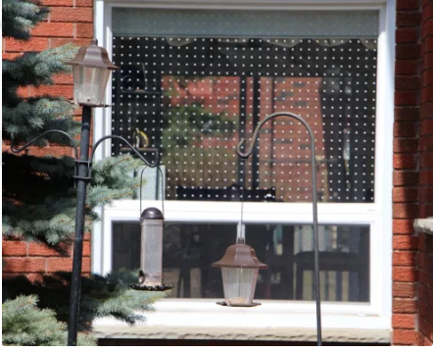
Preventing Birds Hitting Buildings
Apply markings in a dense pattern, leaving no gaps more than 5 cm by 5 cm (2 inches by 2 inches). If gaps are any larger, birds may try to fly through them and still hit the window.
Apply markings to the outside surface of the glass, NOT the inside. Reflections of trees or sky on the outside of the window may render any internal window markings invisible.
Markings must be of high contrast so that they stand out on the window. Markings with poor contrast, for example black dots on a very dark window, might not be noticed by birds.
Each marking should be no less than 6 mm (1/4 inch) in diameter.
Markings must cover the entire surface of the glass.
https://flap.org/stop-birds-from-hitting-windows/

Slide 66
ALAN And Bird Migration: References
https://www.audubon.org/lights-out-program
https://www.audubon.org/news/four-decades-building-strike-records-point-super-collider-birds
https://www.darksky.org/light-pollution-poses-threat-to-migrating-birds/
https://flap.org/
https://flap.org/wp-content/uploads/2019/11/US-Fish-and-Wildlife-Best-Practices.pdf
https://www.nature.com/articles/s41598-018-21577-6.pdf
https://birdcast.info/

Slide 67
Interpreting Dark Skies
Dark Sky Heritage: Stargazing, myths, constellations, loss of night
https://figuresinthesky.visualcinnamon.com/
https://stellarium.org/
https://www.lightpollutionmap.info/
https://facstaff.bloomu.edu/mshepard/star_deck/star_deck_uses.htm
Darkness and Human wellbeing (see https://www.rasc.ca/lpa/resources and the publicly accessible google-drive linked there)
Circadian Rhythm
Direct glare
Darkness at night: Impact on living beings: Birds and bird migration; Insects and pollinators
https://flap.org/
https://birdcast.info/
https://www.lightsoutheartland.org/
Light pollution versus other forms of Pollution
Similarities: waste, carbon footprint, “bad neighbor”
Differences: expense, Local solutions, win-win for all parties

